Slide 1


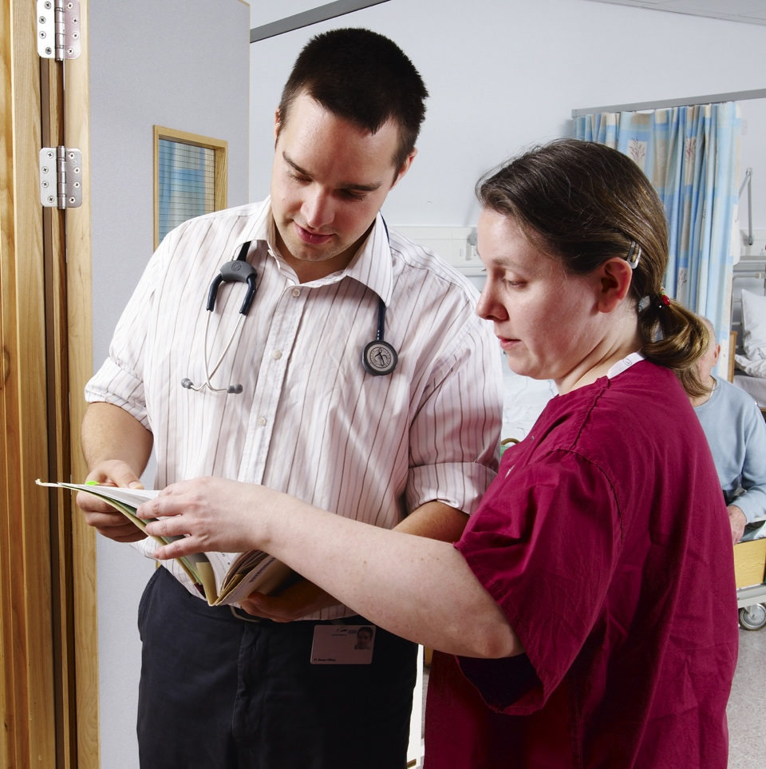

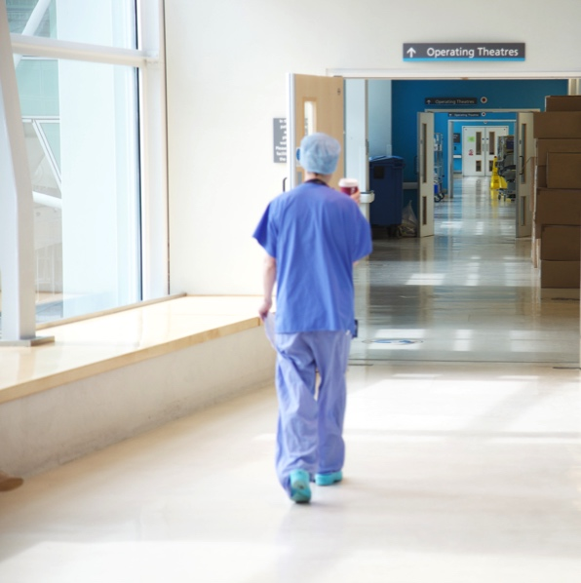
Foundation Programme Curriculum 2021
(2026 Revision)
Summary for trainers and supervisors

Slide 2


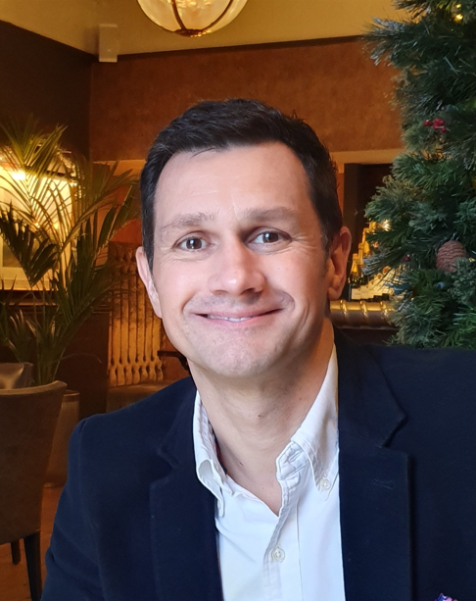
Foundation Programme Directors for Portfolio and Generic Skills with the Northern Foundation School and co-chairs of the UK e-portfolio team advisory group.
Angela Burton
Paul Clarke

Slide 3

Overview of Revision of FP Curriculum 2021
The FP Curriculum 2021 was revised in 2026 with full stakeholder consultation in 2025 from:
AoMRC Foundation Programme Committee (AFPC), FSDs, FTPDs (Wales and Sussex)
FDs via Foundation Doctors Advisory Board (FDAB)
AoMRC patient lay committee, NHS Employers
Royal College reps experienced in curriculum design and contributions from RCPCH, SusQi and AoMRC patient safety leads.
Revision reinforces Foundation Programme as a generalist curriculum promoting:
patient safety
people of all ages, including children and young people
sustainability in QI activity
a core teaching programme to reflect learning in health inequalities and multimorbidity

Slide 4
Key messages
No changes to assessment (summative/formative):
Higher Level Outcomes (HLOs )
Foundation Professional Capabilities (FPCs) [some wording changes to include revisions]
Supervised Learning Events (SLEs), encouragement to provide evidence of patient safety
Quality Improvement (QI) activity, encouragement to consider sustainability
Clinical and Educational Supervisor (CS and ES) reports
Multisource feedback, including Team Assessment of Behaviour (TAB) summary and Placement Supervision Group (PSG) summary reports
Summary Narrative should reference patient safety and any QI work promoting safer practice

Slide 5
Key messages
Some changes to terminology
  Trainee changed to ‘resident doctor’, ‘foundation doctor’ or ‘FD’
  Differential attainment changed to ‘fairer training cultures’
Teaching topics to include:
  Mental health (including mental illness)
  Health inequalities, population health and social justice
  Multimorbidity, frailty and end‑of‑life care
  Human factors, simulation and systems working (promoting patient safety)
  Leadership and teaching skills
  Safeguarding (vulnerable adults and child protection)
  Use of technology and digital healthcare
  QI methodology and environmental sustainability

Slide 6
Examples of e-portfolio tools to evidence patient safety
  FPC 1 – 5 should demonstrate evidence of patient safety with emphasis on
    safe prescribing, high risk prescribing
    Blood transfusion
    Effective guideline use
    Effective handover
    Effective documentation
    Effective teamworking
(Evidence - SLEs, TAB and PSG, reflective practice (RP))

Slide 7
Examples of e-portfolio tools to evidence patient safety
  FPC 6 – 9 include evidence of patient safety with emphasis on
  Importance of handover
Communication, availability and teamworking, recognising care of children and young people (Evidence - SLEs, LEADER form, ES and CS reports, TAB, PSG, RP)
QI activity - sustainability encouraged and may include initiatives to improve patient safety (Evidence - SLEs (LEADER form), QIP form, ES/CS reports, PSG feedback, survey completion, RP)
FPC13 should demonstrate an exploration of the breadth of medical practice to broaden knowledge. (Evidence - career planning form, ES/CS reports, PSG, RP)

Slide 8
Tips for Trainers and Supervisors
What will trainers need to do differently to support their FDs to embed into their practice and evidence the revised curriculum?
Answer: The tools you are accustomed to using in e-portfolio to provide feedback to your FD are already familiar to you e.g. SLEs, TAB, PSG, Supervisor reports – no changes there.
Encourage your FD to read their curriculum and pay attention to the FPC F1 & F2 behaviours and revisions in it.
Highlight and mention specifically in your documented feedback, if their care provided to patients demonstrates any or all of the following
patient safety (active engagement with patient safety principles, recognising risk, learning from incidents, contributing to safer systems of care)
provision of healthcare to children and young people (more inclusive approach to healthcare provision for children and young people)
Encourage your FD to consider environmental and healthcare sustainability, particularly within quality improvement activity.
sustainability in QI activity (While sustainability‑focused projects are not mandatory, FDs are encouraged to reflect on environmental impact and demonstrate learning related to sustainable healthcare practices wherever possible)
Make sure your FD is attending and learning from their core teaching programme, which has been updated to reflect contemporary learning needs, including health inequalities and multimorbidity.

Slide 9
Overall Key Messages
A range of SLEs should be undertaken in each 4-month placement. The expectation is that over the training year there will be sufficient SLEs to demonstrate achievement of the FPCs (curriculum outcomes).
The revisions reflect a progressive curriculum promoting patient safety, inclusivity and sustainable healthcare, reflecting the realities of contemporary clinical practice.
The 2026 revision reflects progress and promotes patient safety as core to medical practice and updated wording makes it more inclusive to children and young people. This is important as FDs regularly interact with children and young people in a range of primary and secondary care placements, even if they do not undertake a paediatric placement. (Darzi report)
This revision has included specific wording to recognise healthcare provision should be delivered with consideration to climate change and the environment, and FDs should demonstrate learning in the provision of sustainable healthcare initiatives. QI activity should include a review of the impact on environmental sustainability.

Slide 10
Thank you for listening

