Slide 1


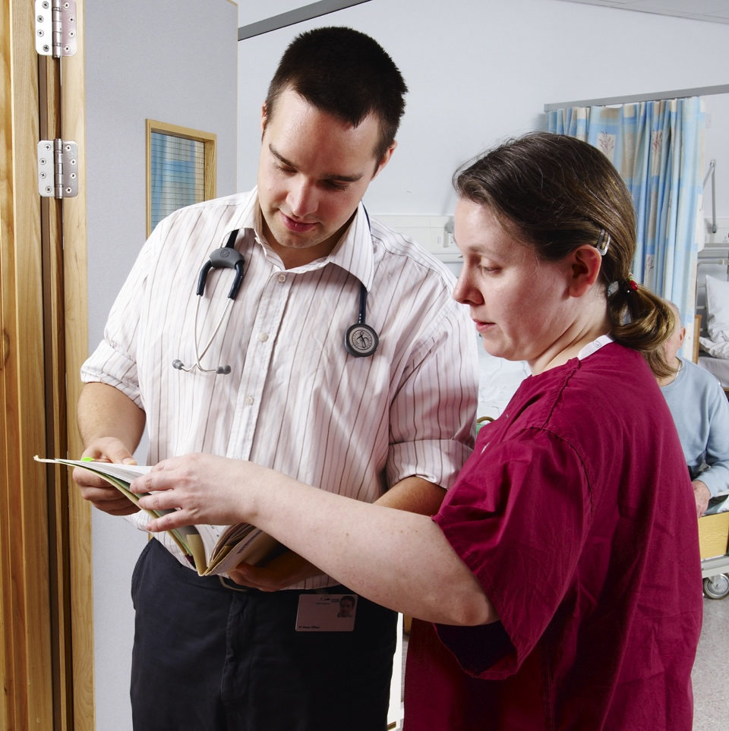


FP Curriculum update
Fiona Cameron
FSD Scotland
Chair AFPC
foundationprogramme.nhs.uk

Slide 2



Foundation
Programme Curriculum 2021 (2026 Revision)
Notes:
Curriculum rewritten in 2021 to map to GMC Professional Capabilities Framework and revised in 2026 to evolve with medical practice. All new F1s will start on the Revised Curriculum. All starting F2 and those out of sync will move on to the Revised Curriculum.

Slide 3

Holistic care and breadth of care
There is a focus on:
  Physical health
  Mental health
  Social health
  Patient safety
Across a variety of different areas:
  Community or primary care
  Acute and chronic hospital environments
  Mental health settings
  Environments that provide health promotion
  Acute care (including acute mental health care) The management of chronic illness Community care (including population health)
Physical health
Mental health
Social health
Notes:
The 2021 Curriculum has more emphasis on mental health – with significant evidence of mental health learning required. The 2026 Revision has more emphasis on patient safety.
Focus on learning in community / primary care / chronic settings. Not just acute hospital care.

Slide 4
Thirteen professional capabilities
The 3 HLOs are broken down into 13 professional capabilities, which form the syllabus:
THE CLINICIAN
HLO1: THE CLINICIAN
THE HEALTHCARE WORKER
HLO2: THE HEALTHCARE WORKER
HLO3: THE PROFESSIONAL
Direct and indirect patient care:
Clinical assessment
Clinical prioritisation
Holistic planning
Communication and care
Continuity of care
Integrating into the healthcare workforce:
Sharing the vision
Fitness to practise
Upholding values
Quality improvement
Teaching the teacher
Professional requirements and expectations:
Ethics and law
Continuing professional development
Understanding medicine
These capabilities can be demonstrated by behaviour in the workplace during the programme
Notes:
Each foundation professional capability (FPC) is further expanded on in the curriculum. There are also a list of behaviours for the FPCs that differentiate the level expected of F1 and F2. All FPCs must be evidenced appropriately by ARCP.

Slide 5
Hierarchy of evidence
HLO 1&2 - Performance in the clinical environment (SLEs) should form the majority of evidence
HLO 3 - largely evidenced by teaching records and reflection
Experiential (SLEs)
Does
(observation)
Shows how
(demonstration of skills)
Simulation
HLO1: An accountable, capable and compassionate clinician
Learning / reflection
Knows how
(application of knowledge)
HLO2: A valuable member of the healthcare workforce
Knows
(knowledge)
HLO3: A professional, responsible for their own practice and portfolio development
Miller’s pyramid – Hierarchy of Evidence
Notes:
The best evidence is demonstrated in the workplace and recorded via SLEs. There is an expectation that FDs will have a range of evidence for the FPCs across the hierarchy of evidence. Clinical performance should not just be evidenced with learning and reflection.

Slide 6
Background to the 2026 revision of the 2021 curriculum
Ongoing assessment of the curriculum through the AFPC
Feedback from stakeholders
Need to ensure curriculum remains ‘future proof’ in a rapidly developing health care system
Focus on patient safety
Population health care priorities to encourage generalism
  Complex multi morbidities
  Aging population
  Health inequalities
Sustainability (health care and environment)
Widening the scope to recognise Foundation doctors care for all ages including children and young people
Strengthening the wording to reflect GMC's work on Fairer Training Pathways

Slide 7
Curriculum developments
Stakeholder engagement from Royal Colleges, GMC, Academy of Medical Royal Colleges (AoMRC) and UK governments to support healthcare improvements, with the aim to meet the healthcare needs of society
For example
  Darzi report
  Blood transfusion enquiry
Balanced approach
Generalist
Prepare the foundation doctor (FD) for working in any specialty
Achievable by all
No increase in workload for FDs or trainers!

Slide 8
Patient safety learning and assessment strategy
Patient safety to run as a thread through all aspects of the curriculum
Evidence to be signposted on the e-portfolio (Horus or Turas)
Supervised learning events (SLEs)
HLO 1
  Clinical SLEs
  Safe care, safe prescribing
  Safe high risk prescribing
HLO 2
  Handover
  QI and safety
  Teamworking
  Teaching others
HLO 3
  Life long learning
  Attendance at teaching
  Legal framework of medicine

Slide 9
Patient safety
Patient safety should be at the heart of doctors’ working lives and be considered during all parts of the patient’s journey. Much of this work is high level planning and outside the remit of the Foundation doctor however Foundation doctors have a significant role to play in the safety culture, safety systems, human factors and risk and raising concerns in the workplace.
The FD can demonstrate at many levels how their provision of healthcare and team working can contribute to a safe healthcare environment. This can be underpinned by learning though locally delivered core teaching supplemented by modules.

Slide 10
Sustainability
Environmental sustainability
  Eg inhalers, plastics etc
Health care sustainability
  Care pathways
  Person-centred
Not a curriculum requirement in own right but should be considered as part of all QI activity

Slide 11
Children and young people
Not new
Children and young people (CYP) are explicitly mentioned in curriculum
Not a mandatory requirement to evidence
A prompt to remind FDs that they can evidence the care they have delivered to CYP in the course of their training posts
Note that not all FDs need to undertake a paediatric post
Many FDs will care for CYP in
  Surgery
  Emergency medicine
  General Practice
  Psychiatry
  Community posts

Slide 12
Fairer training cultures
Healthcare inequalities
Reflect GMC’s work
Awareness for all in healthcare to ensure equity for all healthcare professionals
Awareness of healthcare inequalities and drivers to reduce these

Slide 13
Assessments
Patient safety threaded throughout
No new SLEs
No new ARCP requirements
ARCP outcomes and requirements unchanged
No numbers of SLEs (as before)
Summary narratives
TAB
PSG
QI (thread sustainability)

Slide 14
Examples FPC4 (Communication and care)
F1 behaviours
  Demonstrates safe prescribing, in particular the safe prescribing of high risk medication
F2 behaviours
  Demonstrates safe prescribing, in particular the safe prescribing of high risk medication
  Demonstrates an ability to prescribe that is consistent with the standard required to pass the PSA

Slide 15
Examples FPC5
(Continuity of care)
F1 behaviours
  Hands over care effectively both verbally and in writing and with due respect for confidentiality, recognising that handover is core to patient safety.
  Escalates concerns to more senior doctors (or other appropriate healthcare professionals) as needed, ensuring patient safety.

Slide 16
Examples FPC6
(Sharing the vision)
F1 and F2 behaviours
  Promotion of a safety culture embedding values, guidelines and multiprofessional team working.
  Recognising and demonstrating that effective team working is core to patient safety.

Slide 17
Patient safety learning
Demonstrates at many levels how their provision of healthcare and team working can contribute to a safe healthcare environment. This can be underpinned by learning though locally delivered core teaching supplemented by modules such as elfh AoMRC patient safety modules
Describes and evidences use of reporting systems e.g. datix
Demonstrates learning in human factors through simulation training and learning modules
Applies a proactive systems approach to identifying, evaluating and managing risks to patients.

Slide 18
Simulation is a well-established method of introducing human factors training to promote safe practice
Foundation doctors should have the opportunity to take part in simulation
Simulation and patient safety

Slide 19
Embedded in QI work
Can be environmental or healthcare sustainability
Sustainability

Slide 20
QI and sustainability
Capabilities endorsed by the AoMRC document ‘Training for Better Outcomes: Developing QI into Practice’ (June 2019), and further recommends use of the available resources detailed on the UKFPO website, to address those learning outcomes relating to environmental and social sustainability included within the AoMRC Higher level learning outcomes 1 to 3 shown below:

Slide 21
FPC8 and 9
(Upholding values and Quality improvement)
Understands and recognising areas for improvement and promotion of safe patient care
Quality improvement: take an active part in processes to improve the quality and sustainability of care, with consideration to environmental sustainability; promotion of safe care through engagement with QI activity, risk management and safe prescribing.
F1 behaviours Engages with QI initiatives through activities such as collecting data for audit purposes, attending meetings such as QI meetings and Green Group/sustainability meetings, and following recommendations to improve the quality of care.

Slide 22
Core learning
Mental health, including mental illness
Population health, including social justice and tackling health inequality
Simulation to promote patient safety, human factors and system working
Leadership
Quality improvement methodology, including environmental sustainability
Careers guidance
Integration of acute illness into chronic disease management and complex multimorbidity
Frailty
End of life care
Teaching skills
Patient safety, including teaching on high risk prescribing and systems working
Safeguarding, with a focus on the vulnerable adult and child protection
Use of new technologies and the digital agenda

Slide 23
QI
Additional statement
Quality improvement methods used by FDs should ideally include consideration of the social and environmental impacts of change in addition to patient/population outcomes and financial considerations

Slide 24
Population health, including social justice and tackling health inequality
Examples for F1 Person-centred practice – treating patients in a holistic manner, involving them in their care decisions and supporting them to manage their own health. Examples for F2 Population health – improving population health through preventative measures such as engaging with screening and advice.

Slide 25
Thank you for listening

