Slide 1


A Retrospective Comparison of Artificial Intelligence and the Orthopaedic Multi-disciplinary Team in the Management of Intracapsular Neck of Femur Fractures
Matthew Emmerson, Ryan Hillier-Smith, Amar Malhas
Trauma and Orthopaedic Department, Royal Berkshire Hospital, Reading UK

Slide 2
Introduction
Hip fractures common orthopaedic presentation¹
Artificial Intelligence already investigated in other specialties ²⁻⁴
Aim
Compare ChatGPT and orthopaedic consultant recommendations for intracapsular neck of femur fractures
Assess relative importance of patient-specific factors
Disclaimer
Artificial Intelligence are not currently medical decision-support systems and not trained for clinical use
Preliminary and theoretical - Highlight current gaps in AI validation
Notes:
Hip fractures common orthopaedic presentation
When deciding initial surgical management, variety of resources utilised to guide surgical management. (protocols, textbooks, online resources)
AI could be useful as a tool for aiding clinician decision making
AI – used in other specialties (ED, General Medicine, Radiology) for aiding clinician decision making for triage, diagnosis and management. Minimal research in orthopaedics

Slide 3
Methods
Data Extraction
First Round
Second Round
Validation Round
Statistical Analysis
Patients presented to orthopaedic team with an Intracapsular neck of femur fracture – 18 week period
Age, sex, comorbidities, mobility status, 4 A's test (4AT) score, operation performed
Data anonymised, de-identified
Standardised Prompt generated
Inputted into ChatGPT (GPT-4o) ⁵ - closed chat system
Compared to consultants’ decision at Trauma Meeting
If disagreement, rationale extracted
Second prompt generated with rationale
Inputted into ChatGPT
Reviewed response recorded
30 new patients
Same data extracted, same prompts generated
Inputted into same ChatGPT chat box
Compared to consultants’ decision at Trauma Meeting
Wizard 2 and Jamovi ^{6,7}
Cohen’s Kappa – Agreement
Multinomial and binomial logistic regression – Factor significance
RBH Quality Governance and Ethics Board: N5352

Slide 4
Example Prompt
“A 72-year-old female presents to the emergency department with an intracapsular neck of femur fracture.
Their co-morbidities include Dementia, type 1 diabetes.
They walk with a frame.
Their 4AT score is 7.
Using the most recent NICE guidelines on Hip fracture management, what operation should they have to fix their intracapsular neck of femur fracture?”

Slide 5
Results – 1st Round ChatGPT Responses
Decision | ChatGPT Hemi-arthroplasty | ChatGPT Total Hip Replacement | ChatGPT Cannulated Hip Screw | ChatGPT Dynamic Hip Screw | ChatGPT No Operation
Trauma Meeting Hemi-arthroplasty | 67 | 12 | 0 | 0 | 0
Trauma Meeting Total Hip Replacement | 10 | 3 | 0 | 0 | 0
Trauma Meeting Cannulated Hip Screw | 5 | 0 | 0 | 0 | 0
Trauma Meeting Dynamic Hip Screw | 3 | 0 | 0 | 0 | 0
Trauma Meeting No Operation | 4 | 1 | 0 | 0 | 0
105 patients included
Poor agreement, nil statistical significance
Cohen’s kappa [κ] = 0.03; 95% CI, −0.11 to 0.19; p = 0.70
Top disagreement reasons
“Fit and mobile” (10 patients)
”Extensive significant past medical history” (4 patients)

Slide 6
Results – 2nd Round ChatGPT Responses
Decision | ChatGPT Hemi-arthroplasty | ChatGPT Total Hip Replacement | ChatGPT Cannulated Hip Screw | ChatGPT Dynamic Hip Screw | ChatGPT No Operation
Trauma Meeting Hemi-arthroplasty | 79 | 0 | 0 | 0 | 0
Trauma Meeting Total Hip Replacement | 1 | 12 | 0 | 0 | 0
Trauma Meeting Cannulated Hip Screw | 0 | 0 | 5 | 0 | 0
Trauma Meeting Dynamic Hip Screw | 1 | 0 | 0 | 2 | 0
Trauma Meeting No Operation | 0 | 0 | 1 | 0 | 4
Very strong agreement, statistically significant
Cohen’s kappa [κ] = 0.93, 95% CI 0.84 - 1.00, p < 0.001
Statistically significant improvement in agreement
z = 10.3, p < 0.001
Increasing age – decreasing likelihood of total hip replacement v.s. hemiarthroplasty [odds ratio (OR) = 0.81; 95% CI, 0.70-0.94; p = 0.006]

Slide 7
Results – Validation Round ChatGPT Responses
Decision | ChatGPT Hemi-arthroplasty | ChatGPT Total Hip Replacement | ChatGPT Cannulated Hip Screw | ChatGPT Dynamic Hip Screw | ChatGPT No Operation
Trauma Meeting Hemi-arthroplasty | 18 | 1 | 0 | 0 | 0
Trauma Meeting Total Hip Replacement | 3 | 3 | 0 | 0 | 0
Trauma Meeting Cannulated Hip Screw | 3 | 0 | 0 | 0 | 0
Trauma Meeting Dynamic Hip Screw | 0 | 0 | 0 | 0 | 0
Trauma Meeting No Operation | 2 | 0 | 0 | 0 | 0
Fair agreement, no statistical significance
Cohen’s kappa [κ] = 0.29; 95% CI, −0.04 to 0.60, p = 0.06
No statistically significant difference in agreement compared to the first round of ChatGPT responses
z = −1.51; p = 0.13

Slide 8
Discussion
Conclusion
ChatGPT did not reliably replicate orthopaedic consultant decision-making for intracapsular NOF fracture management
Poor initial agreement, agreement improved with additional information. Improvement did not persist when validated on new sample
Discussion
Limitations
Future Work
1. Forced alignment vs. True model learning
2. Lack of explainability
3. Hallucinations
Possible constraint of ChatGPT responses
Clinically focused AI systems as adjuncts⁸
AI education and literacy for clinicians⁹
Notes:
Conclusion
Not reliably replicate orthopaedic consultant decision making for intracapsular neck of femur fracture management
Poor initial agreement between ChatGPT and Consultants. Agreement improved with additional information. Improvement did not persist when validated on new sample
To clinicians unfamiliar with AI behavior, the transient increase in agreement could create a false impression that the model has learned from feedback. However, the drop off in agreement in the validated sample strongly suggests there was forced alignment of the recommendations ChatGPT gave us regarding hip fracture management. In other words, the model simply agreed with anything we said without actually learning from it during the second round of responses.
This key findings underscores a two significant risk factors regarding the use of AI in healthcare settings
Lack of explainability is the inability of users (i.e. us) to understand how AI uses out inputs to generate the outputs it gives us. This means when an output has been formed, we have no idea whether the output generated has used clinically validated rationale or spurious reasoning.
The generation of false information and reasoning which is not evidence based is known as hallucinations. This is the second risk of using AI and is very dangerous for patients as it can lead to completely the wrong diagnosis, triage outcome or management if AI uses non-clinically validated reasoning.
Risk especially great for more inexperienced doctors such as foundation doctors and trainees, more difficult to spot errors in reasoning if have limited knowledge of the specialty, condition and further management which would be indicated
Limitation
Constraint ChatGPT – asked to use NICE guidance, may have constrained outputs it could generate heavily recommended THR and hemi in 1st round when consultants also recommended dynamic and cannulated hip screws which are not specifically recommended in NICE guidance but have been shown to be clinically validated. Thus, by trying to focus ChatGPT to use clinically validated sources we may have inadvertently restricted the responses it could give
Future work
Following on from this study we would strongly recommend using new clinically focused AI models in further research (such as OpenEvidence endorsed by NEJM). Would be useful to see them used as adjuncts to help summarise evidence with clinicians as the final decision maker rather than AI providing the definitive management decision for patients and to investigate if this helps improve outcomes for patients or adherence to national guidelines.
Furthermore, given AI is likely to become ever present in our working lives, would be useful to understand current AI literacy and education in healthcare professionals, how it is currently being utilised, if at all, and how it could be safely implemented to reap the benefits of AI while retaining the importance of patient safety

Slide 9
References and Appendix
1 National Hip Fracture Database: key performance indicators, prompt surgery. (2025). Accessed: May 13 2025:
2 Zaboli A, Brigo F, Sibilio S, Mian M, Turcato G: Human intelligence versus Chat-GPT: who performs better in correctly classifying patients in triage?. Am J Emerg Med. 2024, 79:44-7. 10.1016/j.ajem.2024.02.008
3 Kanjee Z, Crowe B, Rodman A: Accuracy of a generative artificial intelligence model in a complex diagnostic challenge. JAMA. 2023, 330:78-80. 10.1001/jama.2023.8288
4 Goh E, Gallo RJ, Strong E, et al.: GPT-4 assistance for improvement of physician performance on patient care tasks: a randomized controlled trial. Nat Med. 2025, 31:1233-8. 10.1038/s41591-024-03456-y
5 OpenAI: hello GPT-4o. (2025). Accessed: May 13 2025: https://openai.com/index/hello-gpt-4o/.
6 Wizard: statistics & data analysis software for Mac. (2025). Accessed: May 13 2025: https://www.wizardmac.com/.
7 The jamovi project. Version 2.6. (2024). Accessed: September 18 2025: https://www.jamovi.org.
8 OpenEvidence. (2025). Accessed: August 5 2025: https://www.openevidence.com/about.
9 Principles for artificial intelligence (AI) and its application in healthcare. (2025). Accessed: October 10 2025: https://www.bma.org.uk/media/njgfbmnn/bma-principles-for-artificial-intelligence-ai-and-its-application-in-healthcare....
APPENDIX 1
Example Round 2 prompt: “A 76-year-old female presents to the emergency department with an intracapsular neck of femur fracture. Their comorbidities include Hypothyroidism. They are independent with walking. Their 4AT score is 0. ChatGPT previously recommended the patient should have a Hemiarthroplasty to fix their intracapsular neck of femur fracture according to NICE guidelines; however, several orthopaedic consultants disagree with the decision and instead think the patient should be treated with Total hip replacement. This is because they believe the patient is fit and mobile. Using the most recent NICE guidelines on Hip fracture management and the information given, would you change your management and follow the consultants' management suggestion, or would you stick with the previous ChatGPT management suggestion?”
Notes:
How Data was anonymised
All patient data were anonymised
Further de-identified by removing any dates
Suppressing rare diseases.
Opted out of allowing inputs to be used for external model training when data were entered into ChatGPT
As a result, no data flowed outside the temporarily closed chat system created on the ChatGPT web interface.
All data were deleted within 30 days of chat creation
ensuring no patient information was stored on external servers
Access to the temporary chat was restricted by password protection.
Consequently, individual consent was not obtained.
All methods complied with local data-protection regulations.
Limitations
Instructing ChatGPT to follow NICE guidance may have constrained its responses.
Consultants sometimes selected internal fixation (cannulated hip screws or dynamic hip screws) outside NICE recommendations; a less prescriptive prompt might have increased concordance, but could also allow the model to draw on non-recommended or lower-quality sources.
Could not fully control model variability between sessions.
Although prompts were submitted close together, small timing gaps existed between rounds and the validation run; completing all inputs within a single session or using a fixed API/model version would reduce this source of variation.
Third, when the MDT rationale was absent, the authors conferred with orthopaedic consultants to infer the reasoning behind MDT operative decisions. This approach introduces potential bias
ideally, future studies should elicit the rationale for all operative decisions at the time they are made.
Fourth, small numbers of patients in certain operation or mobility categories required collapsing categories for regression analyses, which may have reduced precision and obscured associations. ]
Finally, our in-session adjustments did not constitute true model retraining and produced only transient alignment with consultant decisions.

Slide 10
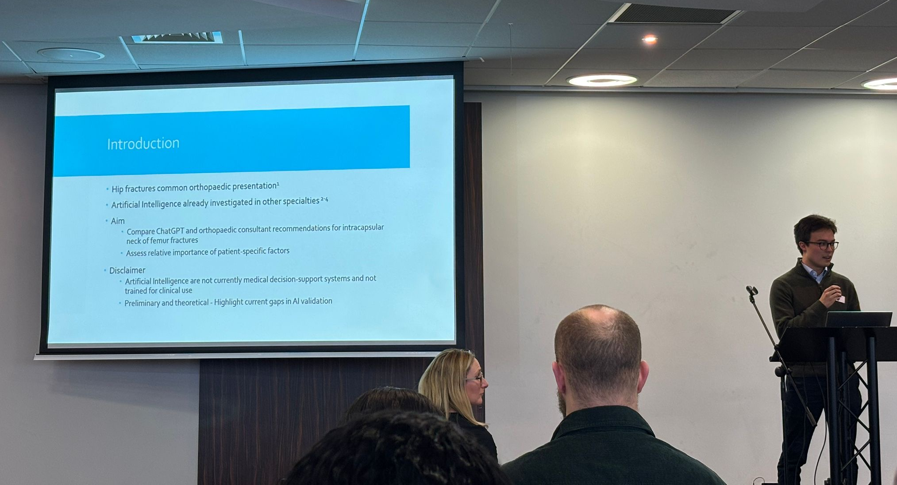
Advice and Reflections
Keep an eye out for emails!
Apply for Study Leave early
Practise presentation to time before the day
Prepare possible questions
Enjoy it!!!

