Slide 1

Two months
until ARCP
Actionable points to round out your e-portfolio
Devon Ward and Kaveeta Malhi
UKFPO Fellows 2025-26

Slide 2
OUTLINE
How to see how ready you are for ARCP
What to map to the hardest FPCs
How to get the most out of e-lfh
How to recognise extra-curricular achievements

Slide 3
How ready
are you?

Slide 4
HOW READY ARE YOU?
Most informal ARCP deadlines are towards the end of May
Most formal ARCP deadlines are in June
This allows time to address any issues
So how do we know if we’re on track to be ready for this deadline?

Slide 5
HOW READY ARE YOU?
Sources of external validation:
  Educational supervisor – ask them to review your ePortfolio remotely or with you and what areas you should improve on before submission
  FPTDs – most FPTDs are happy to review ePortfolios as well BUT try not to overload them! Speak to your ES first
  Colleagues – ask colleagues if there was one area of your ePortfolio to improve, what would it be?

Slide 6
HOW READY ARE YOU?
Sources of internal validation:
  Check Horus and Turas to see that you’re meeting minimum requirements

Slide 7
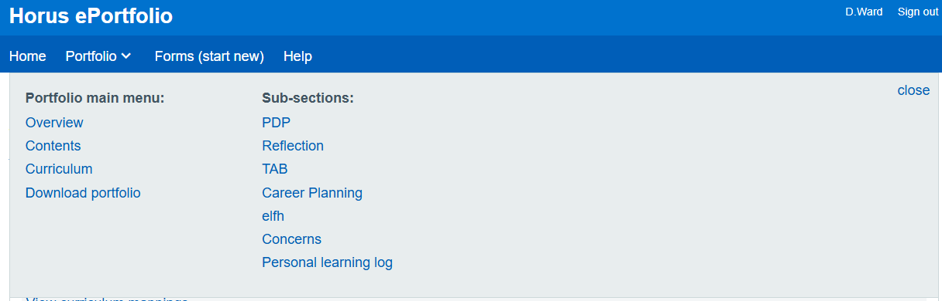
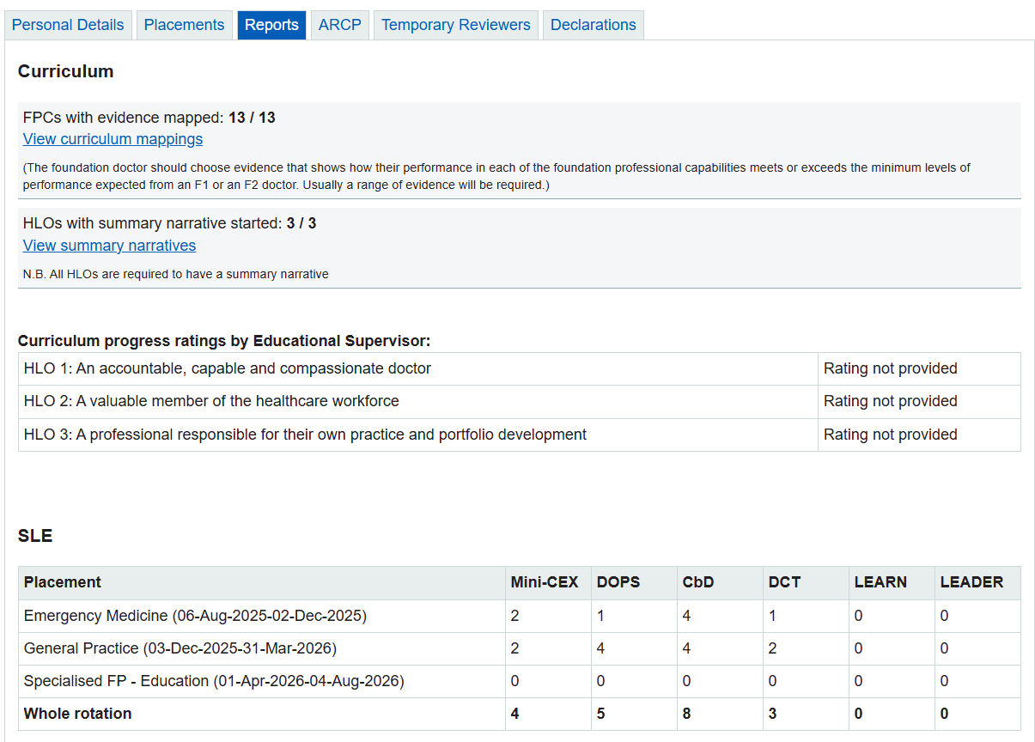
HORUS – HOW READY ARE YOU?

Slide 8
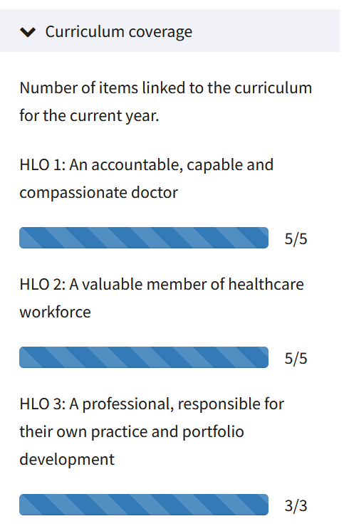
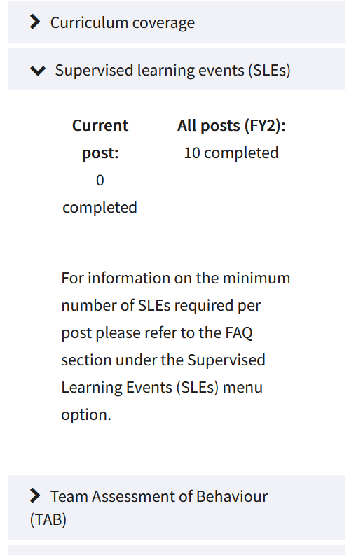
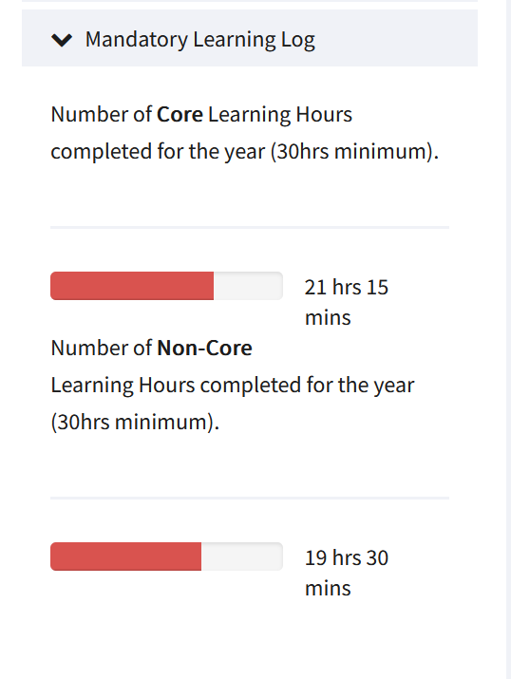
TURAS – HOW READY ARE YOU?

Slide 9
Harder FPCs

Slide 10
ePORTFOLIO SURVEY
393 responses from foundation doctors
  Responses across FY1 and FY2 across 15 out of 17 FS
Reported that FPC1, 3 and 4 are easiest to map
Reported that FPC 7, 8, 9, and 11 are hardest to map
Predominantly because people were unsure what these were about and not sure what to map to it

Slide 11
FPC 7
Fitness to Practise: Develop the skills necessary to manage their own personal wellbeing
F1 Behaviours
Recognises the importance of personal wellbeing for safe patient care (e.g. takes breaks appropriately, understands ‘sleep hygiene’ if working shifts, registers with a GP, understands how to seek help for personal issues if needed).
F2 Behaviours
Recognises the importance of protecting patients and colleagues from risks posed by personal and health issues.
Understands personal wellbeing in the context of planning a future career.

Slide 12



FPC 7
Fitness to Practise: Develop the skills necessary to manage their own personal wellbeing
Wellbeing Apps
GMC NTS
Register with GP – F1
e-lfh modules
Stress - Mental Health (000-1006)
Health (Blood Borne Infection) and Handling Stress (000-1007)
Stress - Bullying (000-1054)
“Understands personal wellbeing in the context of planning a future career.” – career planning form
“understands how to seek help for personal issues if needed” – CS Meeting
MDU Wellbeing Modules

Slide 13
FPC 8
Upholding Values: Act as a responsible employee including speaking up when others do not act in accordance with the values of the healthcare system
F1 Behaviours
Takes responsibility for own actions.
Demonstrates an understanding of the need for 24-hour care in the acute setting, including the need to ensure safe cover in unexpected situations and the concept of scheduling planned care to facilitate safe and efficient use of resources.
Works within their healthcare organisation, conforming to values, policies, training requirements etc.
Demonstrates by application an understanding of the principles of the national healthcare system in which they practice, including conforming to legislative requirements.
Notices and reports failures in care or situations where care is substandard.
F2 Behaviours
Takes a proactive approach with employing organisation to ensure clear cover arrangements, effective personnel management, booking leave etc.
Recognises and reports failures in care, understands causes of medical error and contributes to the systems that prevent/rectify systematic errors.

Slide 14
FPC 8
Upholding Values: Act as a responsible employee including speaking up when others do not act in accordance with the values of the healthcare system
“Understanding principles of NHS” – NHS events
“need for 24 hour care” – exception reports
“Takes responsibility” – increasing independence
“clear cover arrangements” – screenshot of absence emails or swapping shifts
e-lfh modules
Medical Error: When Things Go Wrong (000-1050)
Raising Concerns About Patient Safety (000-1045)
An Underperforming Colleague - What To Do (000-1053)
“confirming to training requirements” – basic training completion screenshot
Involvement in DATIX

Slide 15
FPC 9
Quality Improvement: Take an active part in processes to improve the quality of care
F1 Behaviours
Engages with QI initiatives through activities such as collecting data for audit purposes, attending QI meetings and following recommendations to improve the quality of care.
F2 Behaviours
Takes an active part in ongoing QI work including active involvement with QI processes and encouragement of others to follow recommendations to improve the quality of care.
Where appropriate, instigates and carries out QI project within framework of employing organisation.
Adopts new patterns of working, including the use of new technologies (e.g. virtual consulting, genomics) and philosophies (e.g. a sustainable healthcare approach) to enhance patient care.

Slide 16
FPC 9
Quality Improvement: Take an active part in processes to improve the quality of care
BMJ Learning Quality Improvement
TIPSQI modules
e-lfh modules
Audit (000-1093)
Evidence Based Medicine in Clinical Practice (000-1089)
Guidelines in Clinical Practice (000-1091)
Attending governance meeting
GMC NTS
Involvement in QIP, audit or research
Attending QI Teaching
Sustainability learning
Sustainable practice – reducing IV paracetamol

Slide 17
FPC 11
Ethics and Law: Demonstrate professional practice in line with the curriculum, GMC and other statutory requirements through development of a professional portfolio
F1 Behaviours
Regularly develops and maintains a portfolio of evidence that demonstrates practice in line with the requirements of the foundation curriculum that can be used to show the FD’s readiness to progress to further training, apply for full GMC registration and move on to undertake more independent practice.
Demonstrates initiative.
Participates in quality assurance of training programmes, including national and local surveys.
F2 Behaviours
Develops and maintains a portfolio of evidence that demonstrates practice in line with the requirements of the foundation curriculum that can be used to show the FD’s readiness to practise with indirect supervision and move on to further training.
Actively seeks learning opportunities and proactively develops portfolio to demonstrate skills in line with career expectations and/or future professional development.

Slide 18
FPC 11
Ethics and Law: Demonstrate professional practice in line with the curriculum, GMC and other statutory requirements through development of a professional portfolio
e-lfh modules
Best Interests (783-004)
Deprivation of Liberty (783-006)
Data Security Awareness - Level 1 (743-0008)
PSG
Good Clinical Practice module
“demonstrates initiative” - SLEs
GMC NTS
PDP
“indirect supervision” - SLEs
Engagement with CPD – specialty interest and modules completed
Career planning form

Slide 19
e-lfh

Slide 20
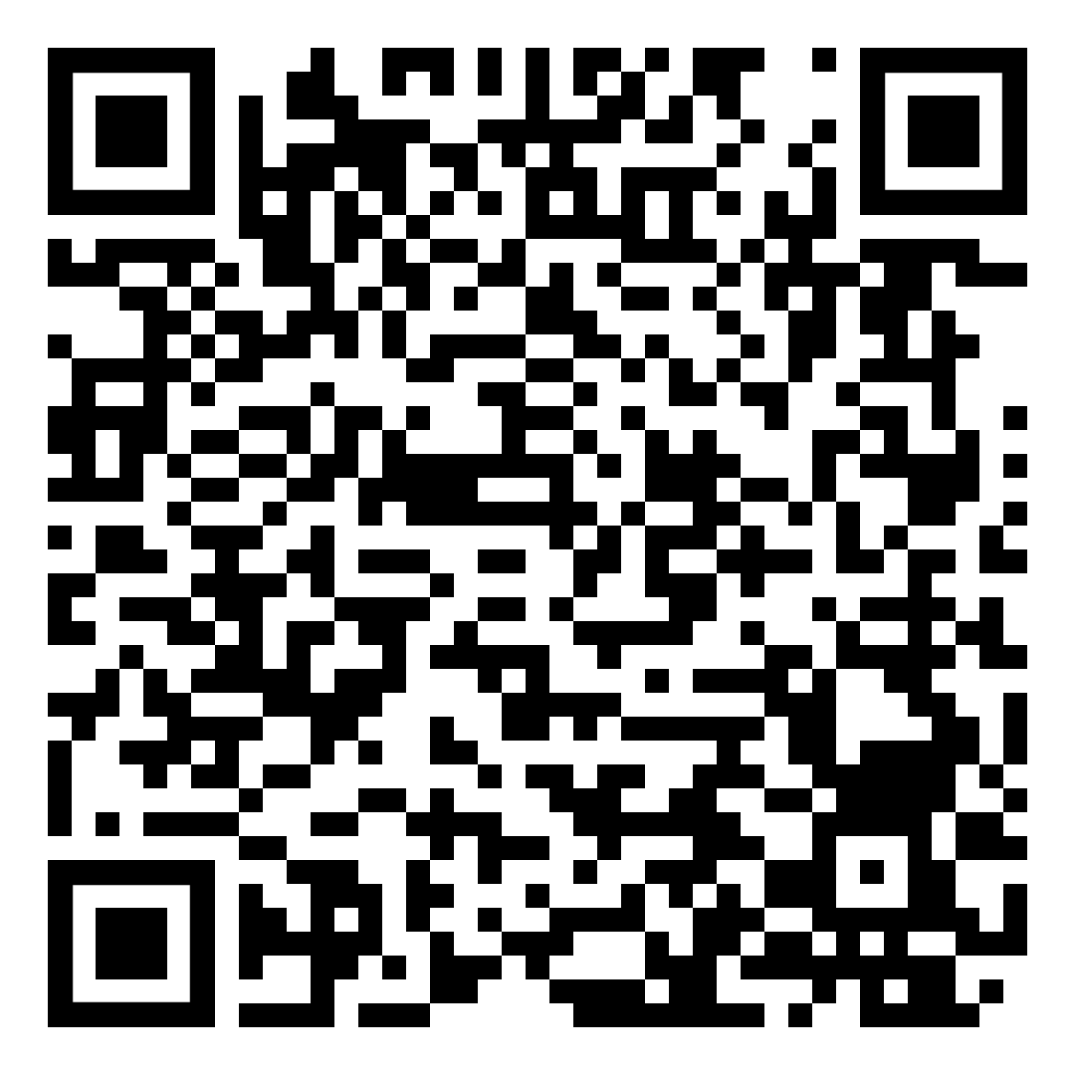
e-lfh
E-learning through e-lfh can be mapped to FPCs
Each counts as hard evidence and can be mapped to 3 FPCs each
Must spend at least 5 minutes in the e-learning module and it to be marked as completed for it to count
Horus has list of e-lfh relevant to each FPC
Turas is a bit harder to find
QR code links to each e-lfh module relevant to each FPC

Slide 21
e-lfh Recommendations
Selection of investigations – FPC 1, 2, 3
Team working and patient safety – FPC 4, 5, 6
Stress – Mental Health – FPC 7, 8
01_05 How to review a paper – FPC 9, 10, 12
Health needs, demands and resource – FPC 11, 13
All 20 minute modules
5 e-learning modules and 1 evidence mapped to every FPC
Good way to work on your ePortfolio in a short amount of time before ARCP

Slide 22
Less traditional options

Slide 23

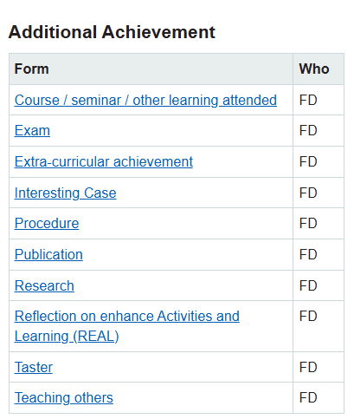
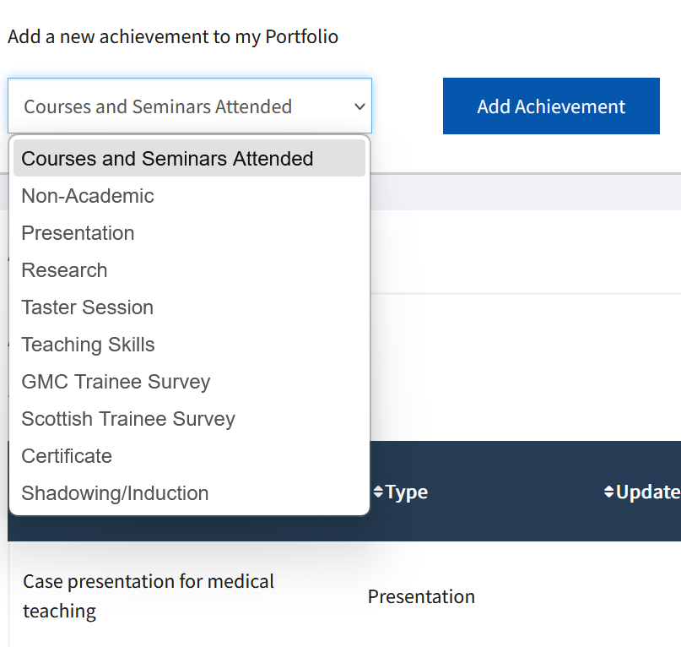
Achievements

Slide 24
Achievements - Horus
Courses/Seminar/Other Learning Attended
ATLS, Surviving in Scrubs, Medics Money, seminars at conferences, PGCert modules, coding courses
Exam
MRCS, MRCP, MSRA, ALS, ATLS
Extra-curricular achievement
Sporting achievement, coding courses, writing, starting business, creative endeavours, cards
Interesting case
Alternative reflection on SLE
Teaching others
Feedback from students on teaching given
Research
Research involvement, literature reviews, ethics applications
Oral or poster presentations at local, regional, national or international presentations (inc. governance)
Publication
Research/Audit/Abstract publications, HOFP inclusion
Taster
Clinics, going to theatre, taster week
No more Grey Wednesday
initiatives, shadowing
periods

Slide 25
Achievements - Turas
Courses and Seminars Attended
ATLS, Surviving in Scrubs, Medics Money, seminars at conferences, PGCert modules, coding courses
Non-Academic
Sporting achievement, coding courses, writing, starting business, creative endeavuors, thank you cards
Presentations
Oral or poster presentations at local, regional, national or international presentations (inc. governance)
Research
Research involvement, literature reviews, ethics applications
Taster session
Clinics, going to theatre
Certificate
MRCS, MRCP, MSRA
Shadowing/Induction
No more Grey Wednesday initiatives, shadowing periods

Slide 26
Summary
There’s a few more months left until ARCP
Use the resources at your disposal to identify some improvement points for your portfolio
Consider how you can improve those areas
  Present another SLE?
  Do an e-lfh module?
  Write a reflection?
  Formalise an extra-curricular achievement?
And good luck!

Slide 27
Thank you for listening!
Devon Ward – Devon.Ward@rlbuht.nhs.uk
Kaveeta Malhi - Kaveeta.Malhi@wales.nhs.uk

