Slide 1




Sustainability in Healthcare For Foundation Doctors
in association with
Victoria England
Clinical Fellow Doctor
PHRC UK Co-Lead 2022/23
PHRC QUB Lead 2020/21-2021/22
Fionán Mac Giolla Bhríde
FY2 Doctor
PHRC UK Co-Lead 2023/24
PHRC QUB Lead 2022/23
QUB SHDG Lead 2023/24

Slide 2






Outline
Sustainability in Healthcare for Foundation Doctors
What does sustainability in healthcare mean?
Environmental sustainability
Social sustainability
Economic sustainability
Actionable tips for foundation doctors
Discussion / Q&A

Slide 3

Mentimeter Link
Sustainability in Healthcare for Foundation Doctors

Slide 4

Sustainability in Healthcare for Foundation Doctors

Slide 5

Opening Question
Sustainability in Healthcare for Foundation Doctors
Mentimeter 1
What comes to mind when you hear “sustainability in healthcare”?

Slide 6


What is Planetary Health?
Sustainability in Healthcare for Foundation Doctors
“…a solutions-oriented, transdisciplinary field and social movement focused on analysing and addressing the impacts of human disruptions to Earth’s natural systems on human health and all life on Earth.”
Planetary Health Alliance
Notes:
Individual health - everyday as foundation doctors
Public health - population (flu vaccine..)
Global health - equity in health, obstacles to health differ among populations and socioeconomic groups
One Health - american term, includes animal health (antibiotic use in livestock and impact on resistance)
Planetary Health - health of planet including natural resources, ecosystems, climate change…

Slide 7

What is Planetary Health?
Sustainability in Healthcare for Foundation Doctors
“…a solutions-oriented, transdisciplinary field and social movement focused on analysing and addressing the impacts of human disruptions to Earth’s natural systems on human health and all life on Earth.”
Planetary Health Alliance
Public Health
Notes:
Individual health - everyday as foundation doctors
Public health - population (flu vaccine..)
Global health - equity in health, obstacles to health differ among populations and socioeconomic groups
One Health - american term, includes animal health (antibiotic use in livestock and impact on resistance)
Planetary Health - health of planet including natural resources, ecosystems, climate change…

Slide 8
What is Planetary Health?
Sustainability in Healthcare for Foundation Doctors
“…a solutions-oriented, transdisciplinary field and social movement focused on analysing and addressing the impacts of human disruptions to Earth’s natural systems on human health and all life on Earth.”
Planetary Health Alliance
Public Health
Global Health
Notes:
Individual health - everyday as foundation doctors
Public health - population (flu vaccine..)
Global health - equity in health, obstacles to health differ among populations and socioeconomic groups
One Health - american term, includes animal health (antibiotic use in livestock and impact on resistance)
Planetary Health - health of planet including natural resources, ecosystems, climate change…

Slide 9

What is Planetary Health?
Sustainability in Healthcare for Foundation Doctors
“…a solutions-oriented, transdisciplinary field and social movement focused on analysing and addressing the impacts of human disruptions to Earth’s natural systems on human health and all life on Earth.”
Planetary Health Alliance
Public Health
Global Health
One Health
Notes:
Individual health - everyday as foundation doctors
Public health - population (flu vaccine..)
Global health - equity in health, obstacles to health differ among populations and socioeconomic groups
One Health - american term, includes animal health (antibiotic use in livestock and impact on resistance)
Planetary Health - health of planet including natural resources, ecosystems, climate change…

Slide 10
What is Planetary Health?
Sustainability in Healthcare for Foundation Doctors
“…a solutions-oriented, transdisciplinary field and social movement focused on analysing and addressing the impacts of human disruptions to Earth’s natural systems on human health and all life on Earth.”
Planetary Health Alliance
Public Health
Global Health
One Health
Planetary Health
Notes:
Individual health - everyday as foundation doctors
Public health - population (flu vaccine..)
Global health - equity in health, obstacles to health differ among populations and socioeconomic groups
One Health - american term, includes animal health (antibiotic use in livestock and impact on resistance)
Planetary Health - health of planet including natural resources, ecosystems, climate change…

Slide 11


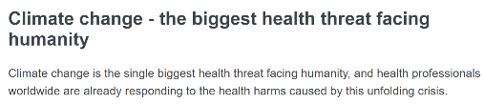


Why does Planetary Health Matter?
Sustainable Healthcare Development Group
Sustainability in Healthcare for Foundation Doctors
“…between 2030 and 2050, climate change is expected to cause approximately 250,000 additional deaths per year…”
Notes:
Has serious implications for our health and the health of our planet
The WHO predicts that between 2030 and 2050, climate change is expected to cause approximately 250,000 additional deaths per year ⁴
Planetary health matters to all of us
4. WHO health and climate change global survey report. Geneva: World Health Organization; 2021.

Slide 12
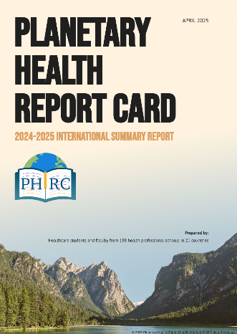
The Planetary Health Report Card
Sustainability in Healthcare for Foundation Doctors
An international student-led initiative that measures sustainability practices in medical schools around the world
Established in 2019, now encompass 10 disciplines from 188 schools spanning 21 countries
Each contributing university is audited in five key domains; curriculum, interdisciplinary research, community outreach, support for student-led initiatives and campus sustainability
Scores are awarded for each metric and recommendations suggested

Slide 13
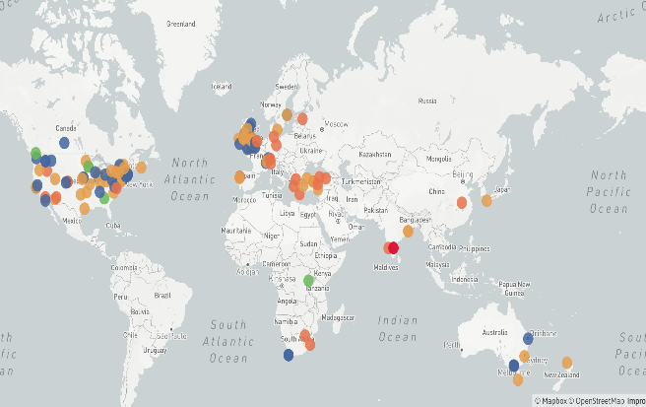
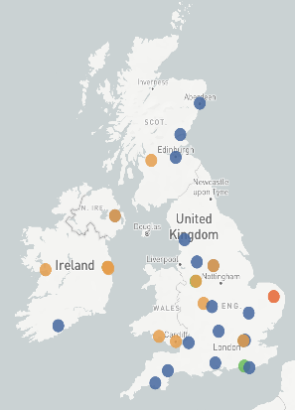


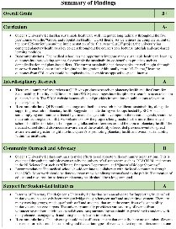
The Planetary Health Report Card
Sustainability in Healthcare for Foundation Doctors

Slide 14


Planetary Health in a Holistic Model of Healthcare
Sustainability in Healthcare for Foundation Doctors
Every action in healthcare has an impact on the individual patient, their community and our environment – both positive and negative
Understanding the complex relationship between our environment and our health is essential for a holistic approach to healing
Measures such as prudent prescribing, green/blue and social prescribing, patient empowerment and community building can help form a more positive relationship between practitioners, patients and the planet ¹
1. Bansal A, Blashki G. Six steps to both greener and better primary care. BMJ; 2020.

Slide 15

What is Sustainability in Healthcare?
Sustainable Healthcare Development Group
Sustainability in Healthcare for Foundation Doctors

Slide 16

What is Sustainability in Healthcare?
Sustainable Healthcare Development Group
Sustainability in Healthcare for Foundation Doctors
Notes:
Health is an SDG - but it is also impacted by all of the other SDGs (rely on clean water, energy for healthcare but health is also impacted by these other factors)
Meet the health needs of today without compromising the ability of future generations to meet their needs
https://www.youtube.com/watch?v=g3xTfNEwfyM as a summary??
https://www.youtube.com/watch?v=ntSFa0GztCQ
The Royal College of Physicians has identified sustainability as a domain of quality “which must run through and moderate other domains” (safety, timeliness, effectiveness, efficiency, equity and patient-centredness).

Slide 17
What is Sustainability in Healthcare?
Sustainable Healthcare Development Group
Sustainability in Healthcare for Foundation Doctors
Safety
“Healthcare should be considered not only in terms of what can be delivered to an individual today, but also to the population in general and the patients of the future.”
Atkinson S, Ingham J, Cheshire M, Went S. Defining quality and quality improvement. Clinical Medicine. 2010 Dec;10(6):537
Patient-centredness
Timeliness
SUSTAINABILITY
Efficacy
Effectiveness
Efficiency

Slide 18
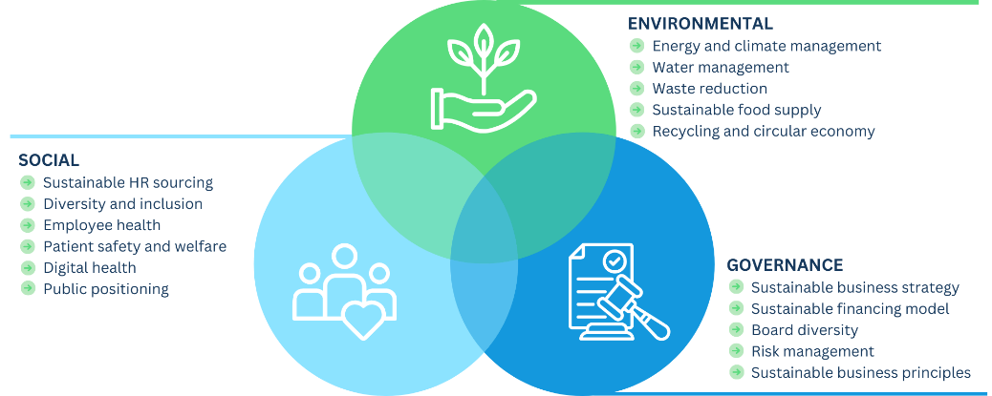
Sustainability in Healthcare for Foundation Doctors
What is Sustainability in Healthcare?

Slide 19
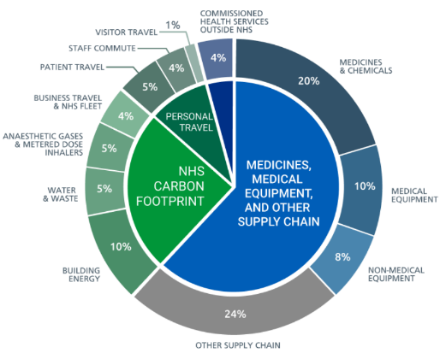
Environmental Sustainability in Healthcare
Sustainability in Healthcare for Foundation Doctors
Healthcare accounts for 4.4% of global CO₂ emissions ²
NHS England directly accounts for 4% of England’s greenhouse gas emissions ³
NHS has committed to being net zero by 2045 ³
GMC mandates awareness of sustainability issues in the curriculum for newly qualified doctors ⁴
2. Pencheon D, Wight J. Making healthcare and health systems net zero. BMJ; 2020.
3. Delivering a Net Zero National Health Service. NHS England and NHS Improvement; 2020.
4. Outcomes for Graduates. General Medical Council; 2018
Delivering a ‘Net Zero’ National Health Service. NHS England; 2020.
Notes:
Not only are our health systems vulnerable to changes in both the burden and pattern of climate-related health impacts, but they are major contributors to climate change itself. If the global health care sector were a country, it would be the fifth-largest greenhouse gas emitter on the planet, ranking just behind Japan.
​The NHS is the UK’s biggest public greenhouse gas emitter, responsible for approximately 5% of all UK environmental emissions with over 20 million tons of carbon from NHS England alone (LARGER THAN AVIATION!}. It is estimated that 5% of all road traffic is NHS related. [susqi.org]

Slide 20
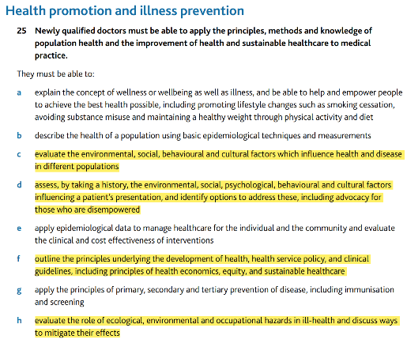
Environmental Sustainability in Healthcare
Sustainability in Healthcare for Foundation Doctors
Healthcare accounts for 4.4% of global CO₂ emissions ²
NHS England directly accounts for 4% of England’s greenhouse gas emissions ³
NHS has committed to being net zero by 2045 ³
GMC mandates awareness of sustainability issues in the curriculum for newly qualified doctors ⁴
2. Pencheon D, Wight J. Making healthcare and health systems net zero. BMJ; 2020.
3. Delivering a Net Zero National Health Service. NHS England and NHS Improvement; 2020.
4. Outcomes for Graduates. General Medical Council; 2018
Outcomes for Graduates. General Medical Council; 2018.
Notes:
Not only are our health systems vulnerable to changes in both the burden and pattern of climate-related health impacts, but they are major contributors to climate change itself. If the global health care sector were a country, it would be the fifth-largest greenhouse gas emitter on the planet, ranking just behind Japan.
​The NHS is the UK’s biggest public greenhouse gas emitter, responsible for approximately 5% of all UK environmental emissions with over 20 million tons of carbon from NHS England alone (LARGER THAN AVIATION!}. It is estimated that 5% of all road traffic is NHS related. [susqi.org]

Slide 21
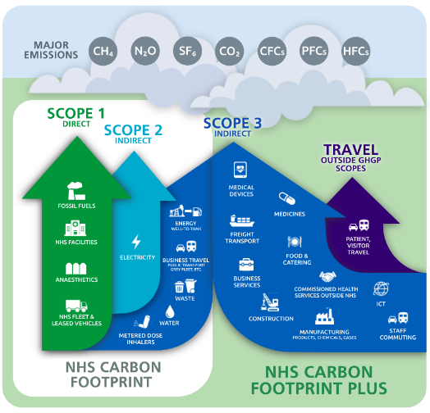
Environmental Sustainability in Healthcare
Sustainability in Healthcare for Foundation Doctors
Delivering a ‘Net Zero’ National Health Service. NHS England; 2020.
Notes:
This infographic highlights how complex the NHS’s carbon footprint is, which emphasises how important it is for all staff within the NHS and patients to collaborate and work towards creating a more sustainable system that benefits everyone – including future generations

Slide 22

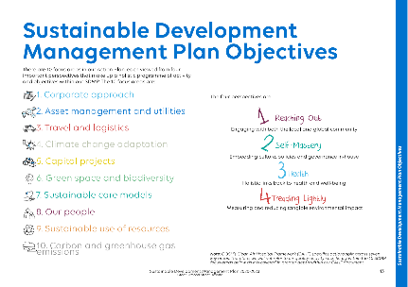
Environmental Sustainability in Healthcare
Sustainable Healthcare Development Group
Sustainability in Healthcare for Foundation Doctors
Case study – Great Ormond Street Hospital
Implemented measures to reduce carbon emissions by 50% by 2030, including energy-efficient lighting, heating systems, and sourcing renewable energy
Have a hospital-wide waste recycling programme
Sustainability plan includes biodiversity and green spaces
Values a holistic approach involving local and global communities

Slide 23
Environmental Sustainability in Healthcare
Sustainable Healthcare Development Group
Sustainability in Healthcare for Foundation Doctors
Mentimeter 2
Have you noticed any sustainability initiatives in your hospital, trust or health board?

Slide 24
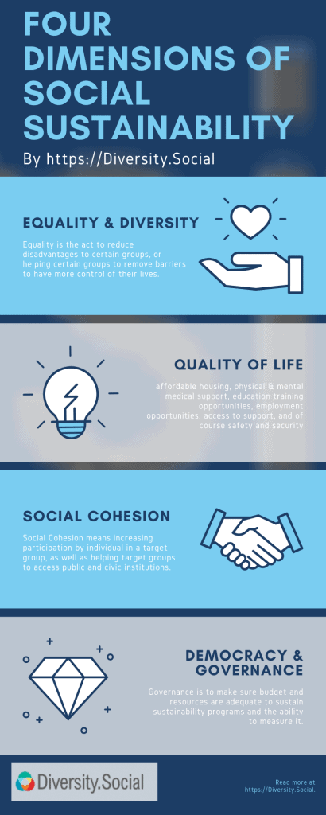
Social Sustainability in Healthcare
Sustainable Healthcare Development Group
Sustainability in Healthcare for Foundation Doctors
NHS has a mission to provide healthcare to all, free at the point of use
Access and outcomes can still vary significantly by region and socioeconomic status
Health and healthcare should be integrated into the inner workings of a community
Creating a positive work culture and promoting mental health and wellbeing amongst staff can help sustain the workforce

Slide 25

Social Sustainability in Healthcare
Sustainable Healthcare Development Group
Sustainability in Healthcare for Foundation Doctors
“Equity in health is the absence of systematic disparities in health (or in the major social determinants of health) between groups with different levels of underlying social advantage/disadvantage.”
Braveman P, Gruskin S. Defining equity in health. J Epidemiol Community Health. 2003 Apr;57(4):254-8.

Slide 26

Social Sustainability in Healthcare
Sustainable Healthcare Development Group
Sustainability in Healthcare for Foundation Doctors
Case study – NHS Long-Term Plan
Chapter 2 – “More NHS action on prevention and health inequalities”
Focus on reducing health inequalities and ensuring that healthcare services are equitable and accessible to all communities, especially in deprived areas
Key issues include smoking, obesity, alcohol, air pollution and antimicrobial resistance

Slide 27
Social Sustainability in Healthcare
Sustainable Healthcare Development Group
Sustainability in Healthcare for Foundation Doctors
Mentimeter 3
What sustainability initiatives have you seen in your hospital to promote equity or improve mental well-being?

Slide 28
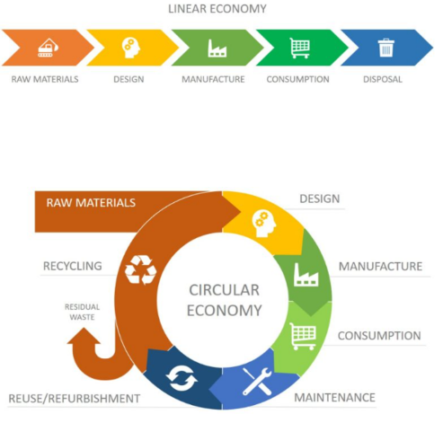
Economic Sustainability in Healthcare
Sustainable Healthcare Development Group
Sustainability in Healthcare for Foundation Doctors
Difficulty in reducing costs while maintaining quality care is essential
Sustainability initiatives can often provide both environmental and financial benefits (e.g. reducing waste in clinical environments)
Shifting towards preventive care, which is more cost-effective than reactive treatments (e.g. the NHS Diabetes Prevention Programme)

Slide 29
Actional Tips for Foundation Doctors
Sustainable Healthcare Development Group
Sustainability in Healthcare for Foundation Doctors
Mentimeter 4
How can you implement sustainable healthcare into your practice?

Slide 30
Actional Tips for Foundation Doctors
Sustainable Healthcare Development Group
Sustainability in Healthcare for Foundation Doctors
Environmental Sustainability
Avoid unnecessary single-use plastics
Dispose of clinical waste appropriately
Public transport to/from work
Green/blue prescribing
De-prescribing or switching to PRN
Social Sustainability
Social prescribing (e.g. exercise, arts and volunteering)
Training in cultural competencies
Try and create a positive work environment
Antibiotic stewardship
Economic Sustainability
Rationalise investigations and avoid unnecessary tests
Encourage breast feeding (less waste, beneficial antibodies = preventative care)
Minimise waste
Advocate for sustainability in your teams
Get involved in sustainability initiatives/SusQI
Educate other staff members/patients and encourage them to get involved
Notes:
Medicines account for around 25% of carbon emissions in the NHS.
Switch OD iron to every other day (just as effective)

Slide 31
Actional Tips for Foundation Doctors
Sustainable Healthcare Development Group
Sustainability in Healthcare for Foundation Doctors
Environmental Sustainability
Avoid unnecessary single-use plastics
Dispose of clinical waste appropriately
Public transport to/from work
Green/blue prescribing
De-prescribing or switching to PRN
Social Sustainability
Social prescribing (e.g. exercise, arts and volunteering)
Training in cultural competencies
Try and create a positive work environment
Antibiotic stewardship
Economic Sustainability
Rationalise investigations and avoid unnecessary tests
Encourage breast feeding (less waste, beneficial antibodies = preventative care)
Minimise waste
General
Advocate for sustainability in your teams
Get involved in sustainability initiatives/SusQI
Educate other staff members/patients and encourage them to get involved
Notes:
Medicines account for around 25% of carbon emissions in the NHS.
Switch OD iron to every other day (just as effective)

Slide 32
Actional Tips for Foundation Doctors
Sustainable Healthcare Development Group
Sustainability in Healthcare for Foundation Doctors
Environmental Sustainability
Avoid unnecessary single-use plastics
Dispose of clinical waste appropriately
Public transport to/from work
Green/blue prescribing
De-prescribing or switching to PRN
Social Sustainability
Social prescribing (e.g. exercise, arts and volunteering)
Training in cultural competencies
Try and create a positive work environment
Antibiotic stewardship
Economic Sustainability
Rationalise investigations and avoid unnecessary tests
Encourage breast feeding (less waste, beneficial antibodies = preventative care)
Minimise waste
Notes:
Medicines account for around 25% of carbon emissions in the NHS.
Switch OD iron to every other day (just as effective)

Slide 33
Actional Tips for Foundation Doctors
Sustainable Healthcare Development Group
Sustainability in Healthcare for Foundation Doctors
Environmental Sustainability
Avoid unnecessary single-use plastics
Dispose of clinical waste appropriately
Public transport to/from work
Green/blue prescribing
De-prescribing or switching to PRN
Social Sustainability
Social prescribing (e.g. exercise, arts and volunteering)
Training in cultural competencies
Try and create a positive work environment
Antibiotic stewardship
Economic Sustainability
Rationalise investigations and avoid unnecessary tests
Encourage breast feeding (less waste, beneficial antibodies = preventative care)
Minimise waste
General
Advocate for sustainability in your teams
Get involved in sustainability initiatives/SusQI
Educate other staff members/patients and encourage them to get involved
Notes:
Medicines account for around 25% of carbon emissions in the NHS.
Switch OD iron to every other day (just as effective)

Slide 34
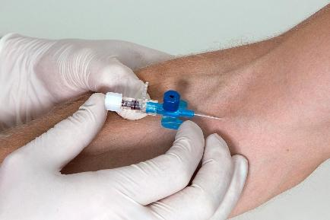
Actional Tips for Foundation Doctors
Sustainable Healthcare Development Group
Sustainability in Healthcare for Foundation Doctors
Case Study – Intravenous Cannulation
Consider the clinical waste produced from one cannula insertion – are there practical ways to reduce this?
Reusable BP cuff instead of disposable tourniquet
Only open the cannula you’re about to use (put the unused back in the supply cupboard/drawer)
Co-ordinate with venepuncture (avoiding repeating procedures unnecessarily)
Label with date and time to maximise length of use
Notes:
Could be a potential SusQI project. Minimum amount of equipment required for each cannulation vs how much was used, calculate money lost and mass? of additional waste produced.

Slide 35
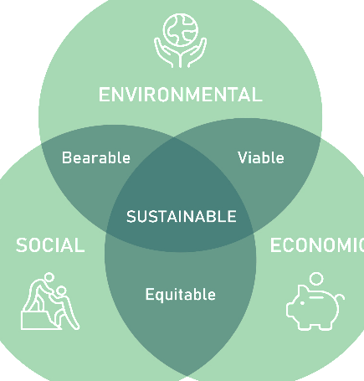

Sustainable Development in Quality Improvement (SusQI)
Sustainable Healthcare Development Group
Sustainability in Healthcare for Foundation Doctors
Improving healthcare in a holistic way through a sustainable lens
Not a replacement for traditional quality improvement
Embeds sustainability into current quality improvement practice
Likely to become mandatory in future clinical practice
Notes:
Sustainability in Quality Improvement (SusQI) is an approach to improving healthcare in a holistic way, by assessing quality and value through the lens of a “triple bottom line”.
In SusQI, the health outcomes of a service are measured against its environmental, social and economic costs and impacts to determine its “sustainable value”. SusQI embeds the CSH principles of sustainable clinical practice: prevention, patient empowerment and self-care, lean clinical pathways and low-carbon alternatives.
Rather than being a replacement for traditional QI, SusQI is designed to embed sustainability into current QI theory and practice, and thus provide practical tools to support health-workers in contributing to health-system transformation

Slide 36

Discussion / Q&A
Sustainable Healthcare Development Group
Sustainability in Healthcare for Foundation Doctors
Mentimeter 5

Slide 37

Feedback
Sustainable Healthcare Development Group
Sustainability in Healthcare for Foundation Doctors

Slide 38








Helpful Resources
Sustainability in Healthcare for Foundation Doctors

Slide 39


Further Questions?
Victoria England
victoria.england.ve@gmail.com
Fionán Mac Giolla Bhríde
fionanmcbride01@gmail.com

