Slide 1

E-portfolio . a foundation doctor’s perspective . devon ward

Slide 2
overview
What was the portfolio like for me?
Advice for the e-portfolio
Examples

Slide 3
Starting the e-portfolio

Slide 4
My experience of e-portfolio
Seemed very overwhelming to begin with
Lots of requirements – some trusts have specific numbers per form
One more thing to do on top of trying to save lives 💪
But the more I did it, the more I found it was legitimately useful
A repository for all of your achievements over the course of the year
A way of identifying the areas you’re good at
A way of identifying your areas for improvement
A consistently accessible way to put your audit/QI/research/teaching details where you can access them when you leave the trust
And! A way to pass the year! 😛

Slide 5
Advice for the e-portfolio

Slide 6
Advice on e-portfolio
Start early
Start smart
Ask for opportunities
Don’t undersell yourself

Slide 7
Start early

Slide 8

START EARLY
ARCP always sneaks up – halfway through third rotation!
Around 42 weeks from the start of rotation
You have the most to learn in 1st placement and therefore the most to reflect on!
“This is the first time I’ve managed X, do you mind if I send you a form so I can reflect on it?”
TAB – make notes of names and ask people throughout placement

Slide 9
actual timeline
Summary narrative update
AUG | SEP | OCT | NOV | DEC | JAN | FEB | MAR | APR | MAY | ARCP
1 CBD
1 mini-CEX
1 DOPS
3 CBDs
3 mini-CEX
3 DOPS
4 reflections

Slide 10
goal timeline
Post-placement reflection – how did your placement go? What did you enjoy or not? What was the most useful thing?
Try and sign off the first patient you present in every rotation
(Depending on trust goals) aim for 2 of each SLE per block
Write a summary narrative at the end of every block (~80 words) when it’s fresh in your mind
Do e-learning early
Know when your breaks/holidays are (you’re not gonna do much!)

Slide 11
GOAL timeline
Summary narrative update
Summary narrative update
Summary narrative update
E-learning
AUG | SEP | OCT | NOV | DEC | JAN | FEB | MAR | APR | MAY | ARCP
1 CBD
1 mini-CEX
1 CBD
1 CBD
1 mini-CEX
1 DOPS
1 mini-CEX
1 mini-CEX
1 CBD
1 DOPS
1 mini-CEX
1 DOPS
1 DOPS
1 CBD
1 DOPS
1 CBD
End of placement reflection
End of placement reflection
End of placement reflection

Slide 12
Start smart

Slide 13

START smart
You aim for 2 bits of hard evidence per FPC
E-learning counts as hard evidence and can be mapped to 3 FPCs – identify overlap in topics to reduce workload to start with

Slide 14
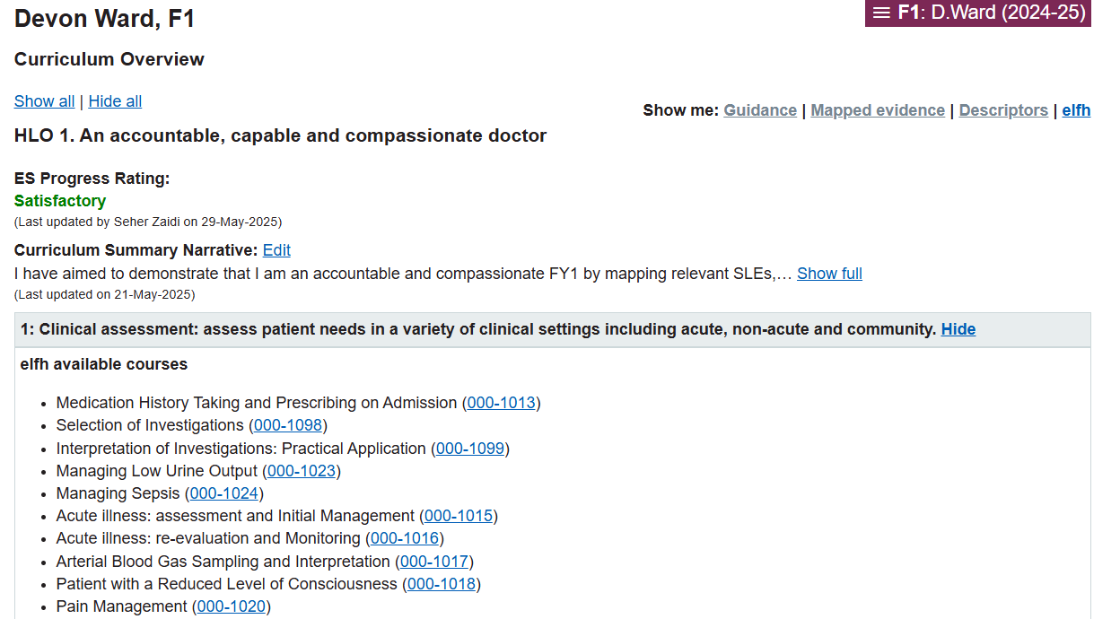
START smart
You aim for 2 bits of hard evidence per FPC
E-learning counts as hard evidence and can be mapped to 3 FPCs – identify overlap in topics to reduce workload to start with

Slide 15
E-lfh with overlap
Selection of investigations – FPC 1, 2, 3
Team working and patient safety – FPC 4, 5, 6
Stress – Mental Health – FPC 7, 8
01_05 How to review a paper – FPC 9, 10, 12
Health needs, demands and resource – FPC 11, 13
All 20 minute modules
5 e-learning modules and 1 evidence mapped to every FPC

Slide 16
START smart
You aim for 2 bits of hard evidence per FPC
E-learning counts as hard evidence and can be mapped to 3 FPCs – identify overlap in topics to reduce workload to start with
Relate your reflections to FPCs when you write them

Slide 17
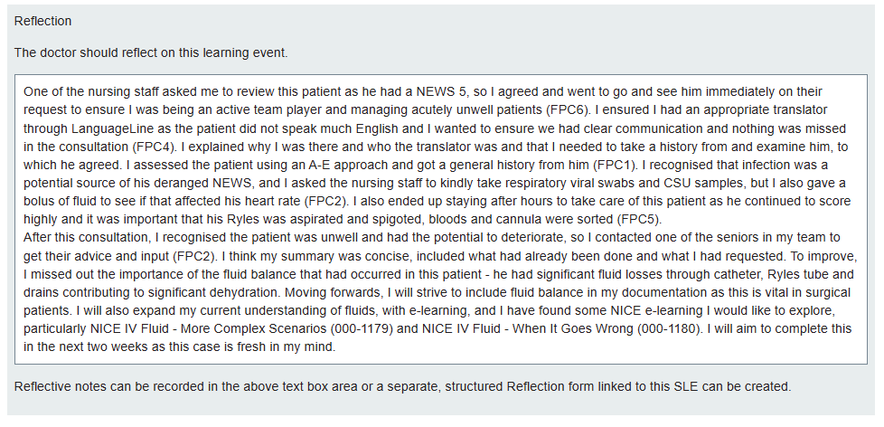
Example

Slide 18
START smart
You aim for 2 bits of hard evidence per FPC
E-learning counts as hard evidence and can be mapped to 3 FPCs – identify overlap in topics to reduce workload to start with
Relate your reflections to FPCs when you write them

Slide 19
Ask for opportunities

Slide 20

Ask for opportunities
Your supervisor and seniors won’t know what you need without you telling them
“I’d really love to learn X skill in this rotation, what can I do to help that happen?”
“Do you have any clinics I could shadow?”
“Is there an opportunity to go to theatre?”
“I’d like to get a CBD this week – would you mind if I review a patient individually and discuss with you?”
“I want to specialise in this specialty – what experiences should I get in this rotation to prepare me?”
You are not a burden
Your portfolio won’t develop unless you push for it

Slide 21
Common opportunities
Doing a presentation at weekly departmental teaching – DCT
Teaching medical students on the ward – Teaching Others
Asking a nurse to shadow you to a catheter/cannula/bloods – DOPS
Discussing patient with SHO/reg on on-call shifts – CBD
MET calls/crash calls – mini-CEX
Asked to re-prescribe a medication – reflection

Slide 22
Challenging opportunities
People seem to struggle or become nervous about the audit/QIP
In FY1, you just need to demonstrate involvement in an audit/QIP, not design your own one
In FY2, you need to lead an audit/QIP
I have 2 recommendations
Reach out to your supervisor and ask to get involved with an audit/QIP at the beginning of the project
Design a simple audit that can become a QIP as soon as you can
Find something people complain about on the ward
Reach out to your ES/CS or favourite consultant to supervise
If it’s bad, make an intervention to improve it (now it’s a QIP)

Slide 23
Don’t undersell yourself

Slide 24
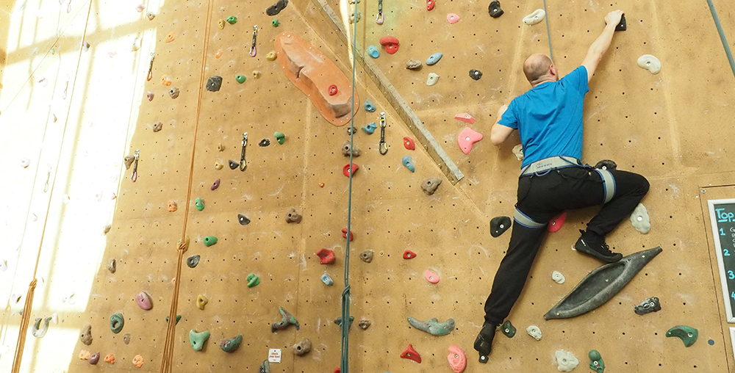
Don’t undersell yourself
Developing the core competencies of FY1 does NOT mean just doing things inside of medicine
You can develop teamworking in sports, personal wellbeing in crochet, understand bias in charity work
The reflective process that contributes to you becoming a good doctor includes your work as a doctor and that you do outside
Include your achievements! Use the portfolio to show how brilliant you are!
(Also very useful for specialty applications to have this all in one space!)

Slide 25
examples

Slide 26
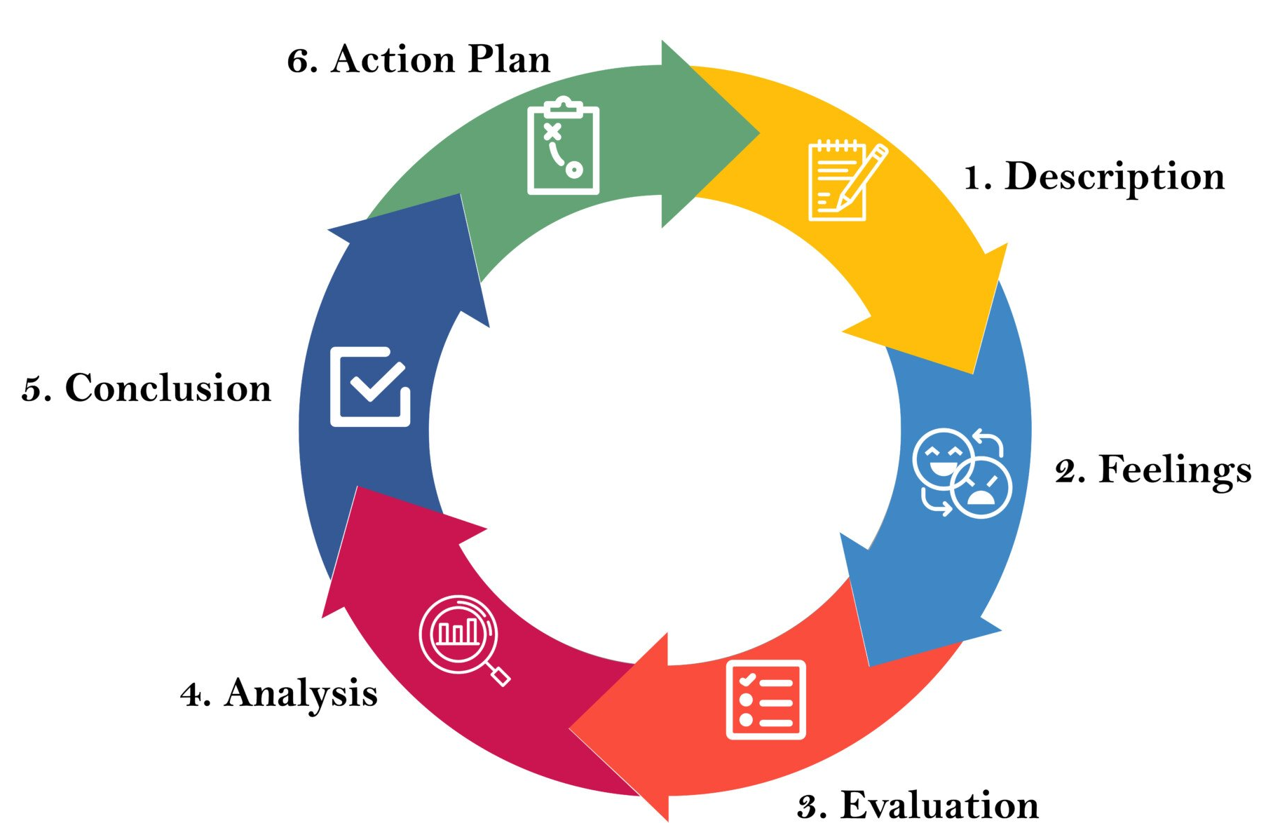
Example reflective cycle
You can use a formal reflective cycle like Gibbs’:
I tend to favour:
What happened – the actual series of events and relation to FPC
What did it mean – what impact did it have on you, the patient, your practice, etc
What next – what will you do to improve for next time?

Slide 27
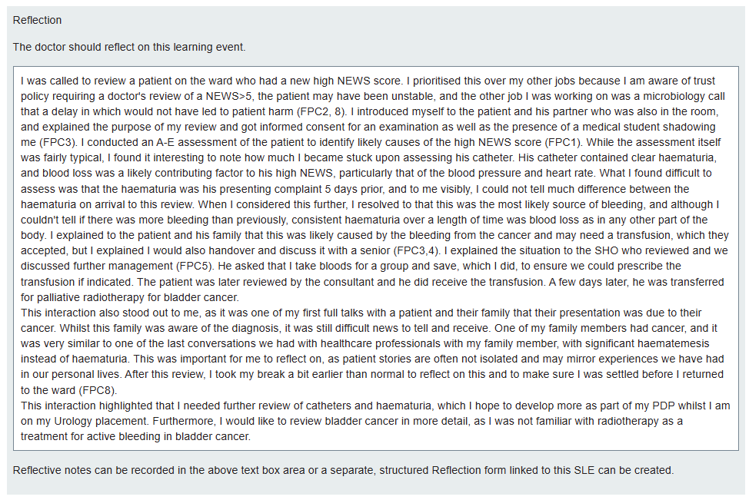
Example – Mini-cex
What happened
What did it mean
What
next

Slide 28
Example – cbd
What happened
What did it mean
What
next

Slide 29
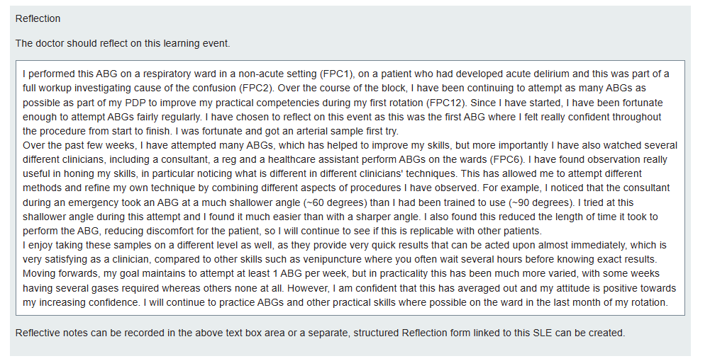
Example - dops
What happened
What did it mean
What
next

Slide 30
At the end of the day…
You truly will get out of the portfolio what you put in
If you see the activities as pointless reflective nonsense just used to pass the year, the e-portfolio will not be useful for you
Try and consider every day, every patient or senior interaction as a learning opportunity
Getting good feedback? Excellent, reflect on it! Why are you doing well?
Getting constructive feedback? Great, reflect on it! What can you do better?
If you see the portfolio as a way to constantly evolve and develop to become a better person and doctor, the e-portfolio will be invaluable for you

Slide 31
Thank you for your time
Happy to answer any questions in the Q+A!
Devon Ward
devon.ward@rlbuht.nhs.uk

