Slide 1


Making the most of your e-portfolio Tips, tools and reflections
Dr Ruth Eakin Deputy FSD Northern Ireland (NI)
Dr Debbie Cullen Foundation Programme Director (NI)
Dr Devon Ward FY2 UKFPO Fellow

Slide 2
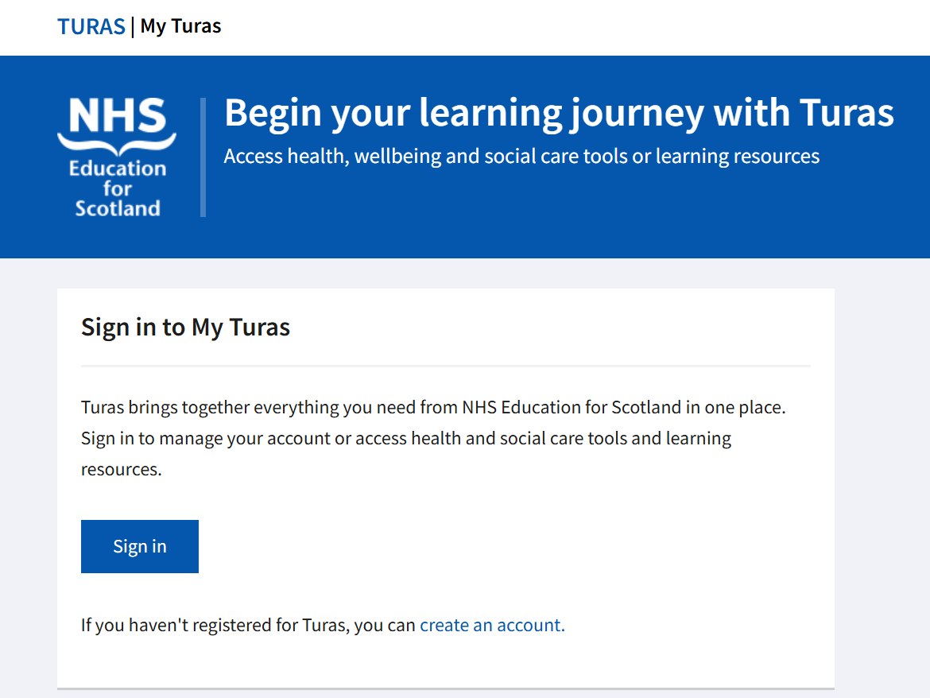
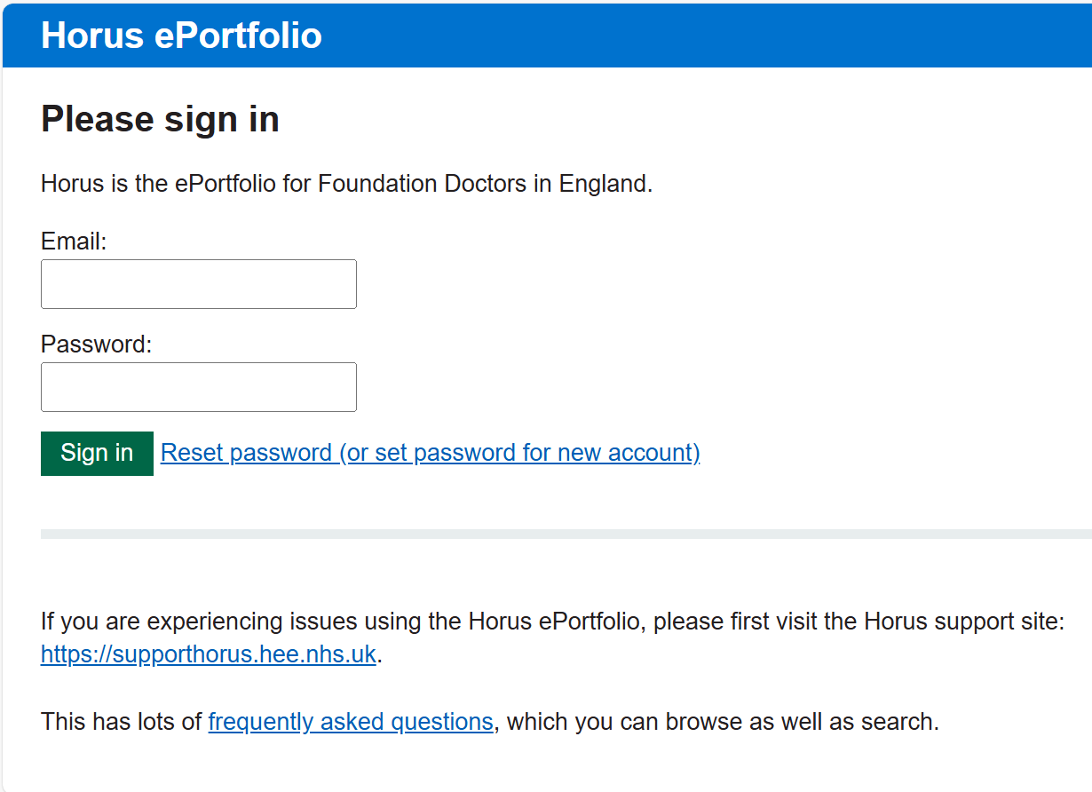
What e-portfolios?

Slide 3

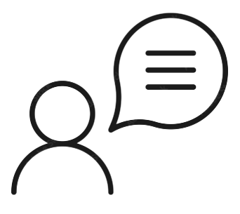
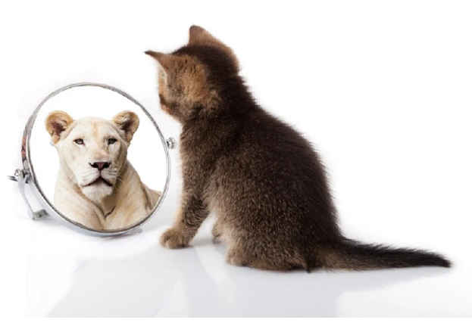
Why e-portfolios?
Promote life long continuous learning
Log evidence and show progress
Record reflections
Supervisor reports
Review personal development (PDP)
Interviews/CVs/Career development
For the ARCP panel to look through and award an outcome!

Slide 4
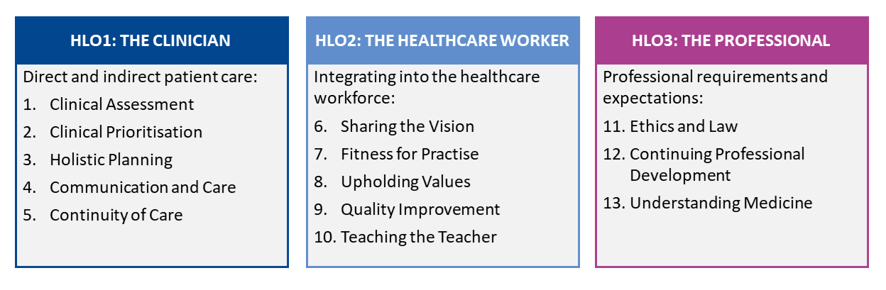
Higher Level Outcomes (HLOs) and Foundation Professional Capabilities (FPCs)
1. An accountable, capable and compassionate clinician
2. A valuable member of the healthcare workforce
3. A professional, responsible for their own practice and portfolio development
Enhancing Patient Care Through Training

Slide 5
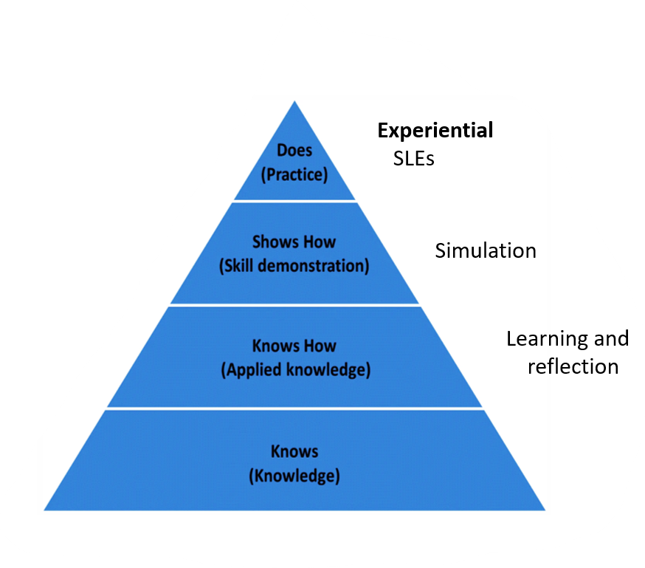
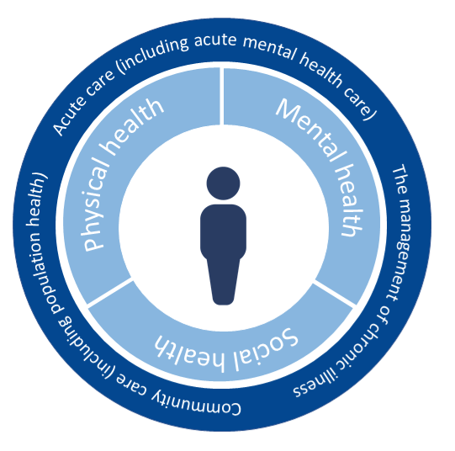
Pieces of Evidence for eportfolio

Slide 6
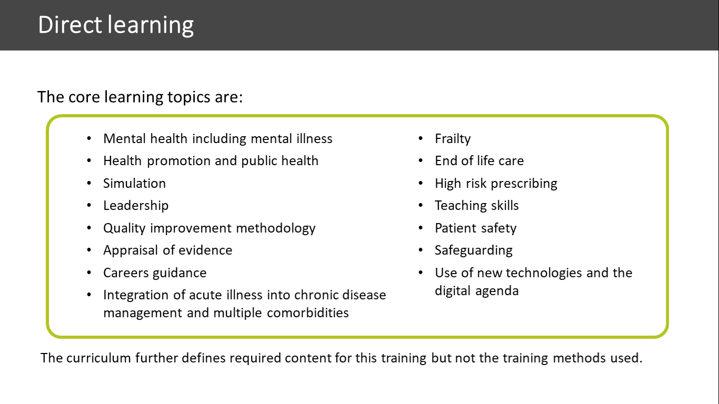
Specific Areas of Core Learning

Slide 7
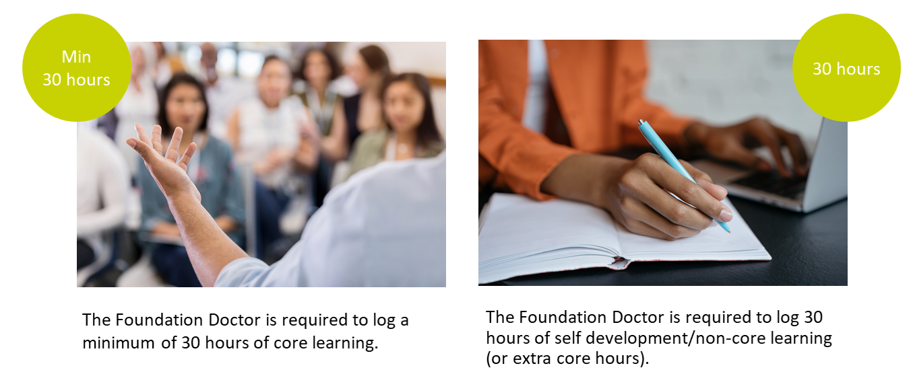
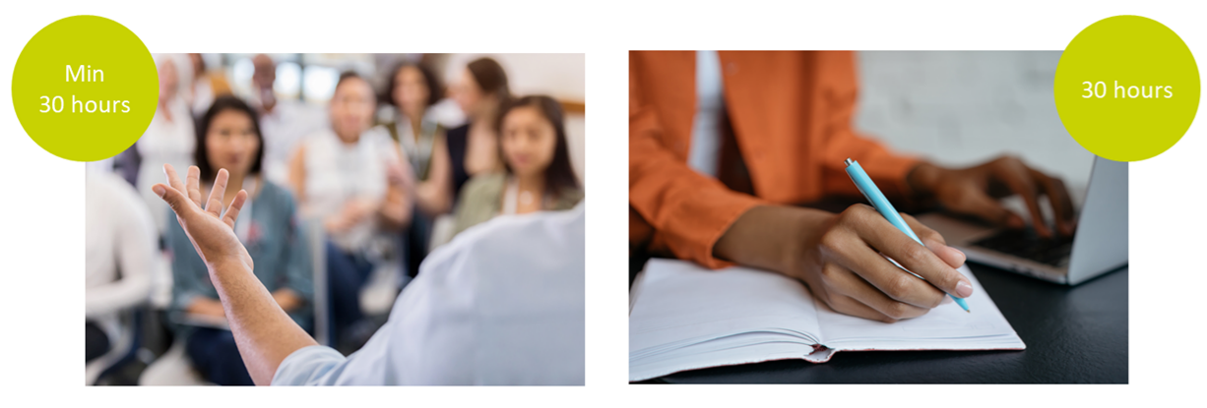
Other learning methods
Core learning
Non-core learning, or more core, or both

Slide 8
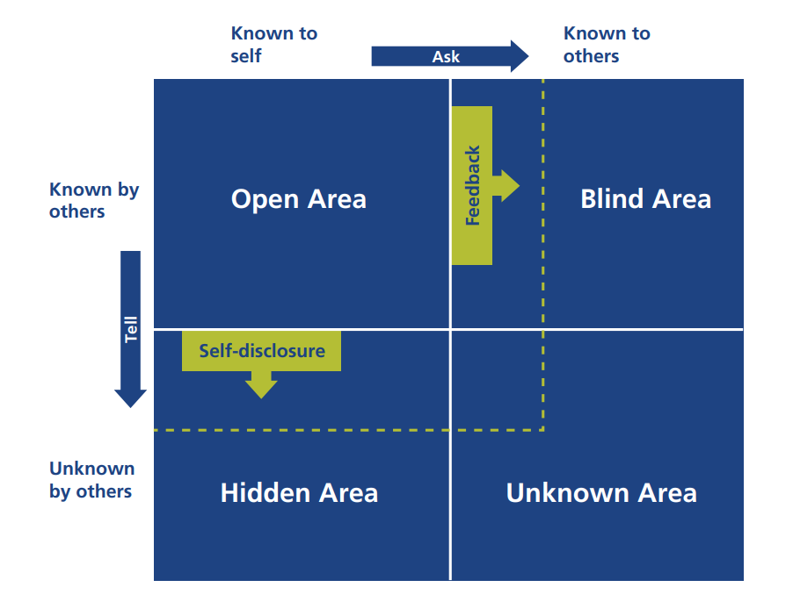

E-learning and reflection

Slide 9
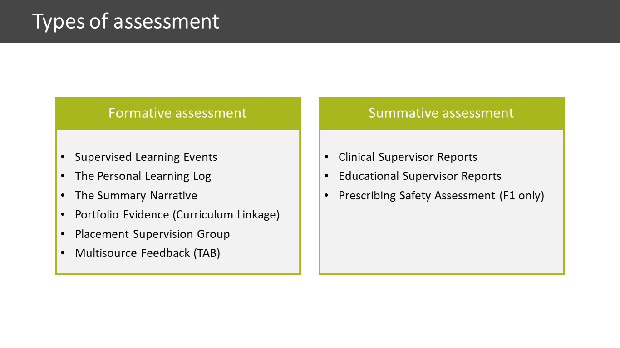
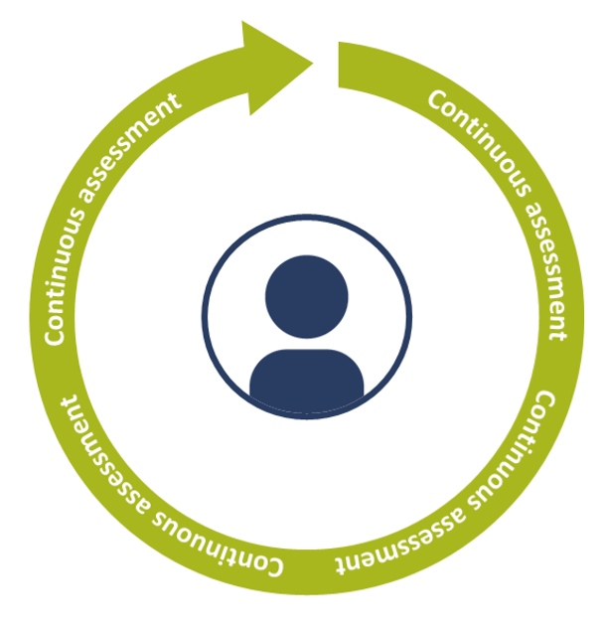
Assessments

Slide 10
Assessments

Slide 11
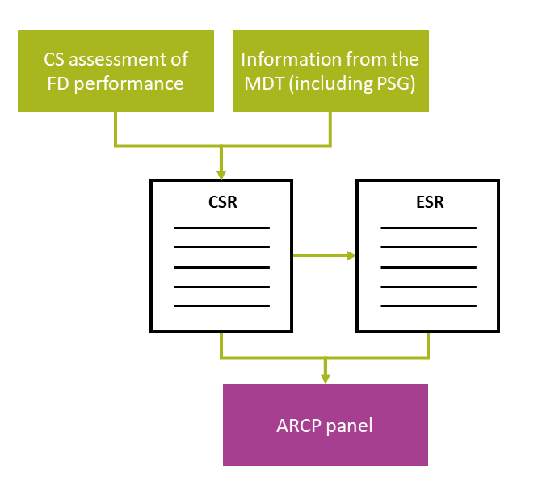
Supervisor reports

Slide 12
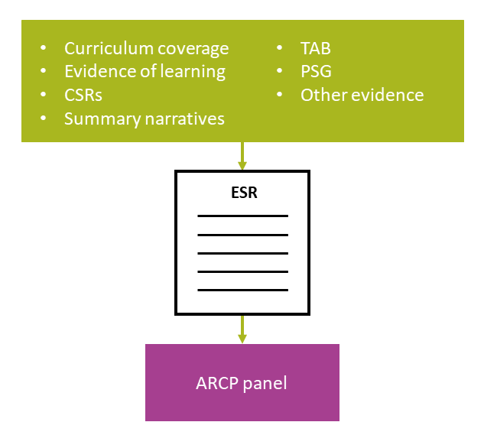
Supervisor reports

Slide 13
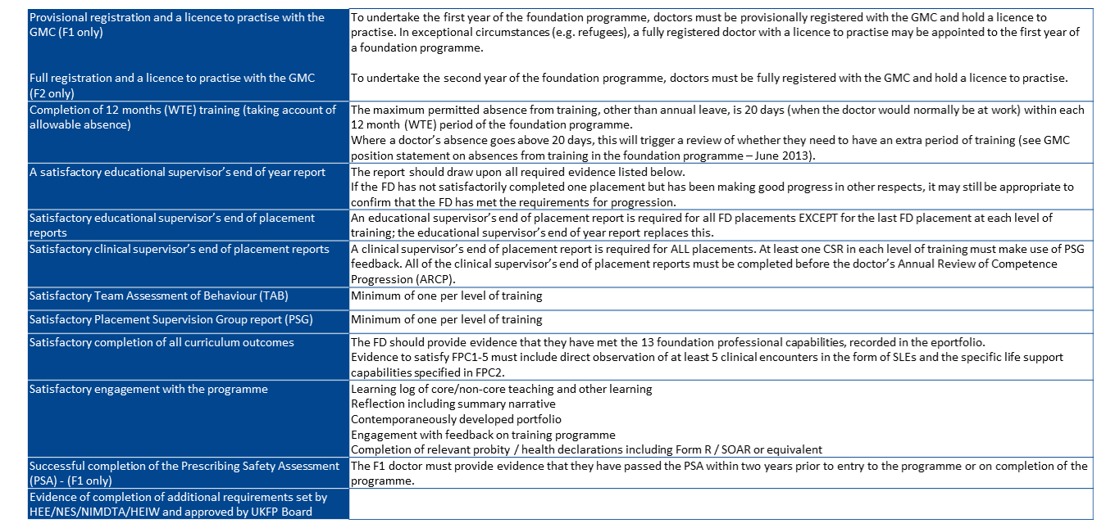
ARCP Checklist

Slide 14
ARCP Checklist

Slide 15
ARCP Checklist

