Slide 1


The evolution of the Foundation Programme curriculum & learning

Slide 2
What is a curriculum?
“Curriculum” is a term used in a number of related ways:
It can refer to the overall content of what is to be taught, as in the "National Curriculum" in the UK, which specifies the content of by far the largest part of compulsory schooling
It can refer to the underlying principles of the approach to teaching and learning, as in a "developmental curriculum" or a "competency-based" curriculum
It can embrace both elements, and refer to the overall "what", "how" and "why" of teaching
Curriculum vs Syllabus

Slide 3
What is a curriculum?
“Curriculum” is a term used in a number of related ways:
It can refer to the overall content of what is to be taught, as in the "National Curriculum" in the UK, which specifies the content of by far the largest part of compulsory schooling
It can refer to the underlying principles of the approach to teaching and learning, as in a "developmental curriculum" or a "competency-based" curriculum
It can embrace both elements, and refer to the overall "what", "how" and "why" of teaching
Curriculum vs Syllabus

Slide 4
What is a curriculum?
“Curriculum” is a term used in a number of related ways:
It can refer to the overall content of what is to be taught, as in the "National Curriculum" in the UK, which specifies the content of by far the largest part of compulsory schooling
It can refer to the underlying principles of the approach to teaching and learning, as in a "developmental curriculum" or a "competency-based" curriculum
It can embrace both elements, and refer to the overall "what", "how" and "why" of teaching
Curriculum vs Syllabus

Slide 5
2010: The Collins Report
WEAKNESSES
‘lacks a clearly articulated and generally accepted purpose’
‘confusion about the role of the trainee’
‘provision of [realistic] career advice is inadequate’
‘distribution of placements by specialty does not reflect future needs of the NHS’
‘assessment of Foundation doctors is excessive, onerous and under valued’

Slide 6

2021 Foundation Programme curriculum
The UK Foundation Programme is designed to support the transition from medical student to doctor.
It thus covers a crucial stage in the medical training, marking:
• the acceptance of professional responsibility for the care of patients and their families/carers;
• the beginning of the doctor’s working life as a qualified healthcare professional who will be a valued member of the multidisciplinary team, go on to provide leadership, and ultimately take overall responsibility for their patients’ care;
• the start of the doctor’s career as an independent, self-directed professional.

Slide 7
2021 Foundation Programme curriculum
The purpose of the UK FP is to establish the newly qualified doctor as:
1. an accountable, capable and compassionate clinician
2. a valuable member of healthcare workforce
3. a professional, responsible for their own practice and portfolio development

Slide 8
What is a curriculum?
“Curriculum” is a term used in a number of related ways:
It can refer to the overall content of what is to be taught, as in the "National Curriculum" in the UK, which specifies the content of by far the largest part of compulsory schooling
It can refer to the underlying principles of the approach to teaching and learning, as in a "developmental curriculum" or a "competency-based" curriculum
It can embrace both elements, and refer to the overall "what", "how" and "why" of teaching
Curriculum vs Syllabus

Slide 9
2010: The Collins Report
WEAKNESSES
‘lacks a clearly articulated and generally accepted purpose’
‘confusion about the role of the trainee’
‘provision of [realistic] career advice is inadequate’
‘distribution of placements by specialty does not reflect future needs of the NHS’
‘assessment of Foundation doctors is excessive, onerous and under valued’

Slide 10
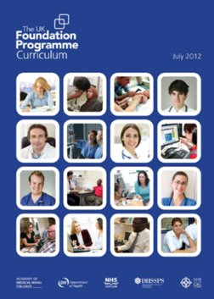
2012 Foundation Programme curriculum
67 outcomes in F1
67 outcomes in F2

Slide 11
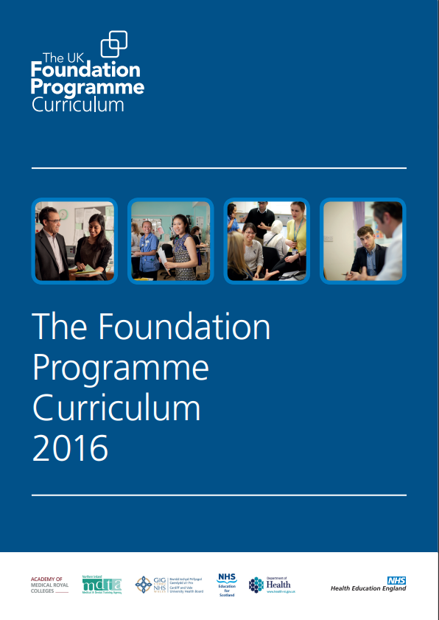
2016 Foundation Programme curriculum
Sections:
PROFESSIONAL BEHAVIOUR & TRUST
COMMUNICATION, TEAM-WORKING & LEADERSHIP
CLINICAL SKILLS
SAFETY & QUALITY
20 Foundation Professional Capabilities (FPCs; aka outcomes)

Slide 12
2021 Foundation Programme curriculum
3 Higher Level Outcomes:
1. an accountable, capable and compassionate clinician
2. a valuable member of healthcare workforce
3. a professional, responsible for their own practice and portfolio development
13 FPCs

Slide 13
What is a curriculum?
“Curriculum” is a term used in a number of related ways:
It can refer to the overall content of what is to be taught, as in the "National Curriculum" in the UK, which specifies the content of by far the largest part of compulsory schooling
It can refer to the underlying principles of the approach to teaching and learning, as in a "developmental curriculum" or a "competency-based" curriculum
It can embrace both elements, and refer to the overall "what", "how" and "why" of teaching
Curriculum vs Syllabus

Slide 14
2021 Foundation Programme curriculum
Educational methods
To develop the Foundation Doctor, the Foundation Programme uses a blend of:
experiential learning
working as a doctor
direct training
core/non-core teaching
self-development

Slide 15
The work of the UKFPO

Slide 16

Implementation of the Curriculum
Academy of Medical Royal Colleges (AoMRC) Foundation Programme Committee
UK wide curriculum
https://foundationprogramme.nhs.uk/curriculum/
ARCP checklist
E-portfolios
Prescribing Safety Assessment (PSA)

Slide 17
Representing the Foundation Programme
Postgraduate National Recruitment Board
COPMED
Medical Schools Council
General Medical Council
AoMRC
PSA

Slide 18
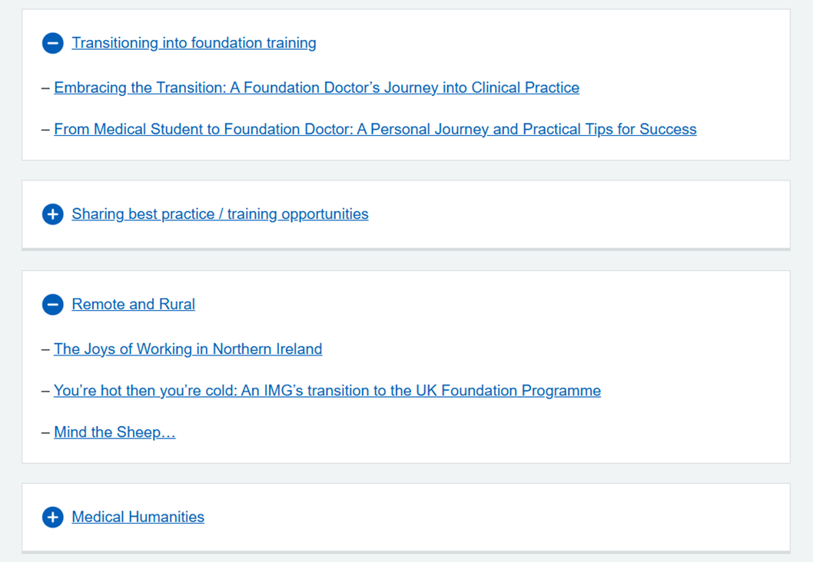
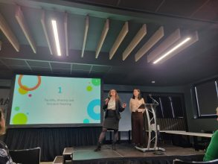
Foundation doctor representation
UKFPO Fellows
Foundation Doctor Advisory Board (FDAB)

Slide 19
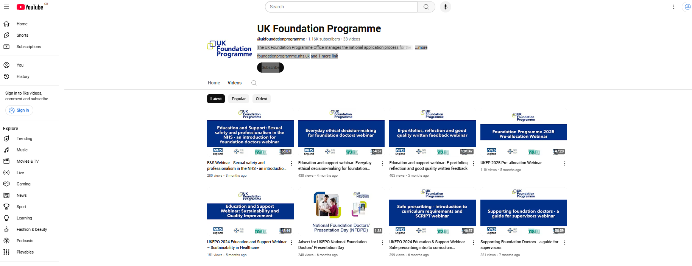
Sharing Good Practice – Webinar series

Slide 20
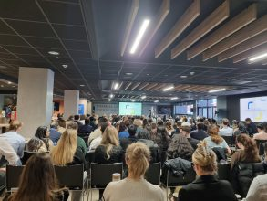
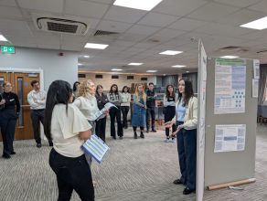
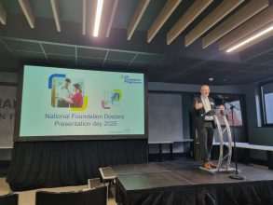
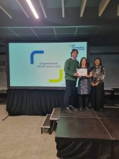
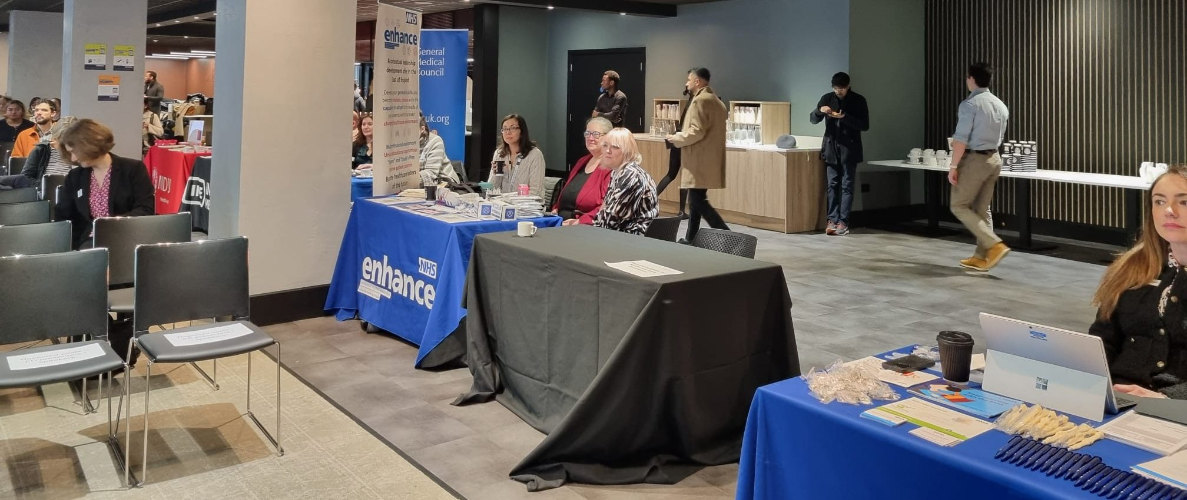
National Foundation Doctors Presentation Day

Slide 21
Where does the Foundation Programme go from here?

Slide 22
Challenges
Increasing numbers of medical students
International desirability of UK postgraduate medical training
Advances in medical care
Different generational characteristics
AI
£££

Slide 23

Celebrating 20 years of the Foundation Programme

