Slide 1

Modernising Medical Recruitment
Prof Tom Yapp
Former Advisor on Recruitment to the UK FPO
FSD, Wales

Slide 2
Unintended consequences*
Always expect the unexpected

Slide 3
20 years of the Foundation Programme
MMC 2003

Slide 4
FPAS and MTAS

Slide 5
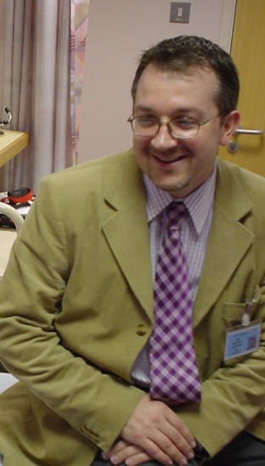
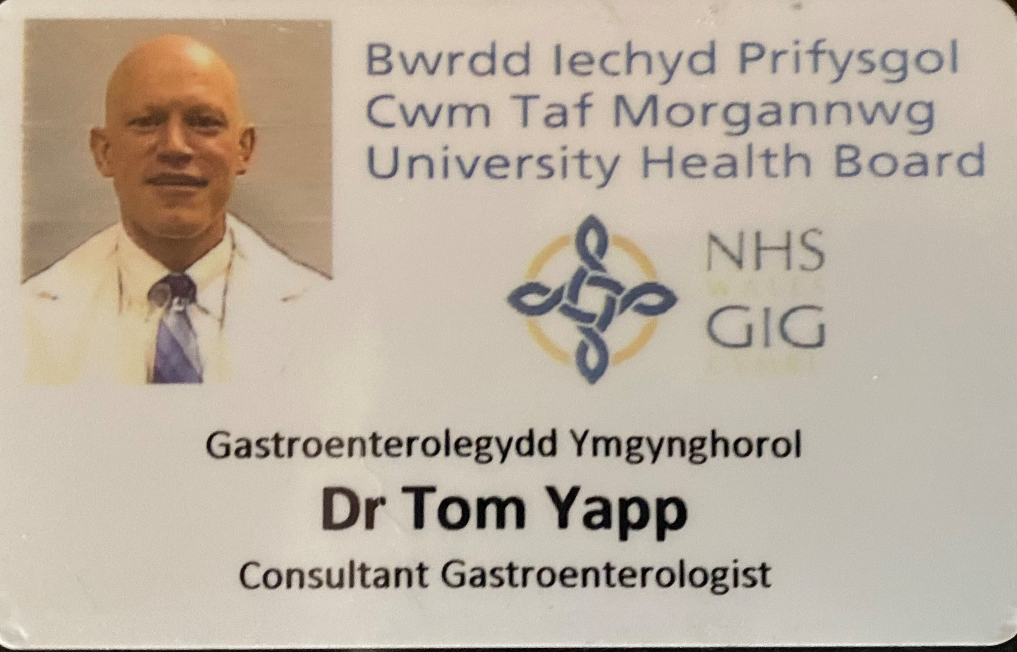
Teaching, Old Dogs, New Tricks
TY 2003
MM 2004

Slide 6
Lessons learnt: Themes

Slide 7
Days and Times*

Slide 8
White Space Questions*
Academic and Non-Academic Achievement, and the Matrix

Slide 9
Prizes, Presentations, Publications*
And Additional Degrees*
Verification Day

Slide 10
Improving Selection to the Foundation Programme
2011
SJT and EPM

Slide 11
Situational Judgement Test*
FP2013
Work Psychology Group
Paper and digital, and Reasonable Adjustments

Slide 12
Foundation Programme Review
2018

Slide 13
‘Special’ Foundation Programmes
Specialised (Academic) Foundation Programmes (SFPs)*
Foundation Priority Programmes (FPPs)*
Psychiatry Foundation Fellowship (PFFs)*

Slide 14
Special Circumstances, Pre-Allocation and IFST
Needs and Wants*

Slide 15
F2 Standalone Recruitment*
Kapenova Case 2014

Slide 16
COVID pandemic
2020
FiY1 (foundation interim year 1) doctors

Slide 17
Algorithms
Meritocratic or Greedy?
Preferences and Ranking*

Slide 18
Preference Informed Allocation, Computer Generated Ranking
DEMEC 2021
Stakeholder Engagement 2023
FP2024

Slide 19
English Language Proficiency
Dean’s Statement*
IELTS and OET*

Slide 20
Numbers*
Oversubscribed and Undersubscribed

Slide 21
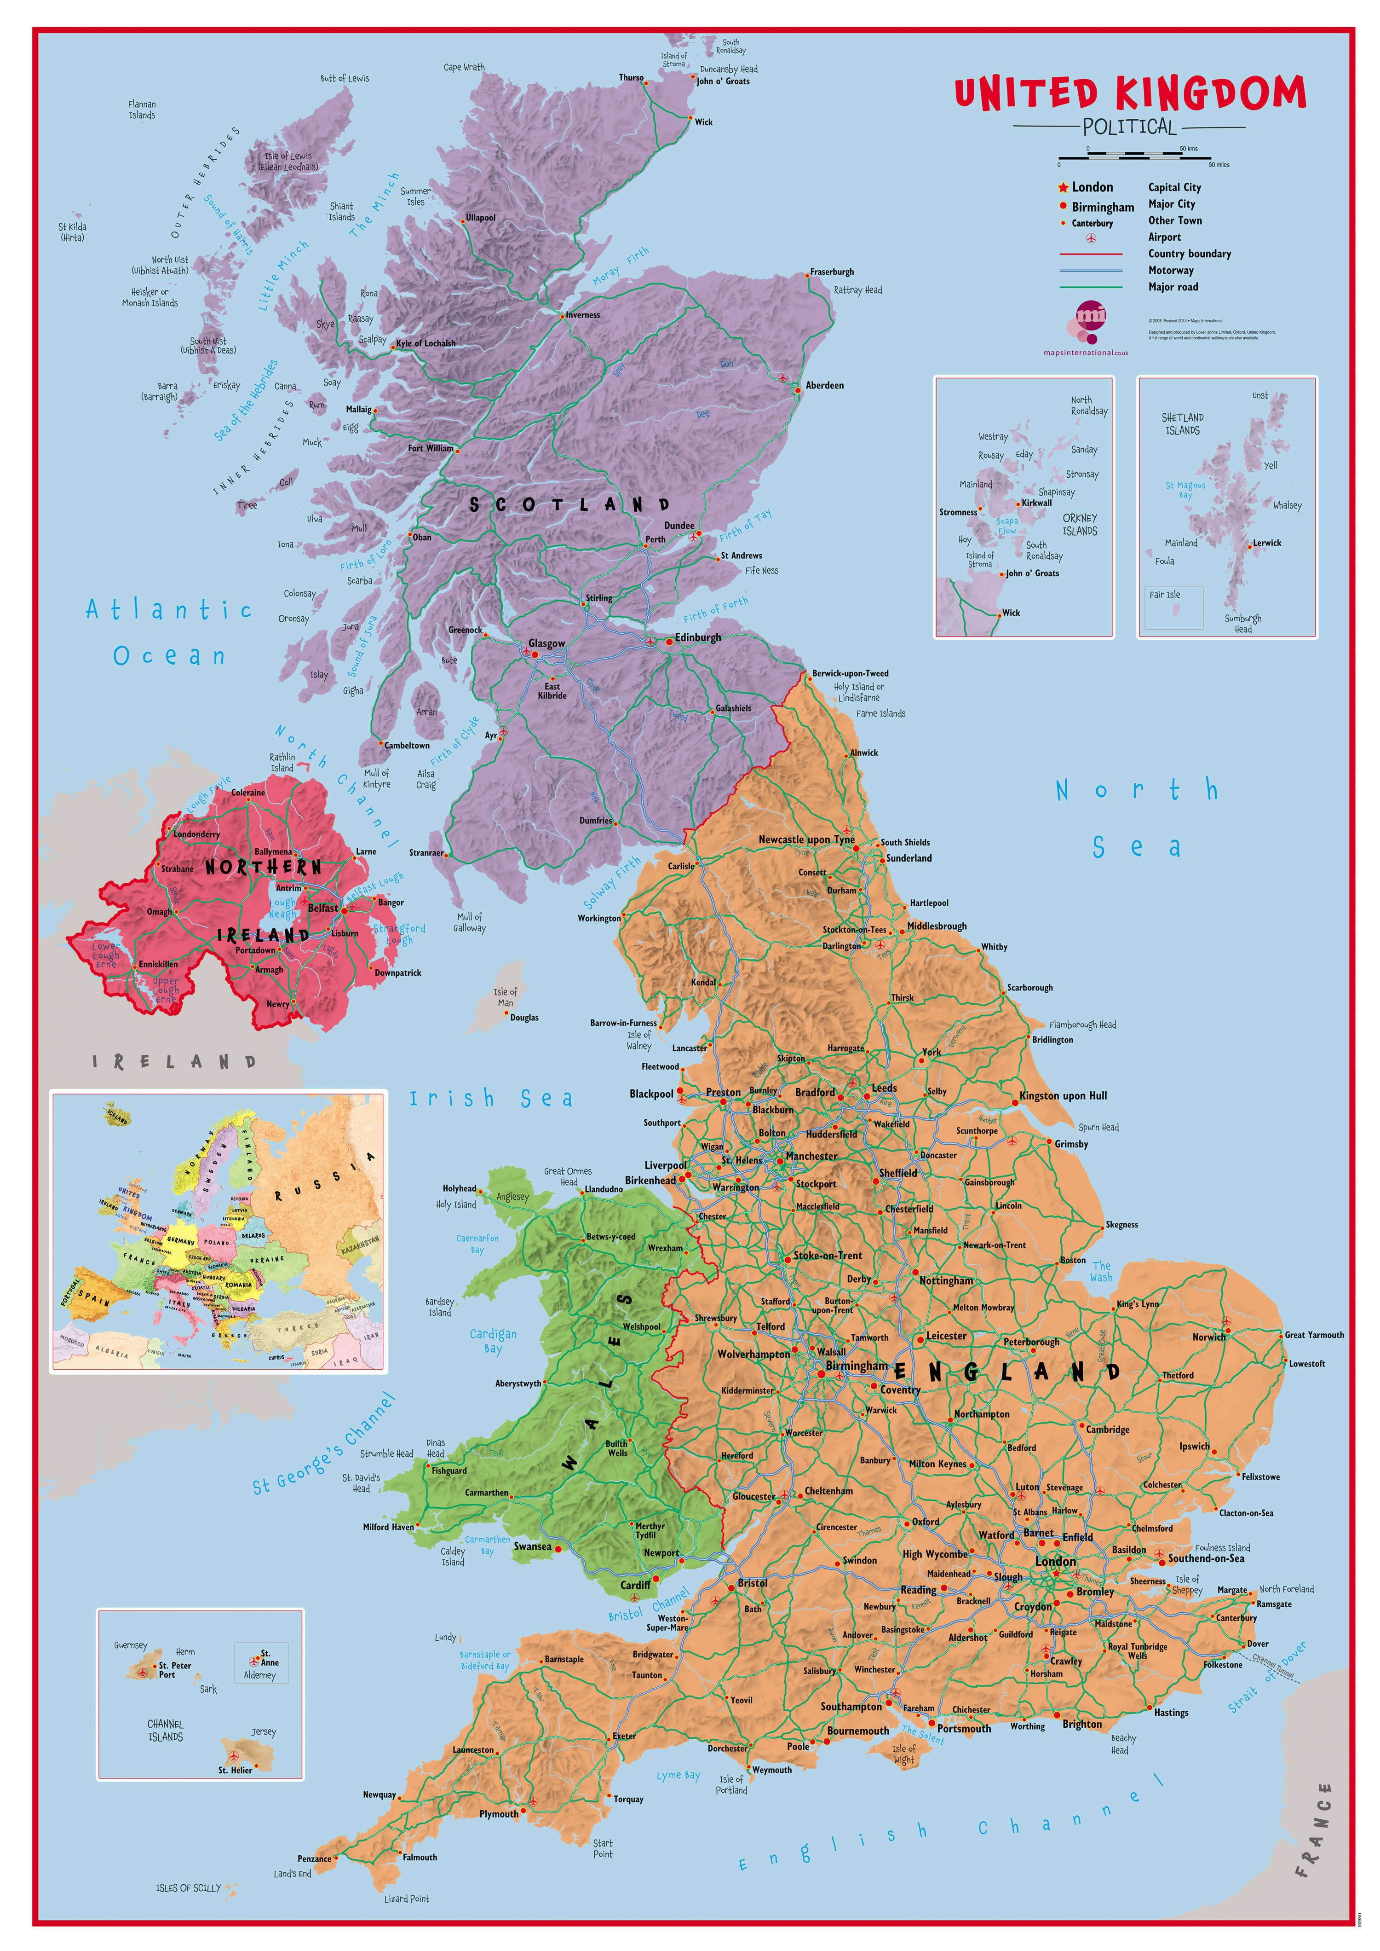
Applicant and post numbers by foundation schools
First preference numbers
Foundation school numbers

Slide 22
If you play a game, expect to win or lose….or draw
A competitive nature

Slide 23
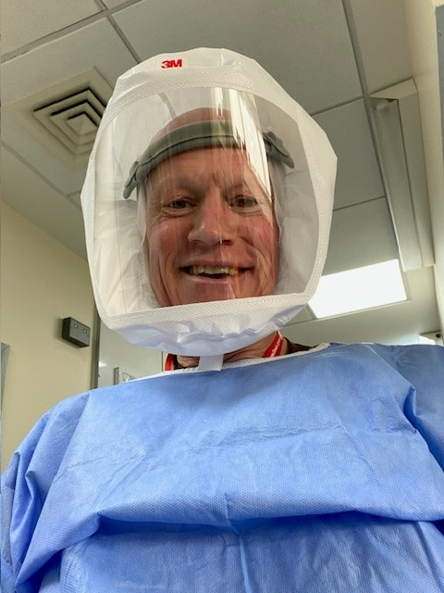
The Future Programme What happens next?

