Slide 1


The evolution of the Foundation Programme curriculum & learning

Slide 2
What is a curriculum?
“Curriculum” is a term used in a number of related ways:
It can refer to the overall content of what is to be taught, as in the "National Curriculum" in the UK, which specifies the content of by far the largest part of compulsory schooling
It can refer to the underlying principles of the approach to teaching and learning, as in a "developmental curriculum" or a "competency-based" curriculum
It can embrace both elements, and refer to the overall "what", "how" and "why" of teaching
Curriculum vs Syllabus

Slide 3
What is a curriculum?
“Curriculum” is a term used in a number of related ways:
It can refer to the overall content of what is to be taught, as in the "National Curriculum" in the UK, which specifies the content of by far the largest part of compulsory schooling
It can refer to the underlying principles of the approach to teaching and learning, as in a "developmental curriculum" or a "competency-based" curriculum
It can embrace both elements, and refer to the overall "what", "how" and "why" of teaching
Curriculum vs Syllabus

Slide 4
What is a curriculum?
“Curriculum” is a term used in a number of related ways:
It can refer to the overall content of what is to be taught, as in the "National Curriculum" in the UK, which specifies the content of by far the largest part of compulsory schooling
It can refer to the underlying principles of the approach to teaching and learning, as in a "developmental curriculum" or a "competency-based" curriculum
It can embrace both elements, and refer to the overall "what", "how" and "why" of teaching
Curriculum vs Syllabus

Slide 5
2010: The Collins Report
WEAKNESSES
‘lacks a clearly articulated and generally accepted purpose’
‘confusion about the role of the trainee’
‘provision of [realistic] career advice is inadequate’
‘distribution of placements by specialty does not reflect future needs of the NHS’
‘assessment of Foundation doctors is excessive, onerous and under valued’

Slide 6
2010: The Collins Report
STRENGTHS
‘credible UK-wide generic training programme’
‘educational infrastructure & faculty’
‘national curriculum’, ‘assessment’ and ‘safety’
‘exposure of trainees to a range of different specialties’
WEAKNESSES
‘lacks a clearly articulated and generally accepted purpose’
‘confusion about the role of the trainee’
‘provision of [realistic] career advice is inadequate’
‘distribution of placements by specialty does not reflect future needs of the NHS’
‘assessment of Foundation doctors is excessive, onerous and under valued’

Slide 7

How the Foundation Programme came about

Slide 8
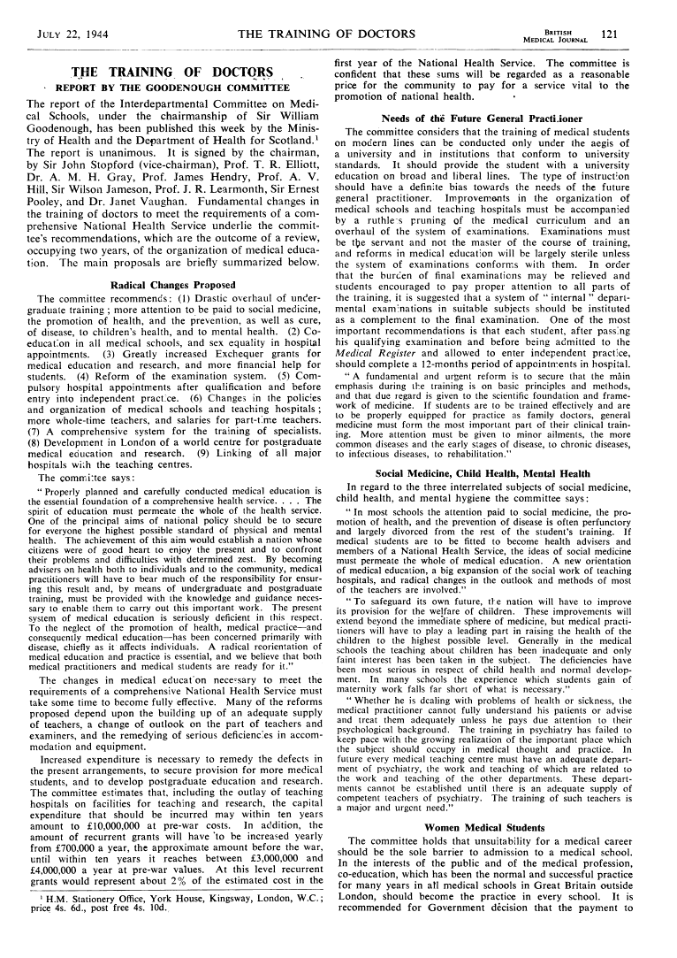
1944: The Goodenough Report

Slide 9
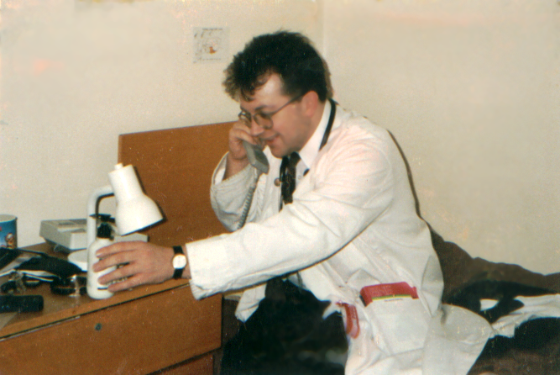

The PRHO years….

Slide 10
FY1s ……..
Undertaking complex emergency treatment with poor supervision
Large administrative burden
Excluded from clinical meetings
Little time for study or reflection

Slide 11
PRHO jobs in 1964
Undertaking complex emergency treatment with poor supervision
Large administrative burden
Excluded from clinical meetings
Little time for study or reflection
Hutton et al, Lancet, 1964

Slide 12
FY1 jobs …….
‘work pressure’
‘link communication person’
‘glorified ward clerk’
‘dustbin’

Slide 13
PRHO jobs in 1991
‘work pressure’
‘link communication person’
‘glorified ward clerk’
‘dustbin’
Dowling & Barrett, Bristol, 1991

Slide 14

PRHO jobs in 1997

Slide 15

Postgraduate Medical Education
PRHOs
Calmanisation – SpRs
Unfinished Business – SHOs

Slide 16

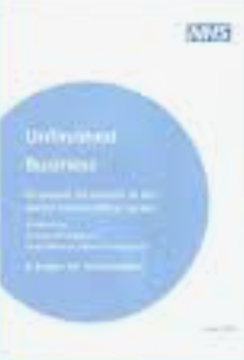
2002: Unfinished Business
Integrated, planned two-year Foundation programme of general training
Develop core generic skills essential for all doctors
Provide experience of different specialties and gain experience in looking after seriously ill patients

Slide 17
2005: The Foundation Programme begins
Educational Supervisors
Named Clinical Supervisors
Portfolio
Workplace based assessment

Slide 18
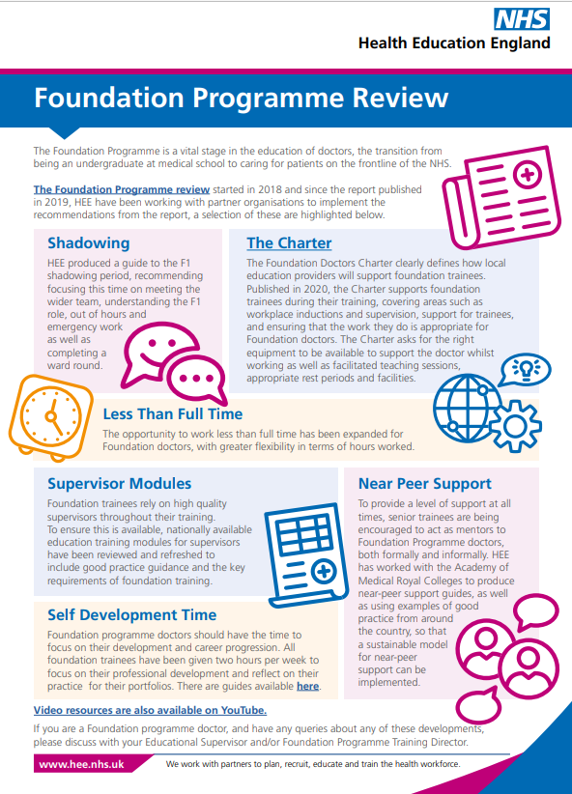
2018: HEE Foundation Programme Review

Slide 19

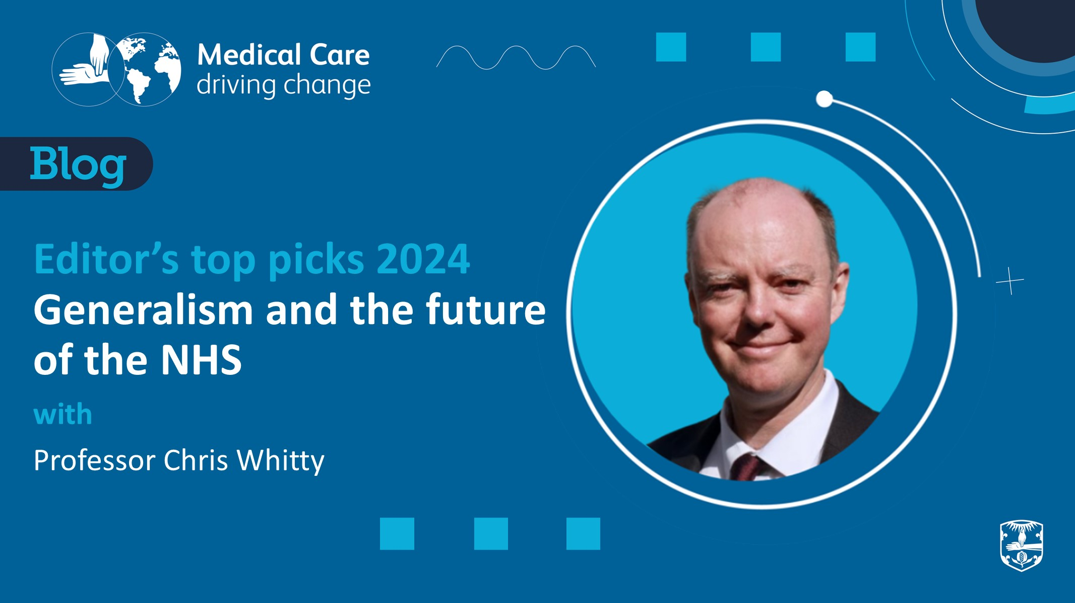
2020: Covid-19 & the Foundation Programme

Slide 20
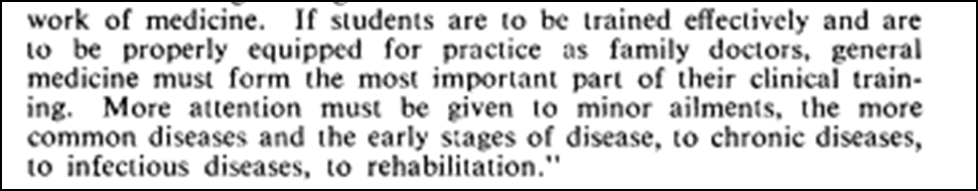
20th year of the Foundation Programme

