Slide 1


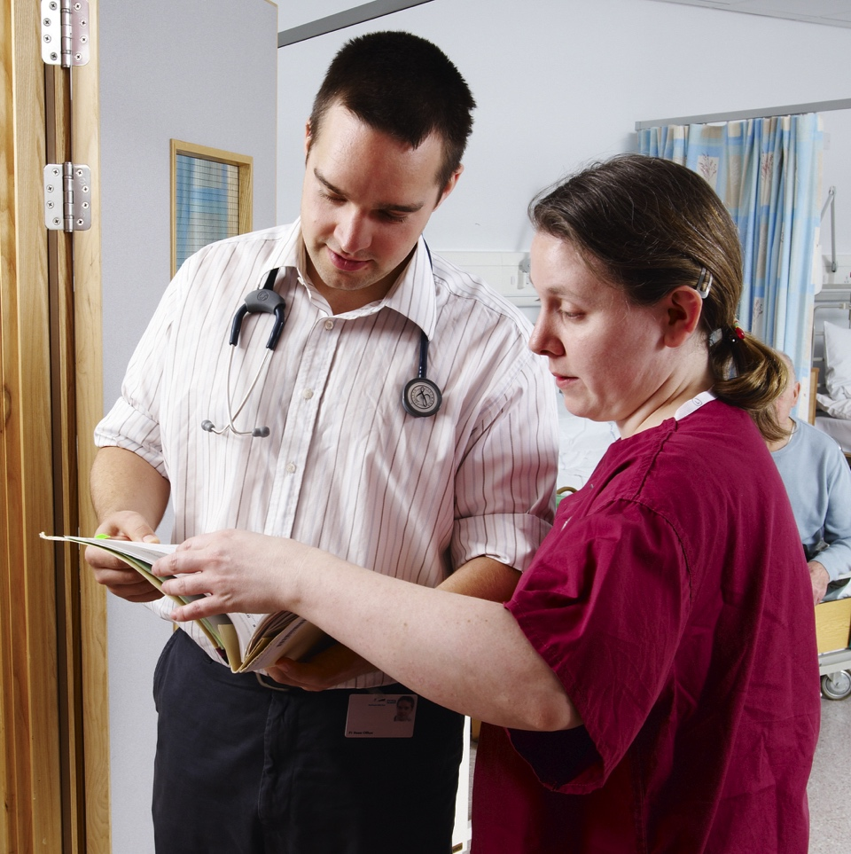
Beyond the basics: Exploring foundation training pathways and opportunities
Dr Mike Masding, National Clinical Director of the UK Foundation Programme Office
Dr Jie Fei Lau, UKFPO Fellow and F2 doctor
Dr Dasha Ibrahim, UKFPO Fellow and SFP F2 doctor (leadership)
Dr Harriet Sharp, foundation school representative for Kent, Surrey and Sussex (KSS) Foundation School and F2 doctor

Slide 2

Types of foundation programmes
Foundation Programme
Foundation Priority Programme
Specialised Foundation Programme

Slide 3
Educational Opportunities
Mandatory training
Foundation teaching programme
E-learning
Grand round
Departmental teaching
Regional study days
Courses & conferences

Slide 4
Leadership Opportunities
Resident doctor forum
Peer-teaching lead
Foundation year representative
Regional representative and Foundation Doctor Advisory Board
UKFPO fellowship
External opportunities and courses

Slide 5
Specialised Foundation Programme
Research
Project
Ethical approval
Grant writing
Publication
Presentation/ prizes
Education
Courses
UG vs PG
Feedback
Curriculum writing
Course development
Lesson planning
Publications
Presentations/ prizes
Leadership
Courses
Logbook
Governance
Care pathways
QIPs
Business case
Cost efficiency
Mentorship
Shadowing
Reflection

Slide 6


Slide 7
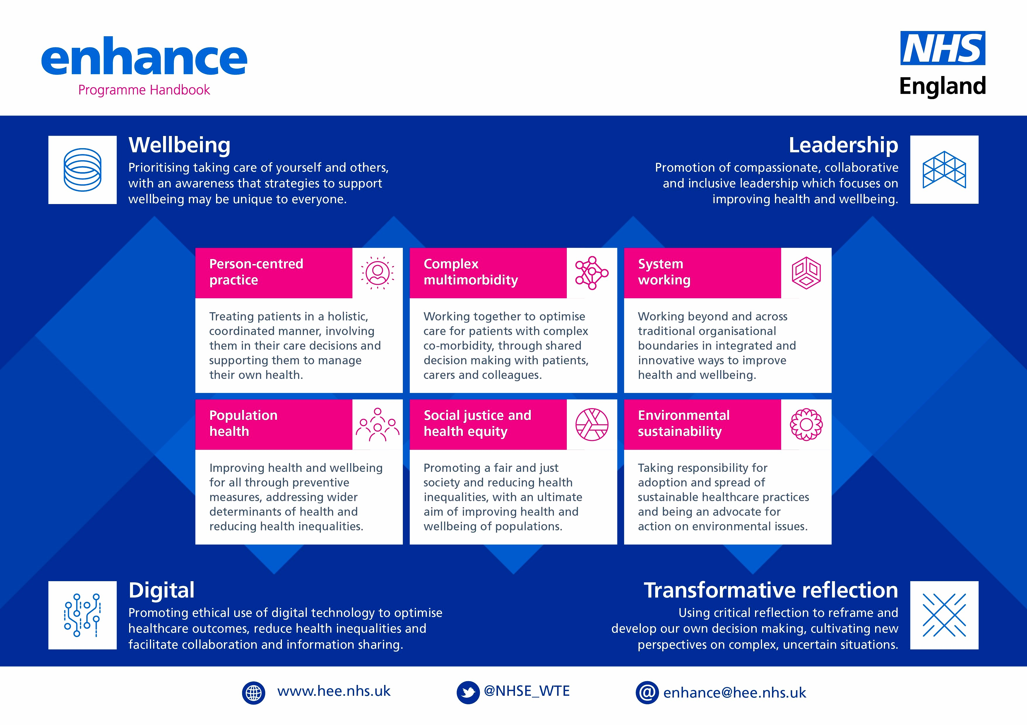

Slide 8
