Slide 1
Tips for Turas
Dr. Heather McAdam
SFP FY2, Scotland Foundation School (West)
Hon. Clinical Fellow, University of Glasgow
Dr. Wesley McLoughlin
FY2, Scotland Foundation School (East)
Hon. Clinical Fellow (Teaching), University of Dundee

Slide 2
What is Turas?
Clinical portfolio for FY1/2 in Scotland, Wales, Northern Ireland (and Malta)
Platform for resident doctors and supervisors to upload evidence for ARCP
Sections to evidence core competencies in addition to extra achievements – portfolio can be accessed post foundation programme
Same forms and requirements as Horus with some subtle differences (check relevant foundation school's website for specific guidance)
The requirements for ARCP are the same for all UK foundation doctors

Slide 3
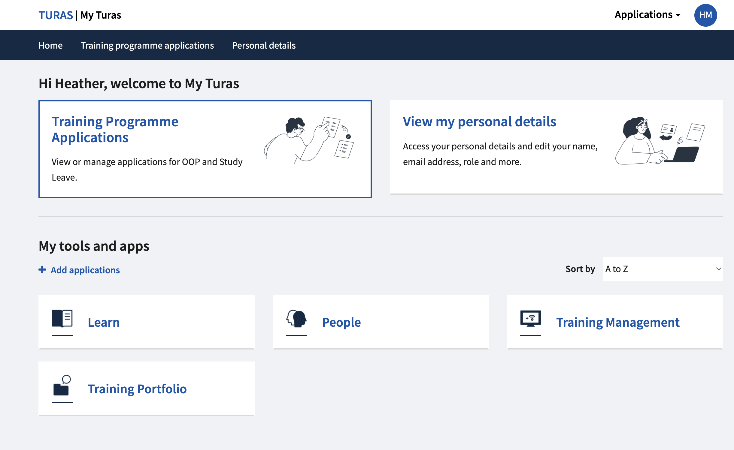
Accessing Turas

Slide 4
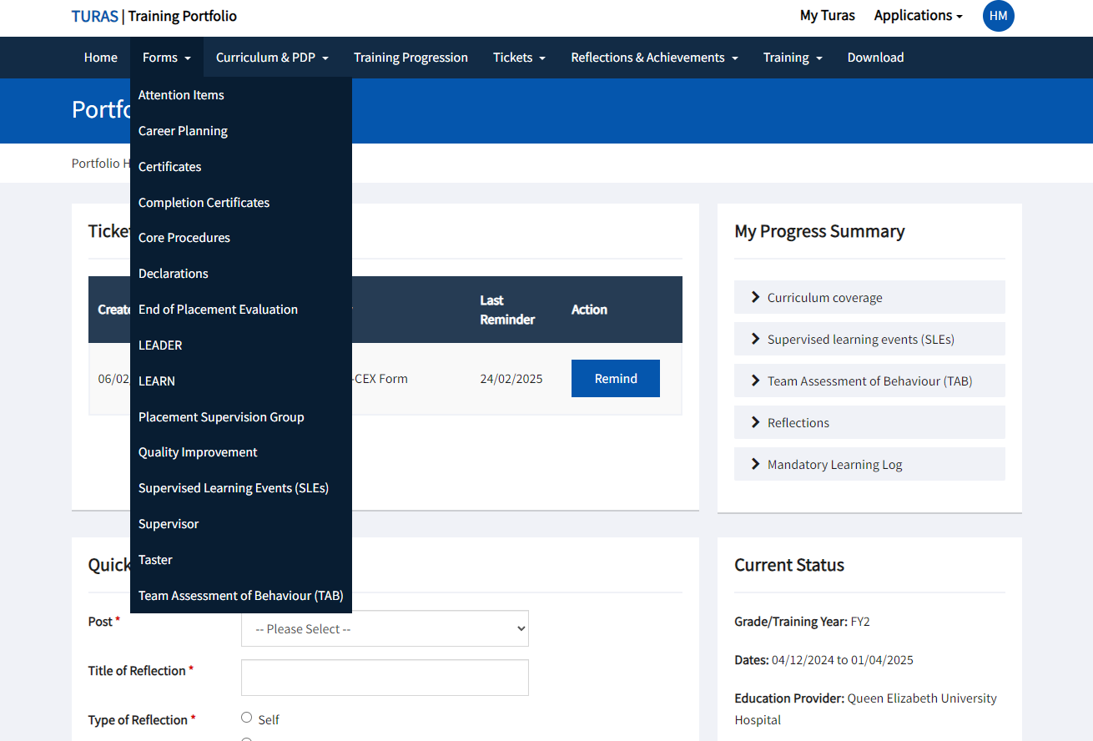
Key Areas​
Linking evidence
Trainee surveys
Teaching
PSA, ILS etc.
Start of FY1 and FY2
Essential sign-offs

Slide 5
Populating your portfolio
Check and write a list of the requirements using the 'UKFPO ARCP checklist'
Send tickets as soon as possible and send more than you need
Aim to get your TAB, PSG and quality improvement project done within the first two rotations
Upload any certificates, trainee survey receipts and teaching evidence straightaway
Check the FAQs on Turas – it will keep your right!
Any further concerns or questions, contact your supervisor +/- programme director

Slide 6
Utilise FAQs!

Slide 7
Curriculum Linking
Curriculum linkage is essential to evidence that your forms (i.e.: everything you have uploaded to Turas) covers the curriculum so you can pass ARCP
Up to 10 links per capability (FPC) with clinical experience (e.g.: SLEs) the strongest evidence
FPCs 1-5 must include evidence covering physical, social and mental health (use reflections in tickets!)
Use teaching, tasters, extra achievements etc to fill gaps
Aim to link straightaway or regularly review during each rotation
Ensure it links to your personal development plan (goals made at start of each rotation) and summary narrative (achievements at end of each rotation)

Slide 8
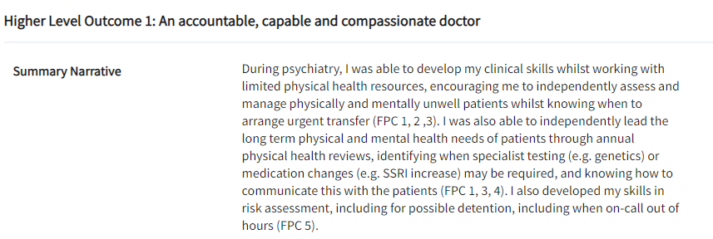
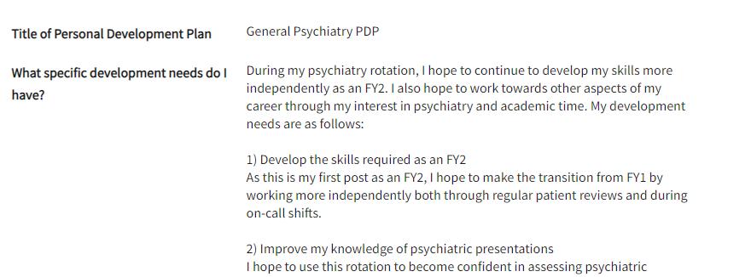
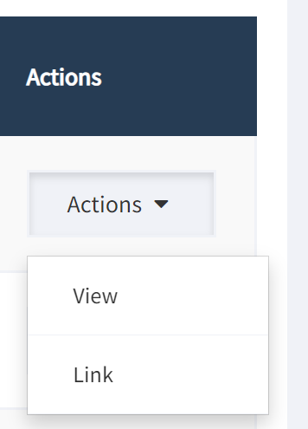
How to Link

