Slide 1
Patient safety: the PSIRF World
Dr Helen Purves
Patient safety lead

Slide 2
Patient safety before
Serious incident reviews – extensive investigations which took a large amount of time and resources. Not needed for all incidents
No real structure for investigating no harm incidents or incidents where there is learning but a full investigation is not appropriate
Did not capture psychological impact of incidents on patients and staff.
Multiple investigations reaching the same learning.
Time spent on investigations and not action plans

Slide 3
Are we counting or are we learning?
Focus on trends and charts
Celebrate numbers going up
Investigate the wrong things
RCA = months to answers
Recommendations superficial/repetitive/delayed/ineffectual
Rarely involved the patient or the staff

Slide 4
PSIRF
NHS approach to developing and maintaining systems and processes for responding to patient safety incidents
Compassionate engagement and involvement of those affected by patient safety incidents
Application of system-based approach to learning from patient safety incidents
Considered and proportionate responses to patient safety incidents
Supportive oversight focuses on strengthening response system functioning and improvement

Slide 5
Key words
Proportionate
Compassionate
System-based
Supportive oversight

Slide 7
PSIRF tools
AIR- after incident review- why it occurred, identify areas for improvement, with a focus on learning from the event and implementing system- based changes.
Thematic review – useful to understand common links or issues within a cluster of incidents
MDT review- useful for reviewing incidents in the past or where staff recollections may be difficult to collect. To identify key contributory factors and system gaps.
SWARM huddle –as soon as possible after an event. MDT discussion. Immediate safety issues identified and addressed.
PSII- similar to previous serious incident investigations

Slide 8
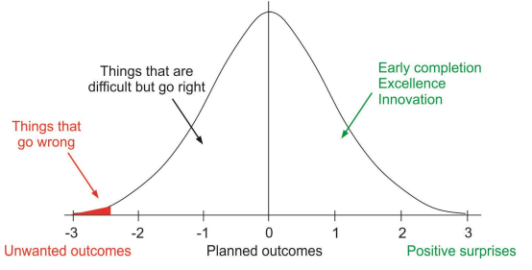
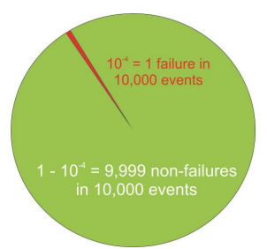
How should we learn about patient safety?
Learning from mistakes only accounts for 2 %
Potential Learning from when things went well 98%
What about all those in between?
What about the near misses?

Slide 9
PSIRF and the Foundation programme
Reflections on incidents can demonstrate multiple areas of the learning across the curriculum – FPC5 contribute to safe ongoing care, FPC8 upholding values, FPC9 Quality improvement, FPC11 Ethics and law
Quality improvement projects are often developed following incidents which highlight the need for improvement
Form R (part B) requires recording of any significant events, complaints or investigation you are named in. It is important that you reflect on these within the portfolio.

Slide 10
Patient safety can only exist in a system where everyone is prepared to learn.

