Slide 1
UKFPO
Patient safety
Dr Fiona Cameron
Consultant anaesthetist
FSD Scotland
Chair Foundation Program committee
AoMRC

Slide 2
Welcome
Dr Jei Fi Lau F2 and UKFPO Fellow- FD experience of patient safety
Dr Helen Purves– Experiences of/learning through PSIRF (NHSE)
Dr Fiona Cameron- 4 nation resources
All- Q&A
Please use Q&A facility to ask questions. Questions will be answered at the end
The presentation will be recorded and published on the UKFPO you tube channel

Slide 4
Curriculum requirements
From 2025 all FDs will be required to evidence patient safety in the portfolio
Learning- face to face or on MS teams, e-lfh, e-learning resources
Signposted in SLEs
Reflections
Summary narrative

Slide 5
4 nation resources
NHSE -Patient Safety Incident Response Framework, https://www.england.nhs.uk/patient-safety/
NHS Scotland NES
https://learn.nes.nhs.scot/514/patient-safety-zone
https://www.ihub.scot/improvement-programmes/scottish-patient-safety-programme-spsp/
Wales – HEWI https://www.gov.wales/sites/default/files/publications/2021-09/quality-and-safety-framework-learning-and-improving_0.pdf

Slide 6
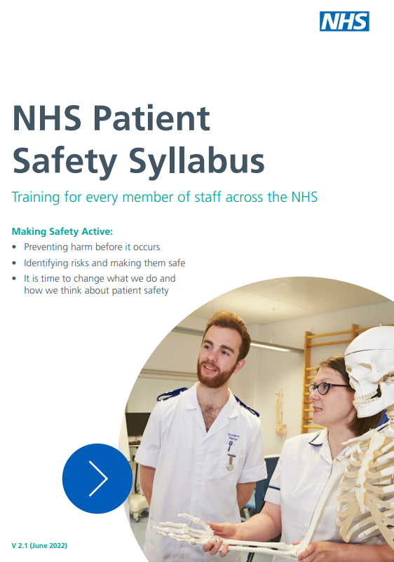

Slide 7
Scottish Patient safety program
(SPSP)
The Scottish Patient Safety Programme (SPSP) is a national quality improvement programme that aims to improve the safety and reliability of care and reduce harm.
Since its launch in 2008, the Scottish Patient Safety Programme has expanded to support improvements in safety across a wide range of care settings. This includes acute, primary care, mental health, perinatal, paediatric services and medicines safety.
The SPSP has three core components as follows:
SPSP Essentials of Safe Care
SPSP Programmes of Work
SPSP Learning System

Slide 8
Wales patient safety and human factors
https://heiw.nhs.wales/education-and-training/dental/quality-improvement/patient-safety-and-human-factors/

Slide 9
Thank you

