Slide 1
Preparing for ARCP – Time to polish up your e-portfolio
Dr Jie Fei Lau (FY2 UKFPO Fellow, North West Foundation School)

Slide 2
What should your e-portfolio look like for ARCP?
A good mix of supervised learning events (SLEs)
Minimum 60 hours of core/non-core teaching
Summary narrative
Notes:
As a guide, most FDs need to accrue at least 5 to 10 SLEs per four-month placement to ensure they
have sufficient amounts and variety of evidence to
show that they have covered the whole curriculum.

Slide 3
Supervised Learning Events
Mini-CEX
CBD
DOPS
DCT
LEARN
LEADER

Slide 8
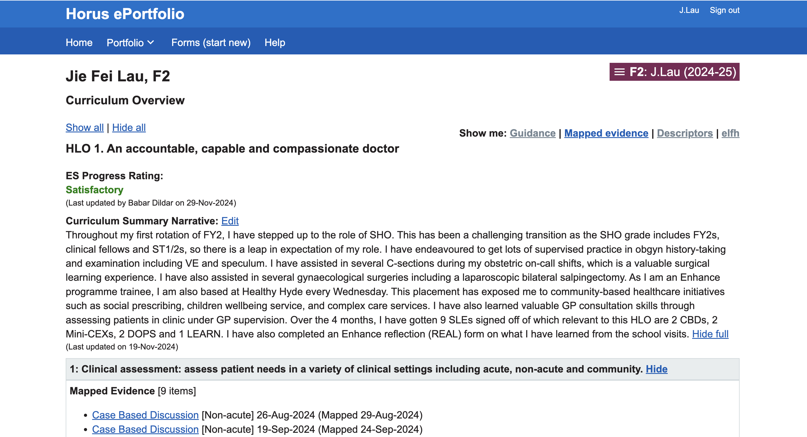
Summary narratives

Slide 11
E-LFH modules (extra-learning!)

Slide 12
Additional achievement forms
Taster
Publication
Research
Procedure
Exam
Course
Interesting case
Career planning
Extra-curricular achievement
Reflection on Enhance Activities and Learning (REAL)

Slide 15
Dr Jie Fei Lau, FY2
Humans of the Foundation Programme
Celebrating the stories, experiences and diversity of foundation doctors
Notes:
Who am I.
Why am I speaking to you today.

Slide 16
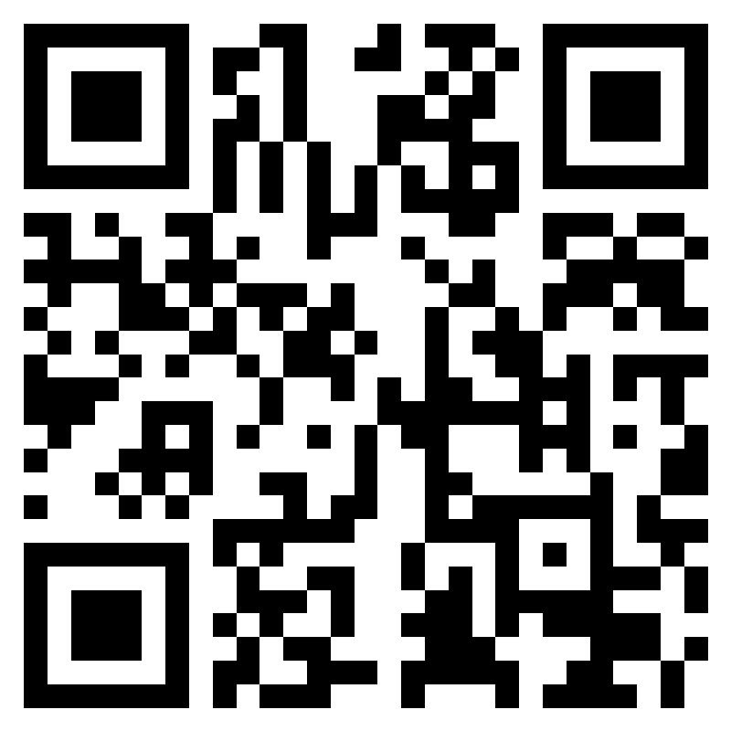
Remote and rural
Medical Humanities
Transitioning into foundation training
Sharing best practise
Notes:
Current project
Breakdown of the sections
How can you get involved?
How can we expand and continue and grow together

Slide 17
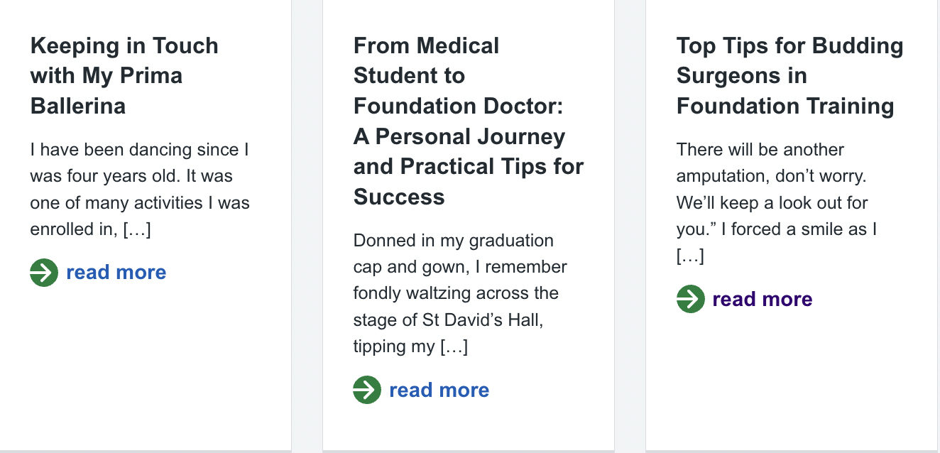
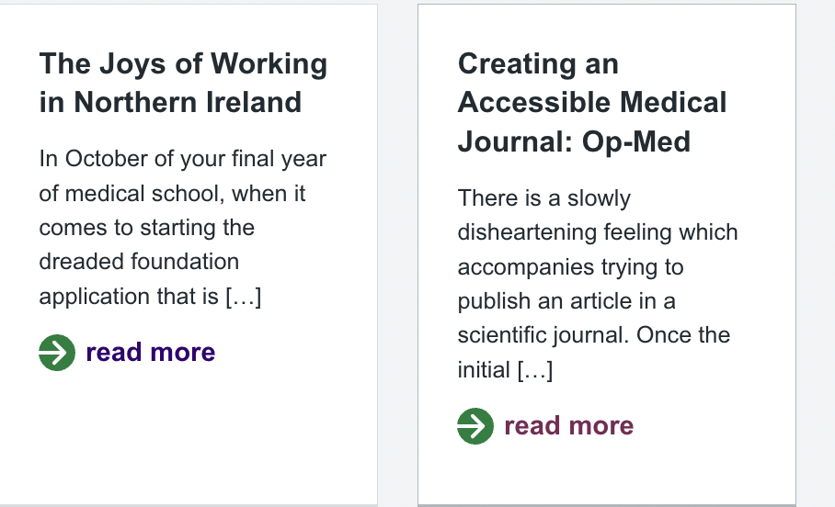
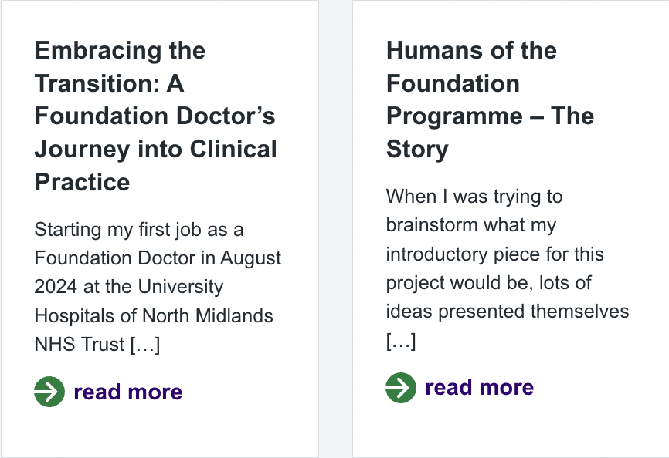
The project is live!
Notes:
Feedback

Slide 18
My top tips & advice for FD
Explore
Consistency
Variety
Start that TAB now!
Use e-LFH to supplement your learning

Slide 19
My top tips for clinical/educational supervisors
Engage
Inspire
Stay on track
Make every moment teachable

Slide 20
Thank you!
Jiefei.lau@tgh.nhs.uk

