Slide 1
Supporting Trainees Entering Practice (STEP) webinar 27 February 2024 Dr Clare Van Hamel, FSD, Severn Foundation School Dr Alice Carter, FSD, London Foundation School Dr Tom Yapp, Senior Advisor UKFPO & FSD, Wales Foundation School Elaine Colaco, Head of UKFPO Content also relevant for 2025 and timeline updated

Slide 2
Introductions
Welcome & introductions
Dr Tom Yapp – UKFPO Senior Advisor, Foundation School Director (Wales)
Dr Alice Carter – Foundation School Director (London)
Dr Clare van Hamel – Foundation School Director (Severn)
Elaine Colaҫo – Head of UKFPO
Webinar will be recorded, and link will be available on UKFPO website
We will answer pre-submitted questions at the end of the presentation.

Slide 3
Overview
What is a STEP form ?
Who should complete one ?
When to complete it ?
How to complete it ?
Who will it be shared with ?
What happens next ?

Slide 4
What is STEP ?
Supportive process which aims to help graduates transition into the Foundation Programme and the workplace
We know that everyone is likely to feel nervous/ anxious as they start the Foundation Programme.
Opportunity for you to explain previous and ongoing challenges
Ensures foundation schools and employers have the right information to allow them to provide appropriate support and ensure this is in place in a TIMELY way

Slide 5
The GMC
‘Organisations must have a process for sharing information between all relevant organisations whenever they identify safety, wellbeing or fitness to practice concerns about a learner, particularly when a learner is progressing to the next stage of training’
Notes:
STEP form enables this to happen. For UK medical graduates this will be online. Signed by medical school. Fir IMGs, word document

Slide 6
Who should complete a STEP form?
All applicants to the foundation programme must complete a form.
UK Medical School Students complete the form online – your medical school will contact you about the process
Non-UK/Eligibility applicants complete an offline Word version of the form (this includes UK applicants who graduated 2+ years ago) and email this to the allocated foundation school.
Completion of the STEP form does not impact your foundation school allocation (STEP takes place after allocation). It is also very unlikely to impact your programme/posts, unless your circumstances require it.

Slide 7
Conceptual organisations
Organise and deliver training of Foundation Doctors
Coordinate with NHS Trusts / health boards and LEPs (local education providers)
Maintain links with medical school(s)
Offer support to doctors in a range of settings
Foundation Schools

Slide 8
Role of each organisation in relation to STEP
UKFPO
Facilitates STEP process and the online form, provides guidance to medical schools, foundation schools and applicants.
Foundation School
Foundation School Director (FSD)
Receives & reviews all STEP forms for incoming F1 doctors.
They will pass the form on to your Foundation Training Programme Director (FTPD) and Medical Education team.
There is a box you can tick on the form if happy you are for the FSD to contact you before you start F1. If you ticked this box, they may contact you once they receive your form to discuss who, apart from the FTPD and Medical Education team, may be best placed to receive this information, bearing in mind the principle that it should only be shared with those who have a real need to be informed .

Slide 9
Role of each organisation in relation to STEP continued…..
Employer (NHS Trust / Health board / LEP)
Foundation Training Programme Director (FTPD) & Medical Education Team
They look after foundation training in your allocated trust/health board/LEP.
They may feel that your Educational Supervisor, who is responsible for educational development and progress, needs to see the contents of your form and will discuss this with you. The contents of your form will only be shared with your Educational Supervisor or anyone else, with your consent.
Medical Staffing & Occupational Health
In some cases, information may need to be shared with these departments at your allocated employer as they have legal duties that the information will help them to fulfil. E.g. they have a legal duty to consider making reasonable adjustments for employees. This will only be done with your consent.

Slide 10
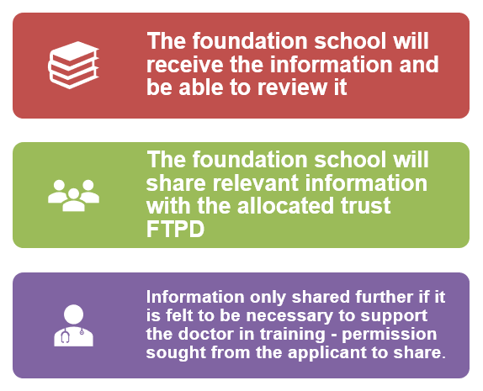
Who will the information be shared with ?

Slide 11
The STEP form
The form has four sections: Health, Welfare, Personal Performance and Skills, Professionalism
Once completed, the forms is reviewed by the nominated medical school staff member(s) to ensure the relevant information has been given.

Slide 12
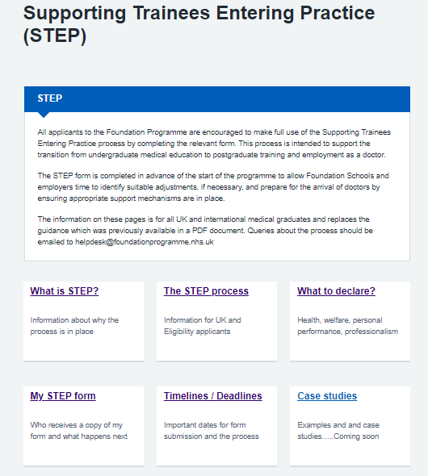
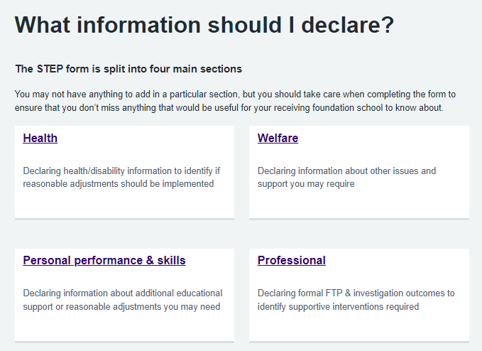
STEP Guidance
Guidance about the process and completing the form is on the UKFPO website: https://foundationprogramme.nhs.uk/resources/supporting-trainees-entering-practice-step/

Slide 13
Timeline
https://foundationprogramme.nhs.uk/resources/supporting-trainees-entering-practice-step/step-timeline-and-deadlines/
What | When
Online STEP form available for use (UK medical schools only) Word version of the form available for use (Eligibility applicants) | Monday 3 March
UK medical schools liaise with their students about the STEP process and completing the form. | March onwards
UK medical schools review forms. Each form is signed and approved by medical school team | March – May
Deadline for medical schools to have approved & submitted all forms on the online portal | Friday 9 May
Foundation School Director’s (FSDs) in each foundation school review the STEP forms for their incoming F1 doctors | May – June
Foundation schools liaise with employers to ensure that any reasonable adjustments that an applicant requires can be put in place for the start of the training programme. | May – July

Slide 14
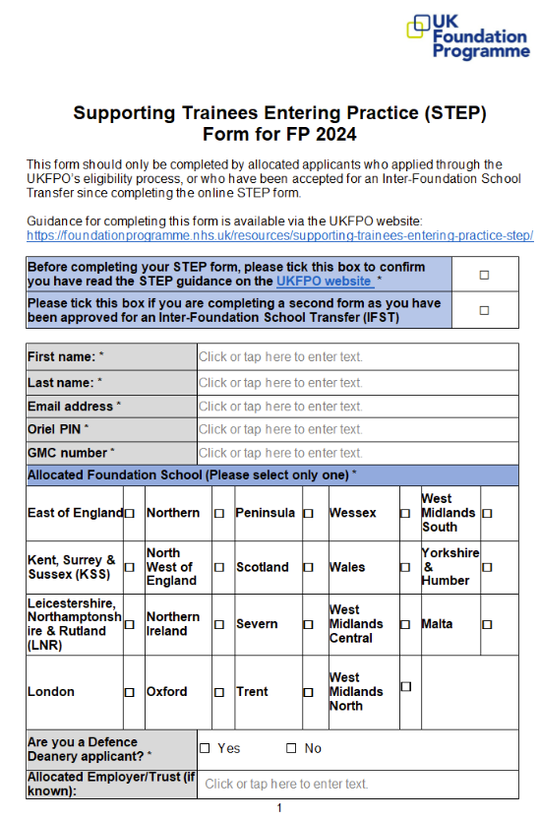
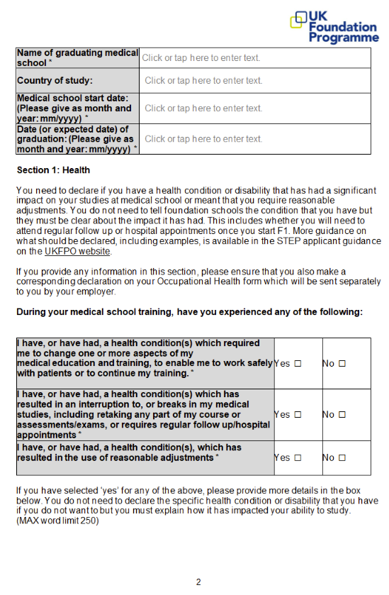

Slide 15
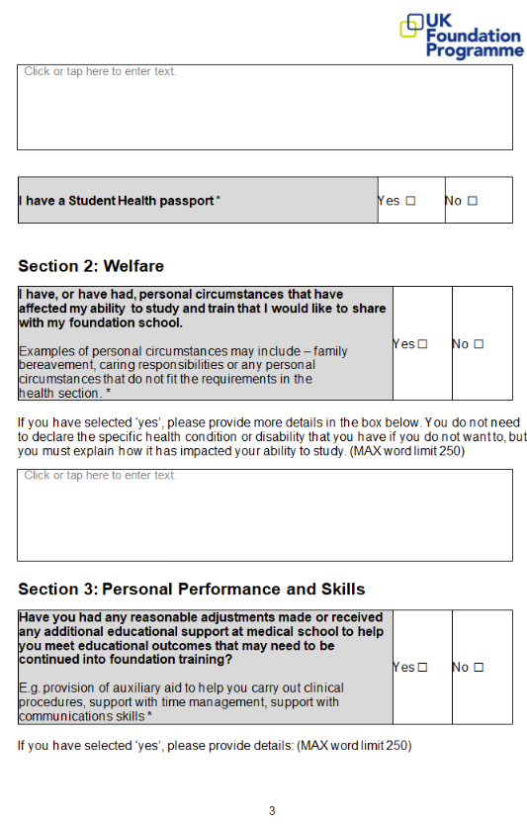
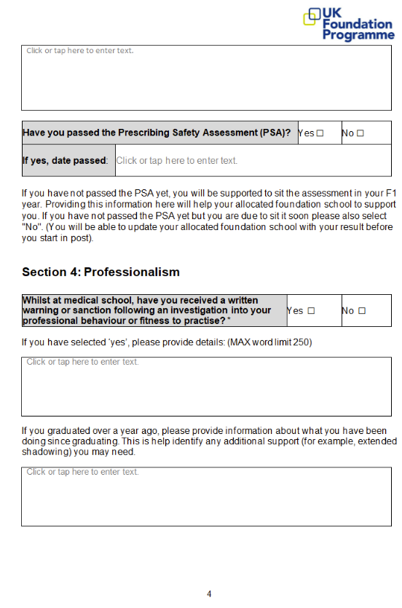

Slide 16
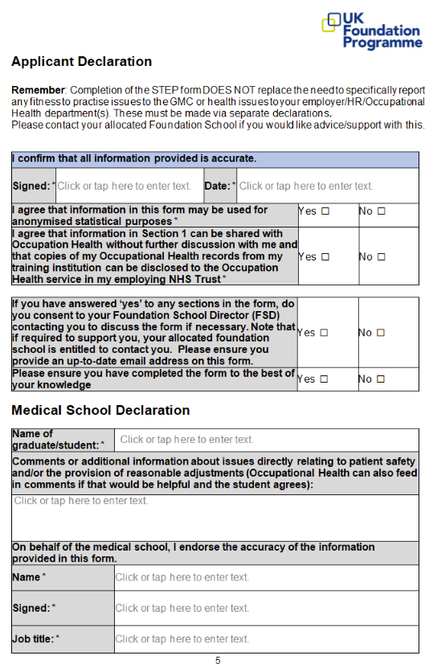

Slide 17
Examples
An incoming doctor needing hearing loops in areas they will be working
Doctors who have ongoing health appointments; liaising with their employers about how this can be managed within their work schedules
Plans to work less than full time (LTFT) and discuss between the department and the doctor how best to deliver this
Anxious doctors put in touch with their future foundation faculty to ensure they know who will be offering support

Slide 18
What STEP does not do
Completion of the STEP form does not replace the need to report any fitness to practice issues to the GMC or to inform the employing organisations/Local Education Provider’s (LEP) HR or Occupational Health departments of any health issues.
Doesn’t guarantee all requested adjustments or timeframes for adjustments to be made/put in place
Doesn’t guarantee adjustments to allocated placements/rotations
Less than full time training (LTFT) has a separate application process. Some of the same staff will be involved – info will be on Deanery websites. Foundation School teams can point applicants towards this
Information given by student/medical school in a pre-allocation form doesn’t always get passed to the Trust. Sometimes it might get passed onto the FTPD. Important to put same info on STEP form.

Slide 19
Examples
If you don’t tell ‘us’ we cannot plan support options in readiness for your transition

Slide 20
Case 1
UK medical graduate
Known ADHD and dyslexia
Moving away from family support (Dr’s choice)
Following receipt of STEP form
ACCESS to work – laptop and software
Workload reviewed
FTPD and FSD support meetings

Slide 21
Case 2
International Medical Graduate
Known health issues at medical school
Repeated year 1 and year 4
Reluctant to share information. STEP form not completed.
Deferred start due to mental health reasons
Started in trust – struggled with post 1
OH referral made, took a few months, advised reasonable adjustments, supported but further periods off work.
Extension time required to complete F1.

Slide 22
Case Example
Pre-recorded account of an F1 doctor's experience of using the STEP process
Current F1 doctor, James, from the London Foundation School
Notes:
Managing expectations
Certain groups may find additional challenges to starting Foundation
Additional support to specific groups:
IMGs
Graduate entry/older

Slide 23
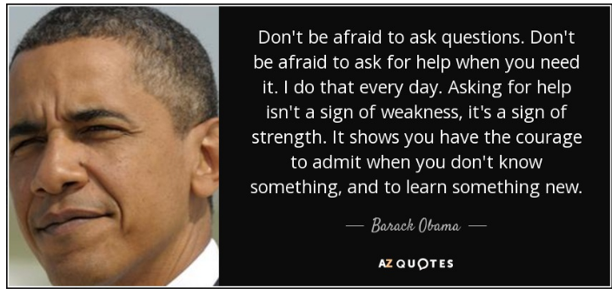
Notes:
Managing expectations
Certain groups may find additional challenges to starting Foundation
Additional support to specific groups:
IMGs
Graduate entry/older

