Slide 1
Ethical Decision-Making for Everyday Clinical Practice
UK FPO Webinar Series
Professor Laura L. Machin
Dr Phil Spencer
Dr Lina Hamad

Slide 2
What is ethics?

Slide 3
What is ethics?
Does ethics matter for foundation doctors?

Slide 4
What is ethics?
Isn’t ethics all about the ‘big’ stuff?
Does ethics matter for foundation doctors?

Slide 5
What is ethics?
Isn’t ethics all about the ‘big’ stuff?
Can’t I just trust my gut instinct?
Does ethics matter for foundation doctors?

Slide 6
What is ethics?
Isn’t ethics all about the ‘big’ stuff?
But surely, it’s the law that matters at the end of the day?
Can’t I just trust my gut instinct?
Does ethics matter for foundation doctors?

Slide 7
Case Study: Panel Discussion
Mr. X is a 50-year-old man who presented to A&E with chest pain. His observations are normal, but he has nonspecific ST-changes on his ECG and borderline troponin levels.
He initially agreed to admission for observation and investigation, but after a lengthy wait in A&E for a bed, he has become fed up and now says he is going to leave because “I need a cigarette, and nothing is being done anyway”. Although evidence for a myocardial infarction is lacking, it is strongly suspected that his pain is due to ischaemic heart disease.
The on-call F2 doctor has attended for a discussion with Mr X. In the course of the conversation Mr X says that he is quite happy to sign whatever form is needed, but he is going to leave.
The F2 is uncertain of her responsibilities and whether she should become complicit in helping him to leave by prescribing cardiac medication for him before he goes.

Slide 8
The four principles
Respect for autonomy - literally ‘self-rule’
Beneficence – the duty to maximize benefit or minimize harm (a positive duty)
Non-maleficence – the duty to avoid causing harm (a negative duty)
Justice
Moral justice – rights, fairness, resource allocation, etc.
Legal justice – what does the law demand, allow, and prohibit?

Slide 9
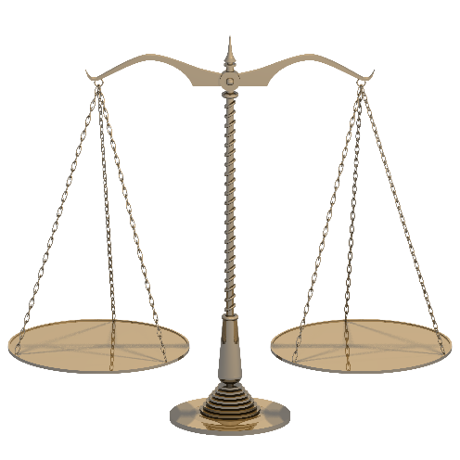
Remember that …
Ethics enables you to justify and give reasons for why you chose a particular course of action.

Slide 10
Remember that…
Sometimes ethical principles will impose conflicting demands on us. We are then facing an ethical dilemma. In such situations, we must make a choice about which obligation we will prioritise and why.
Note that there is no ranking, or order of importance, implied by the four principles. All carry equal weight. So, two people may apply the same ethical principles but still disagree on the ‘best’ course of action, but at least the point of disagreement becomes explicitly clear.
In practice, it is often helpful to consider what the law says first, because we must abide by the law whatever the ethics tells us (the two do not always agree!).

Slide 11
In summary…
When facing a challenging dilemma, ask yourself:
what does the law require or permit?
what does the GMC say?
what moral demands are imposed by the 4Ps?
…And use that as the starting point for deliberation
There may be more than one morally justifiable option
Ethics is not about giving you the ‘right’ answer, it is a means of applying logic and reasoning to your thinking.

