Slide 1
Good Quality Written Feedback
Dr Lorraine Parks
FSD Northern Ireland
17 September 2024

Slide 2
Purpose of Feedback
Essential for professional development
Enhances & facilitates reflection, learning & improvement
Measures performance & progress (current v previous v desired)
E-portfolio evidence of improvement (SLEs) and achievement of curriculum outcomes (TAB, PSG, EOP CSRs & ESRs)

Slide 3
Types of written feedback
Supervised Learning Events; DOPS, CBD, Mini-CEX
Multisource Feedback; TAB
Placement Supervision Group (PSG)
End of Placement Reports; CSR, ESR
Formative v Summative

Slide 4
Characteristics of Good Feedback
Timely
Accurate, honest, fair, non-judgemental
Specific, structured, descriptive
Relevant to expected level of performance
Constructive
Directed towards agreed learning goals
Include action plan for further development

Slide 5
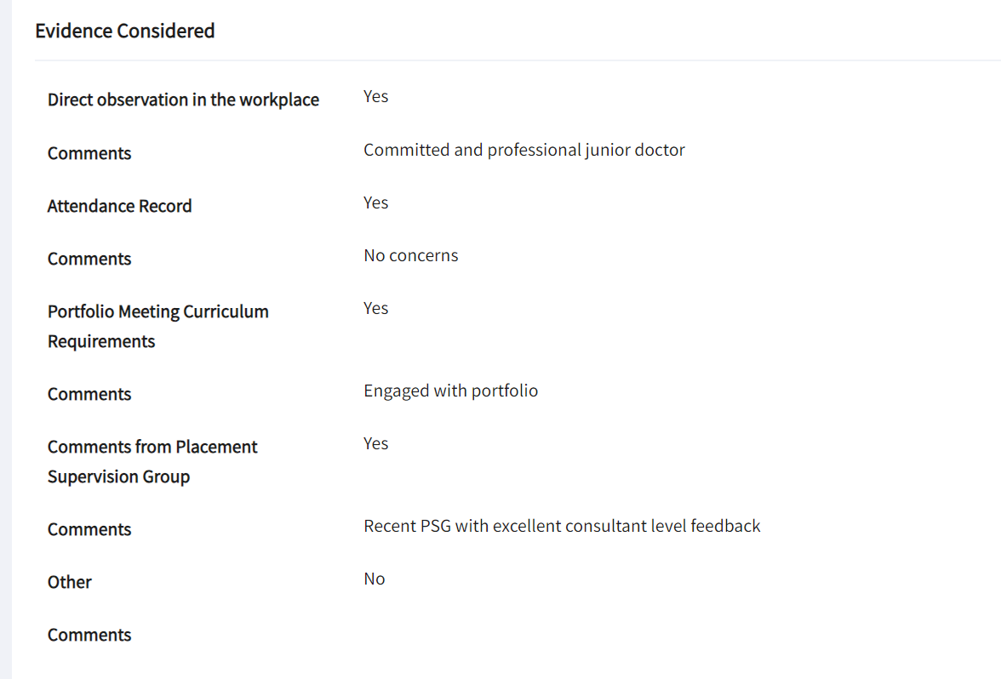
Basic CS Report

Slide 6
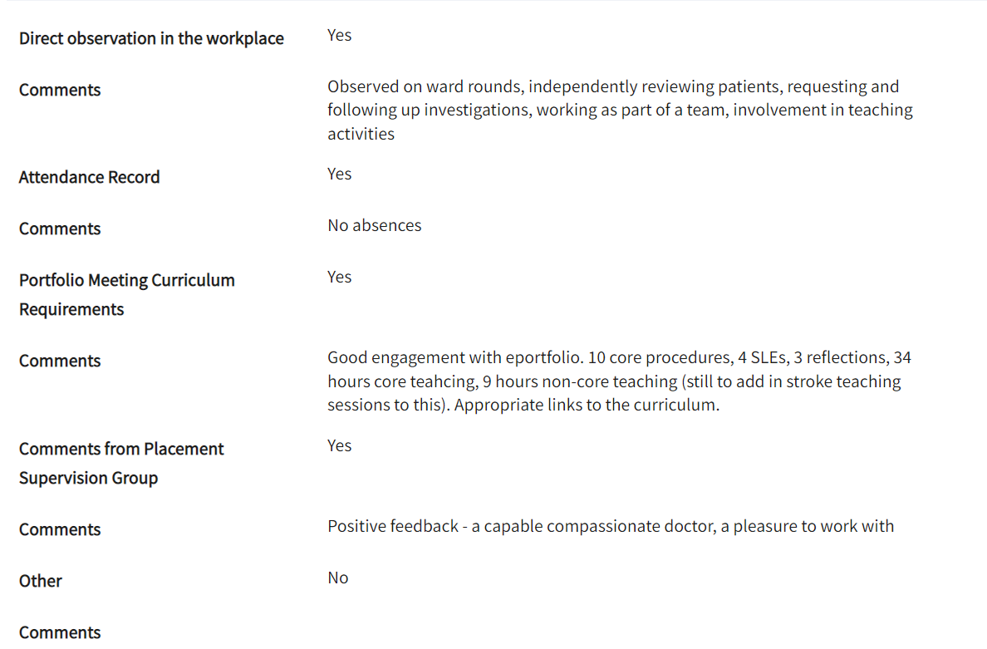
Better CS Report

Slide 7
Less useful feedback
No concerns
Performed procedure competently
Should improve with more experience
Got the line in on 3rd attempt; with practice will improve
Completed history, exam and discussed range of treatment options

Slide 8
More useful feedback
“ You explained the procedure very clearly to the patient, used the correct aseptic technique, and provided reassurance when the patient became anxious. Throughout this learning event, you exhibited excellent communication and technical skills, showing a high level of situational awareness and clinical competence ………
Maybe consider having a spare needle available next time to minimise delay or interruption to the procedure ………
As you may not get an opportunity to perform this technique again on a patient for some time, you might wish to consider practising on the simulator to maintain and develop your skills further ….

Slide 9
Thank you for listening
“Feedback, when given well, should not alienate the receiver of the feedback, but should motivate them to perform better.”

