Slide 1
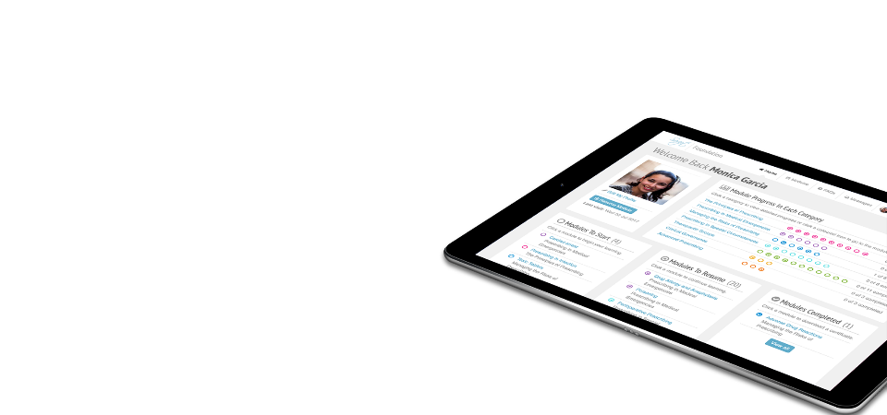
eLearning to improve prescribing and support the safe, effective use of medicines
Hannah Vallance
SCRIPT eLearning Manager, University of Birmingham

Slide 2
Our Learners
125 modules
spanning the NHS workforce
Over 95% of Foundation trainee doctors used SCRIPT in 2022/23
Over 16,000
medical and nursing students
1 million modules completed
across all SCRIPT portfolios
2010
Available to all NHS staff
Now

Slide 3
Aims
Support learning in prescribing and medicines
Encourage safe, effective, and rational prescribing
Standardise prescribing education across the NHS workforce
Provide a platform for learners and supervisors to interact to monitor educational progress and initiate feedback

Slide 4
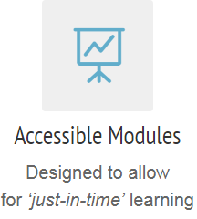
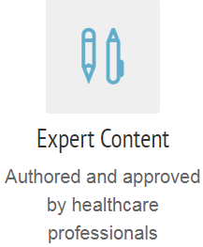
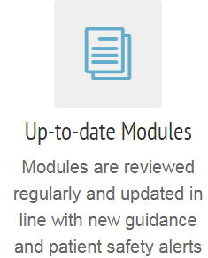
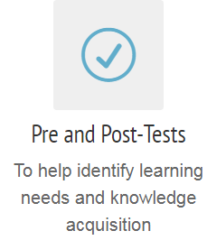
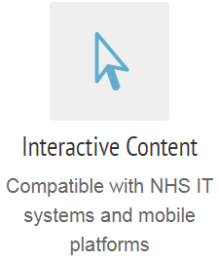
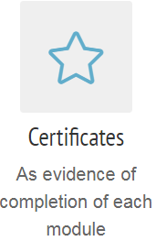
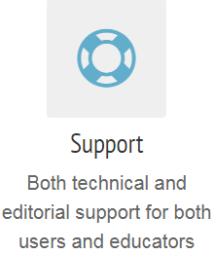
Programme

Slide 5
Medicine and Surgery
55 modules
Wide range of subjects in prescribing and therapeutics
Clear learning outcomes

Slide 6
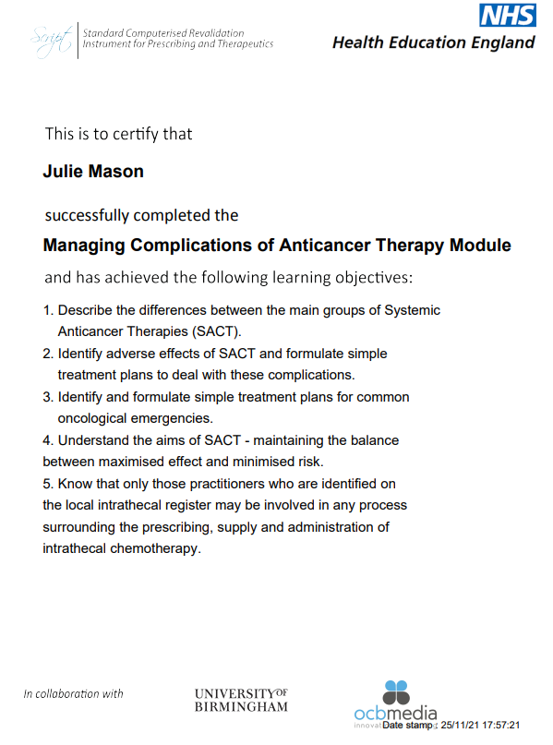
Certification
Date & time stamped
Learning objectives
No set pass mark
Downloadable (PDF)
Always available on your profile

Slide 7
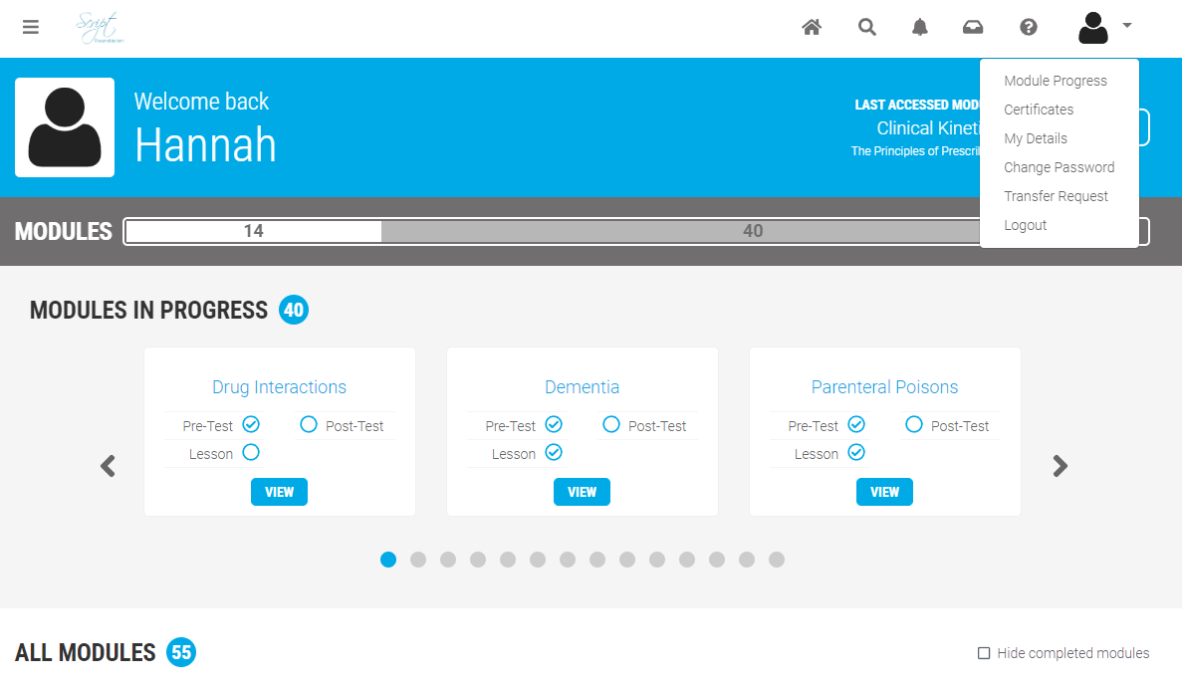
Registration
Trainees not previously registered:
https://foundation.safeprescriber.org/login
Transfer request for trainees previously registered:

Slide 8
SCRIPT module and PSA Preparation
PSA Themes | SCRIPT module
Underpinning Principles Calculation Skills (Section 5) Planning Management (Section 3) Prescribing (Section 1) Prescription Review (Section 2) | Adverse Drug Reactions Adherence Dosing and Calculation Drug Interactions Formulation: An Overview for Prescribers Administration: An Overview for Prescribers Hepatic Dysfunction | Older People Pregnancy Prescribing in Infection Prescription Documentation Renal Dysfunction Utilising the BNF(C)
Therapeutics Adverse Drugs Reactions (Section 6) Data Interpretation (Section 8) Drug Monitoring (Section 7) Prescribing (Section 1) Prescription Review (Section 2) Providing Information (Section 4) | Anticoagulation Part (1) Anticoagulation Part (2) Diabetes Medical Emergencies in Diabetes Disorders of Psychosis Drug Allergy and Anaphylaxis | Fluids (Principles) Fluids: Practical Prescribing in Adults Infection in Secondary Care Parenteral Poisons Sepsis in Hospital Toxic Tablets

Slide 9
Feedback: Content Development

Slide 10
Feedback: Common themes
Feedback form
Mandatory modules
Minimum time spent on module
Pass marks
Resetting modules
Accessibility
Layout/length
Clinical content

Slide 11
Contact Us
www.safeprescriber.org
Email for technical queries: info@safeprescriber.org
Email for clinical queries:
script@contacts.bham.ac.uk
Follow us @safeprescriber

Slide 12
Questions
Any questions?

