Slide 1
Evidencing prescribing in e-portfolio
Dr Dasha Ibrahim & Dr Jie Fei Lau (UKFPO fellows)

Slide 2
Demonstrating and evidencing
SLEs
CBD
Mini-CEX
Reflections

Slide 3
Example topics
Dosing and calculations:
Discussion pharmacist on ward- TTO prescribing and dosing of Ferinject in a patient
Pain management:
Limited choice of analgesia e.g. gastroduodenal ulcers
Analgesia dependent patient
Multi-team approach- medics, pharmacy, pain team
Palliative and End of Life
Anticipatory medication prescribing and difficult conversations with family- supporting a dying patient
Involvement of palliative care team

Slide 4
Teaching
Online
In person

Slide 5
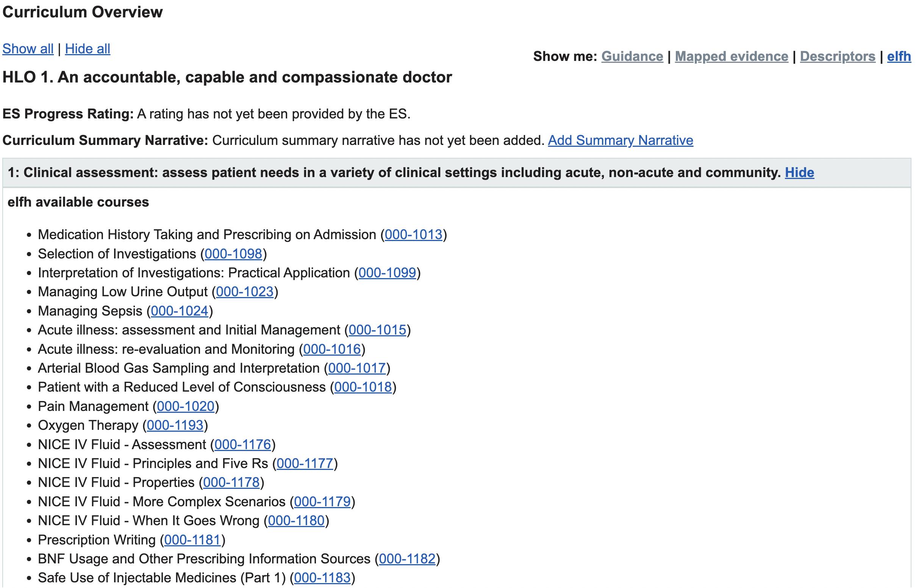

Slide 10
Thank you! Questions

