Slide 1
Leadership development for Foundation Doctors: experiences and resources
30 April 2024
Ms Kirsten Armit | Dr Josie Cheetham | Dr Jamie Smyth | Dr Shehryar Khan |Miss Ria Bhandari

Slide 2
Who we are
Ms Kirsten Armit Director of Research, FMLM PhD candidate at Bayes Business School, City, University of London. | Dr Josie Cheetham FMLM Trainee Steering Group Chair GPST3, South Wales, MSc Med Ed RSM Trainee Section Council President BMA GP registrar committee lead for Wales Medical Women's Federation PG doctor rep for Wales
Dr Shehryar Khan FMLM Clinical Fellow FMLM Douglas Fellow and NHS England Fellow Psychiatry ST1 Medical Advisor | Dr Jamie Smyth Public Health Specialist Trainee – ST2 National Medical Director’s Clinical Fellow 2022-2023
Miss Ria Bhandari FMLM Medical Student Group Chair 4th Year Medical Student

Slide 3
What we will discuss today
Introduce the FMLM Leadership and management standards for medical professionals
Share research evidence about why medical leadership matters
Present resources available to support leadership development
Provide insights and top tips from the leadership development experiences of doctors in training and students.

Slide 4
About FMLM
To inspire and promote excellence in medical leadership to drive continuous improvement in health and healthcare in the UK
Professionalise medical leadership and management
Improve the quality of leadership through evidence-based research
Leadership development

Slide 5
Leadership and management standards for medical professionals (3rd edition, 2021)
UK medical and dental professionals | All specialties | All career stages | All sectors
www.fmlm.ac.uk/standards
Self
Self awareness and development
Personal resilience, drive and energy
Team
Effective teamwork
Cross team collaborations
Organisation
Organisational team player
Organisational culture, improvement and innovation
System
System leadership
Notes:
The definition of the professional standards of medical leadership and management is long overdue given the importance of effective leadership to the quality of patient care, and the increasing accountability and responsibility faced by medical leaders. Currently, there is no clarity regarding the expectations for medical leaders and no "gold standard" of achievement against which applicants for medical leadership and management roles can assess themselves and be measured.
The UK medical profession has a distinguished international reputation for clinical standards; it needs to replicate this for leadership and management. This was emphasised in the 2012 ‘Report of the Mid-Staffordshire NHS Foundation Trust Public Inquiry’ which called for “stronger healthcare leadership” and “the recognition that healthcare management and leadership is, or should be treated as a profession”.

Slide 6
Experiences developing and applying leadership
Dr Shehryar Khan FMLM Clinical Fellow FMLM Douglas Fellow and NHS England Fellow Psychiatry ST1 Medical Advisor | Dr Josie Cheetham FMLM Trainee Steering Group Chair GPST3, South Wales, MSc Med Ed RSM Trainee Section Council President BMA GP registrar committee lead for Wales Medical Women's Federation PG doctor rep for Wales
Miss Ria Bhandari FMLM Medical Student Group Chair 4th Year Medical Student | Dr Jamie Smyth Public Health Specialist Trainee – ST2 National Medical Director’s Clinical Fellow 2022-2023

Slide 7
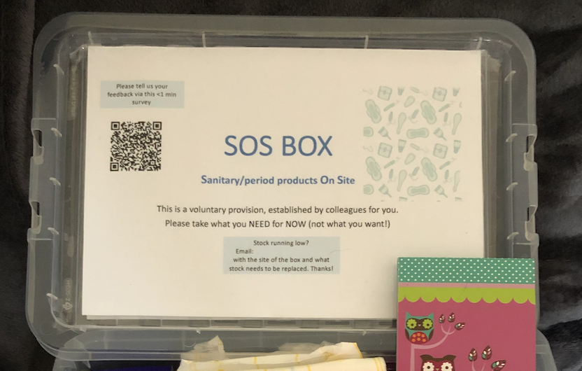
Leadership: my journey
F1
F2
Year out
CT1
CT2
GPST1
GPST2
GPST3
Informally, as a doctor in training

Slide 8
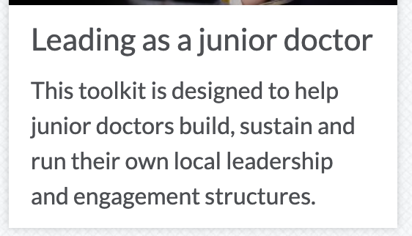
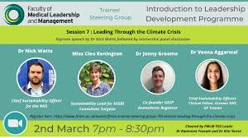
The TSG: leadership is for all
Case studies
Collating opportunities
Toolkits
X book club
Report from surveys and focus groups
Free leadership webinar series

Slide 9
Leadership as a Medical Student
Character, Competence, Commitment
Societies, Causes & Initiatives
Mentoring
Qualifications

Slide 10
Top tips!
Dr Shehryar Khan FMLM Clinical Fellow FMLM Douglas Fellow and NHS England Fellow Psychiatry ST1 Medical Advisor | Dr Josie Cheetham FMLM Trainee Steering Group Chair GPST3, South Wales, MSc Med Ed RSM Trainee Section Council President BMA GP registrar committee lead for Wales Medical Women's Federation PG doctor rep for Wales
Miss Ria Bhandari FMLM Medical Student Group Chair 4th Year Medical Student | Dr Jamie Smyth Public Health Specialist Trainee – ST2 National Medical Director’s Clinical Fellow 2022-2023

Slide 11
Why leadership matters
“Leadership is the most influential factor – every interaction by every leader every day shapes the culture of the organisation and communicates values.”
(Prof Michael West, Lilly lecture, 2015)
Leadership effectiveness associated with higher ratings of clinical governance and lower patient complaints. ^{[1]}
Relationship between leadership and patient complaints - explained by care quality climate ie a collective commitment to put the needs of the patient first, regardless of other operational pressures. ^{[1]}
Strong association between HR practices (appraisal, training, teamworking) and patient mortality. ^{[2]}
UK public enquiries into health service failures repeatedly point to the lack of clinical leadership and need for clinical leadership.
“The recognition that healthcare management and leadership is, or should be treated as a profession, is important.” ^{[3]}

Slide 12
Why medical leadership
Involvement of doctors at a senior strategic and organisational governance level has a positive impact on clinical engagement, staffing ratios and organisational (quality and financial) performance. ^{[9-22]}
Assumed that positive effects due to:
combination of knowledge and credibility, which leads to better decision-making, and engagement from clinicians throughout the organisation in quality improvement initiatives ^{[9,10,22]}
hybrid status made them potential ‘boundary spanners’ who strengthen the capacity of organisations and systems to improve the quality of services. ^{[23,24]}
MDs undertake several important areas of work: translation, diplomatic, repair ^{[24]}
Organisations with greater medical engagement have lower mortality rates, fewer serious incidents, higher levels of service provision, sound financial status, higher delivery of targets and core standards. ^{[27]}

Slide 13
Supporting resources
Guidance to support leadership development and assessment (for supervisors, educators, trainers)
https://www.fmlm.ac.uk/members/resources/leadership-and-management-development-and-assessment
Commitment to junior doctors (aimed at employers)
https://www.fmlm.ac.uk/members/resources/fmlm-leadership-commitment-for-junior-doctors
Toolkit for junior doctors on leadership
https://www.fmlm.ac.uk/members/resources/leading-as-a-junior-doctor
Webinars
https://app.medall.org/event-listings/fmlm-tsg-leadership-webinar-for-international-medical-graduates
https://app.medall.org/contents/v-leadership-and-management-for-foundation-doctors
https://app.medall.org/contents/v-leadership-fellowships-the-what-why-and-how

Slide 14
Contact details
Ms Kirsten Armit Kirsten.armit@fmlm.ac.uk | Dr Josie Cheetham josiech@me.com / tsg.chair@fmlm.ac.uk @drjosiech @FMLM_TSG
Dr Shehryar Khan www.linkedin.com/in/dr-shehryar-khan | Dr Jamie Smyth Jamie.smyth1@nhs.net
Miss Ria Bhandari www.linkedin.com/in/riabhandari

