Slide 1
FP Curriculum 2021
Tony Choules (Chair AoMRC Foundation Programme Committee)
Fiona Cameron (Assessment Lead)

Slide 2
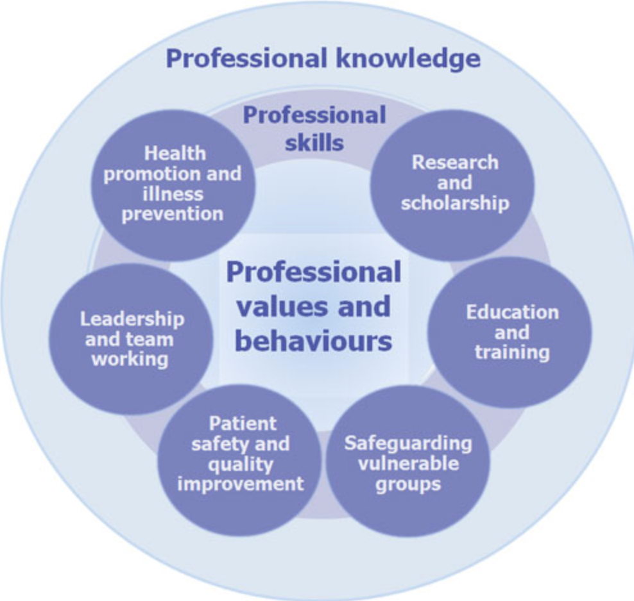

Slide 4
Example Foundation Programme Rotation
Emergency medicine
Urology
Paediatrics
Diabetes and Endocrinology
Psychiatry
Trauma and orthopaedics
F1
F2

Slide 5
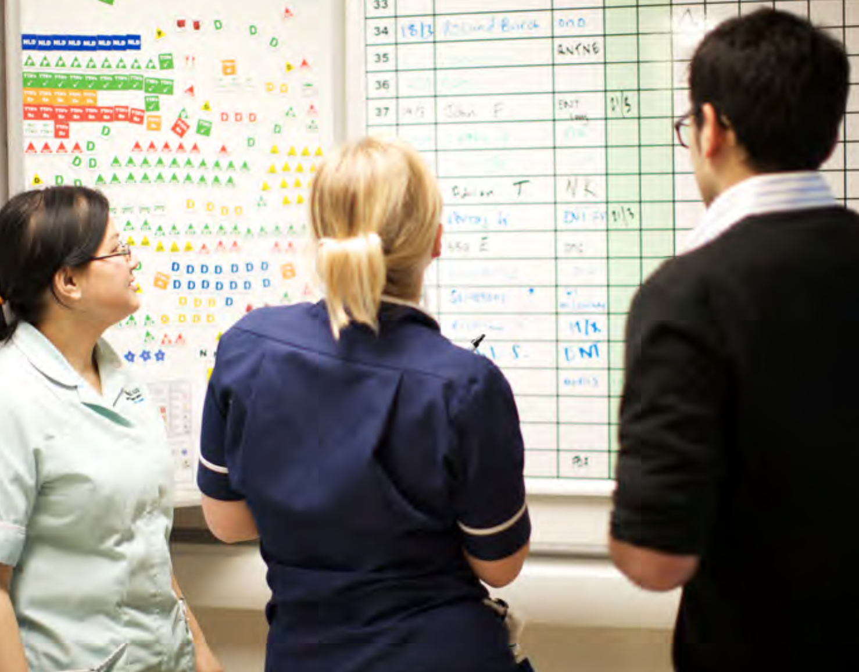
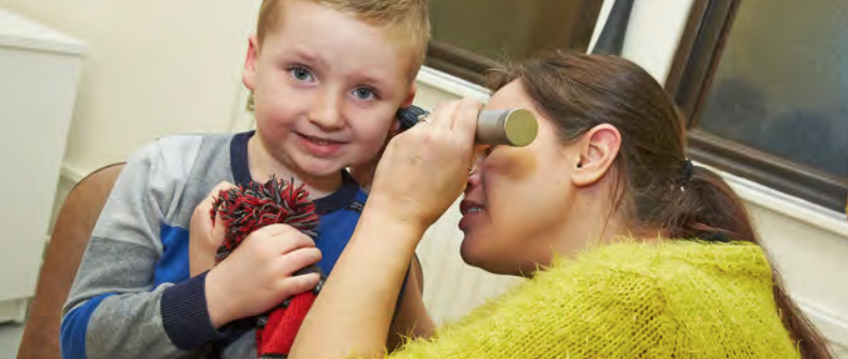
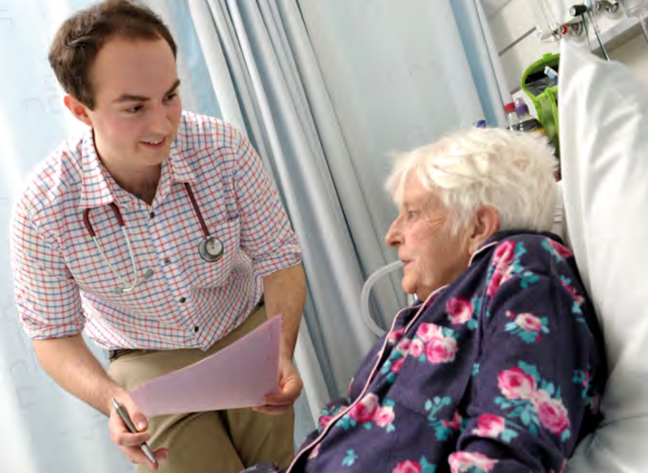
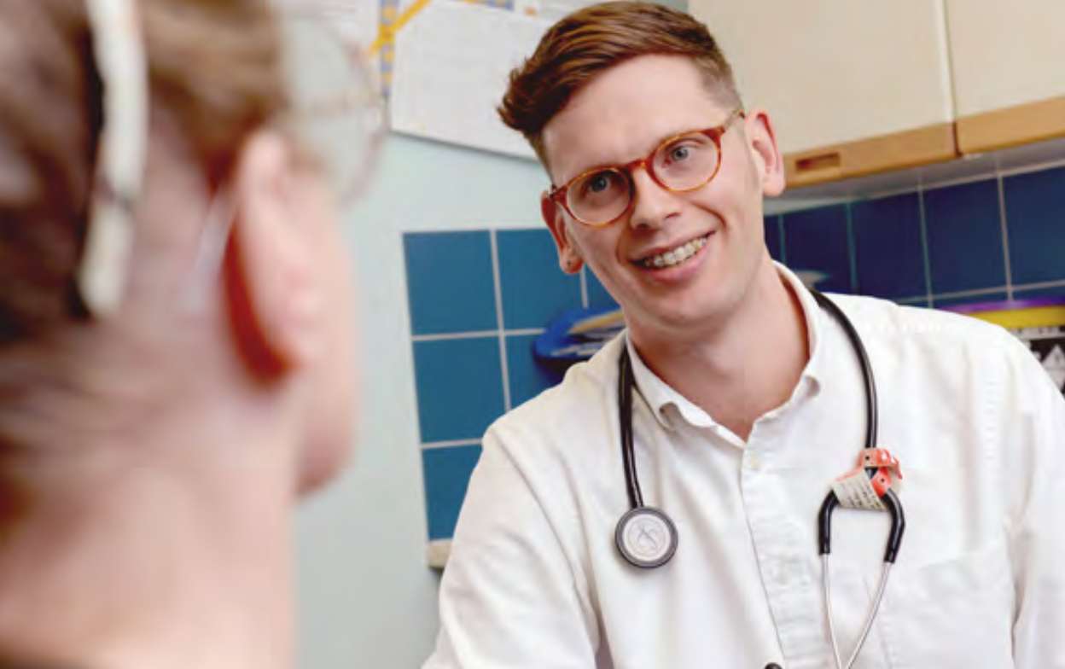

Slide 6
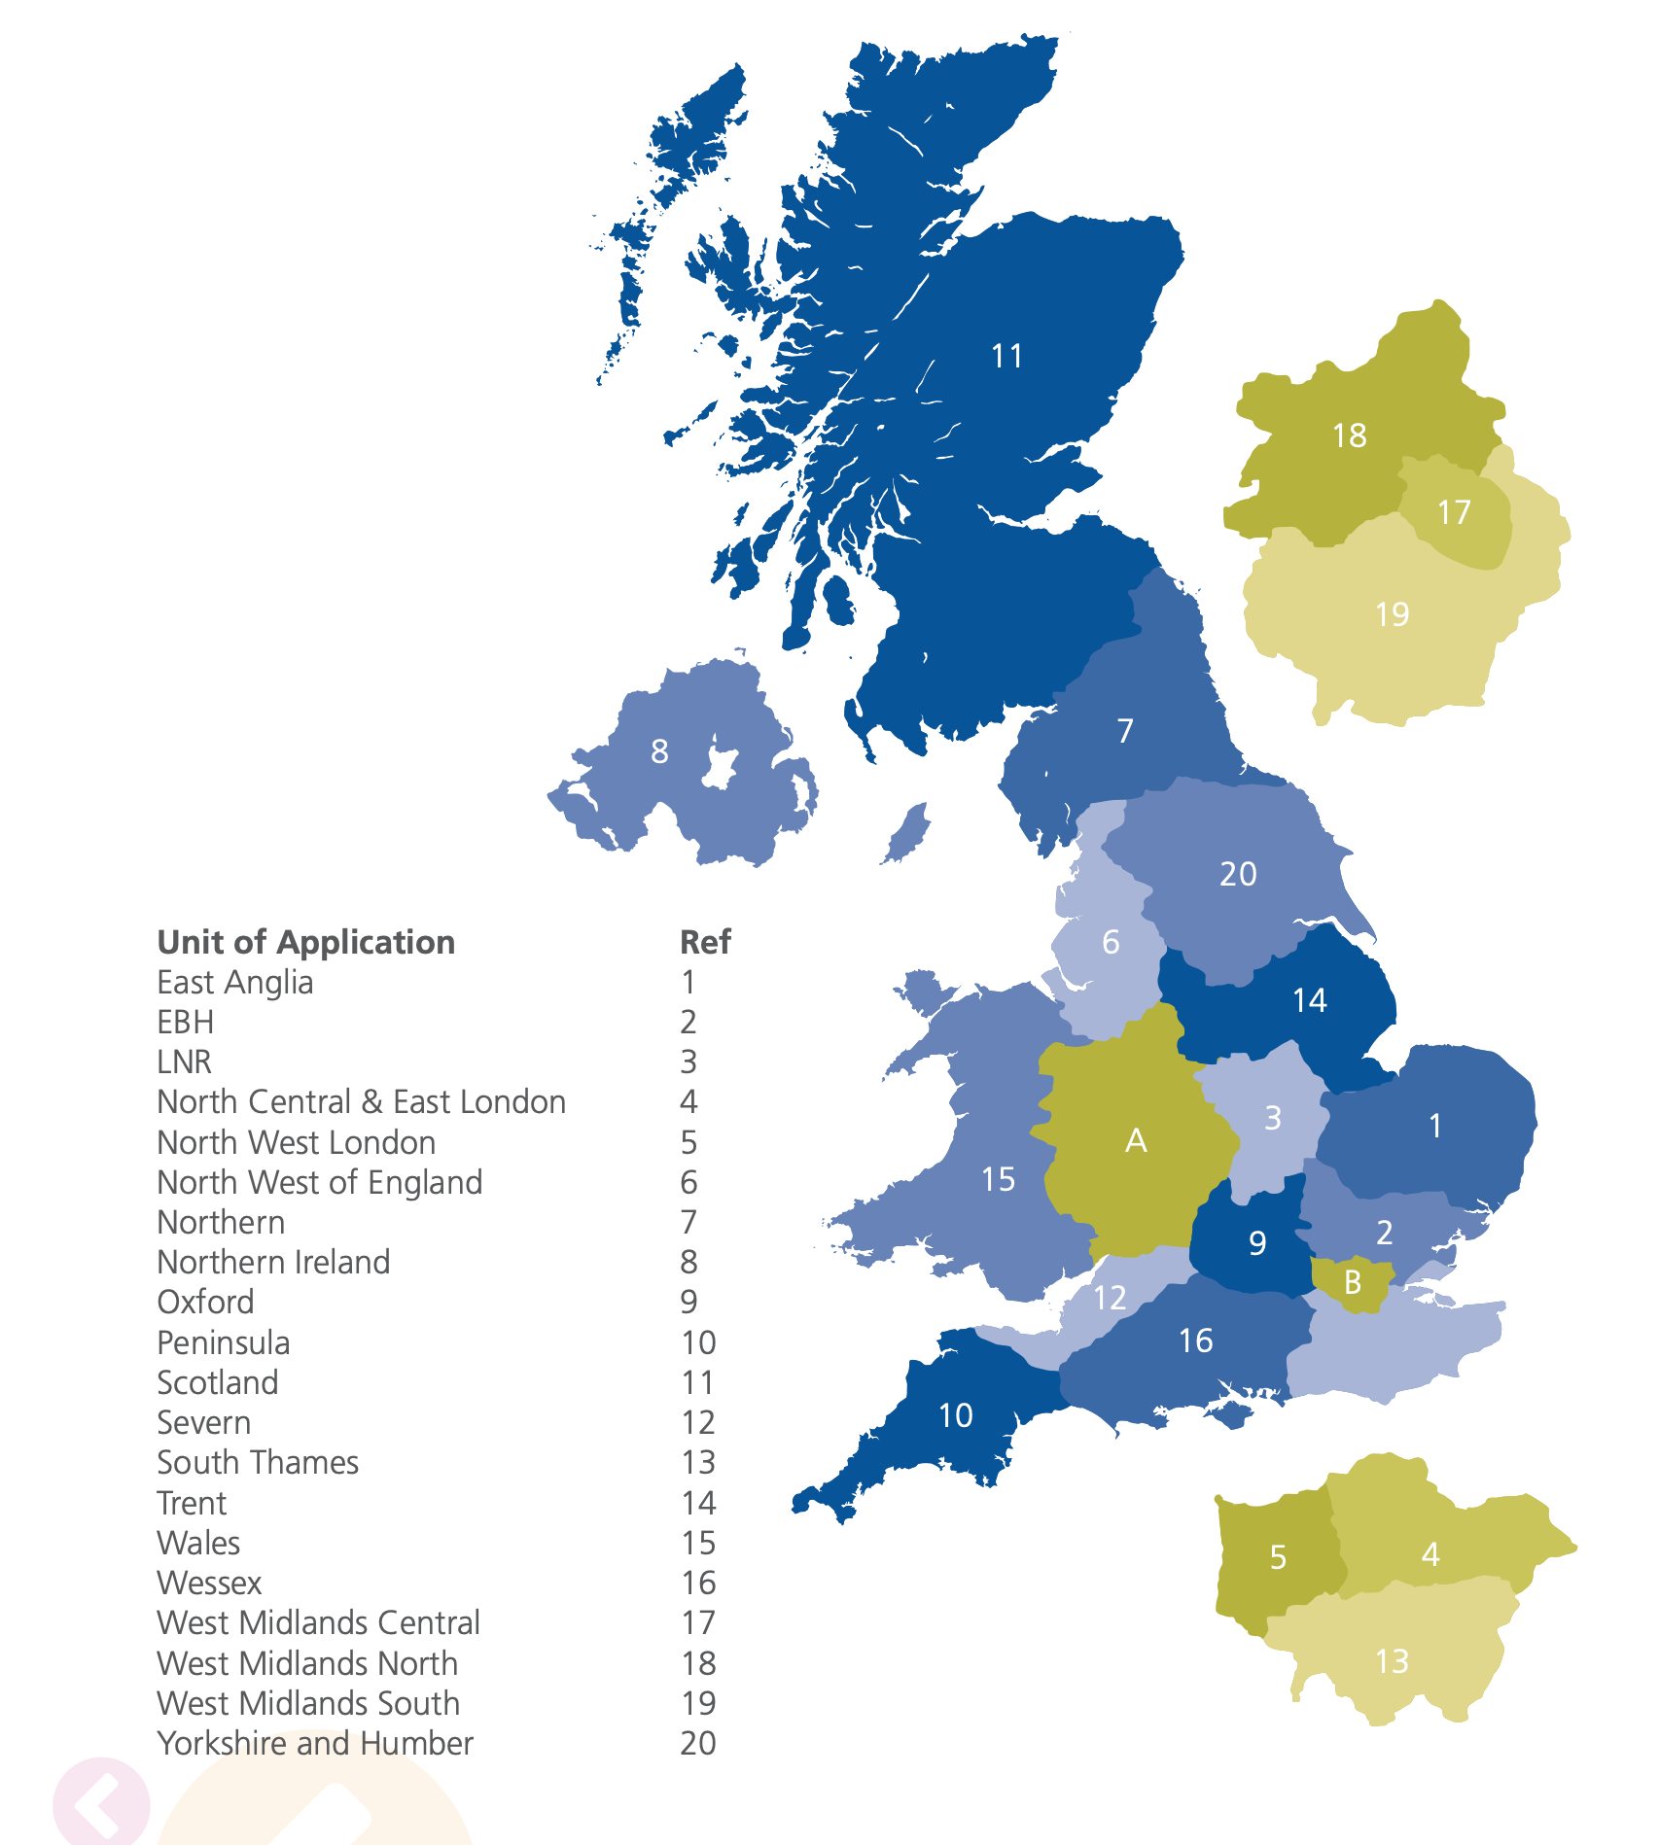

Slide 8
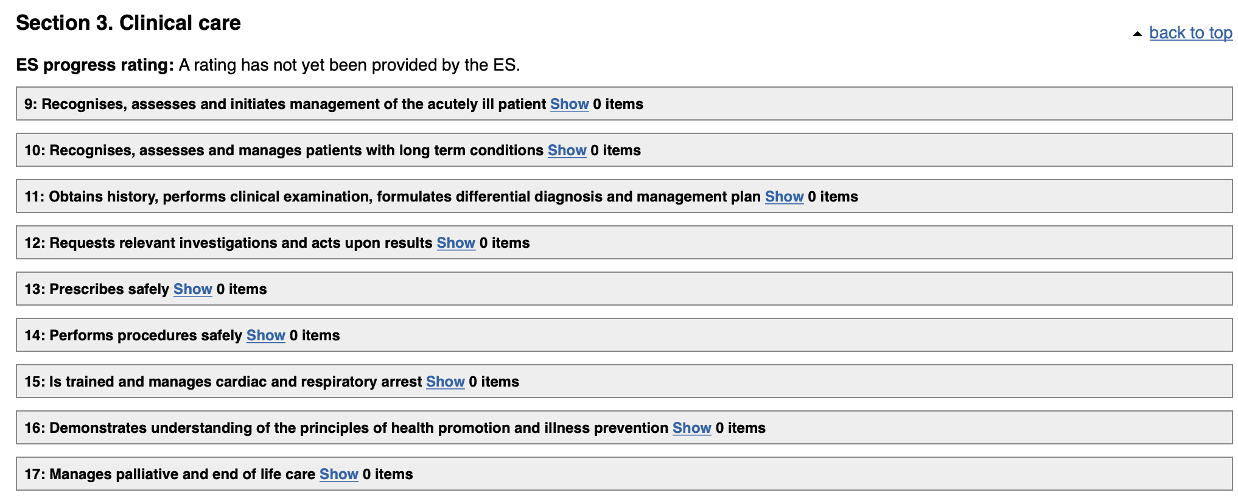

Slide 9
2016 curriculum
4 outcomes
20 capabilities
2021 curriculum
3 outcomes
13 capabilities

Slide 10
The accountable, capable and compassionate doctor
Clinical Assessment: Assess patient needs in a variety of clinical settings including acute, non-acute and community
Clinical Prioritisation: Recognise and, where appropriate, initiate urgent treatment of deterioration in physical and mental health
Holistic Planning: Diagnose and formulate treatment plans (with appropriate supervision) that include ethical consideration of the physical, psychological and social needs of the patient
Communication and Care: Provide clear explanations to patients/carers, agree a plan and deliver health care advice and treatment where appropriate
Continuity of Care: Contribute to safe ongoing care both in and out of hours

Slide 11
The valuable member of healthcare workforce
Sharing the Vision: Work confidently within and, where appropriate, guide the multiprofessional team to deliver a consistently high standard of patient care based on sound ethical principles
Fitness to Practice: Develop the skills necessary to manage their own personal wellbeing
Upholding Values: Act as a responsible employee including speaking up when others do not act in accordance with the values of the healthcare system
Quality Improvement: Take an active part in processes to improve the quality of care
Teaching the Teacher: Teach and present effectively

Slide 12
The professional, responsible for their own practice and portfolio development
Ethics and Law: Demonstrate professional practice in line with the curriculum, GMC and other statutory requirements through development of a professional portfolio
Continuing Professional Development: Develop practice including the acquisition of new knowledge and skills through experiential learning; acceptance of feedback and, if necessary, remediation; reading and, if appropriate, by research
Understanding Medicine: Understand the breadth of medical practice and plan a career

Slide 13
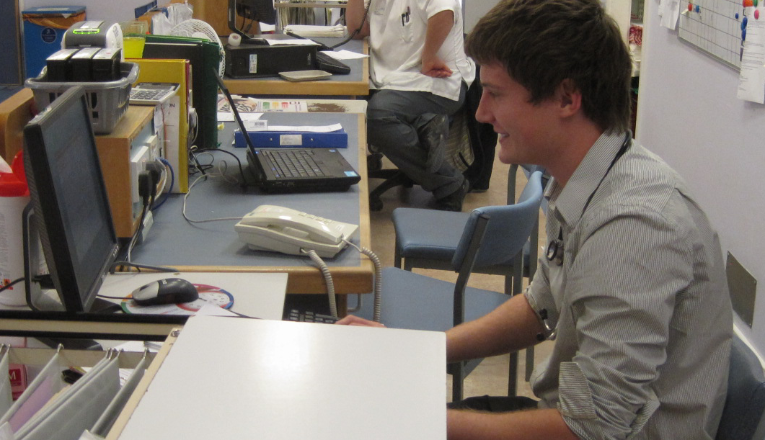
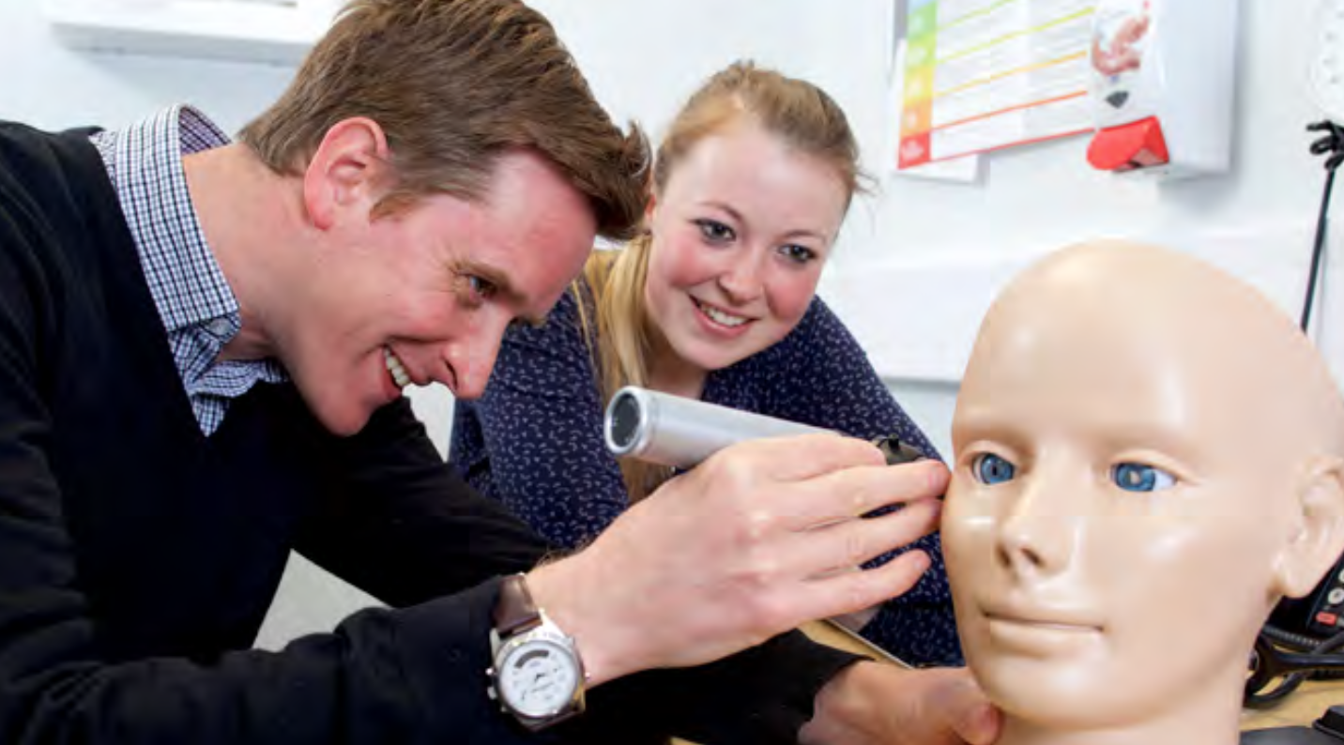
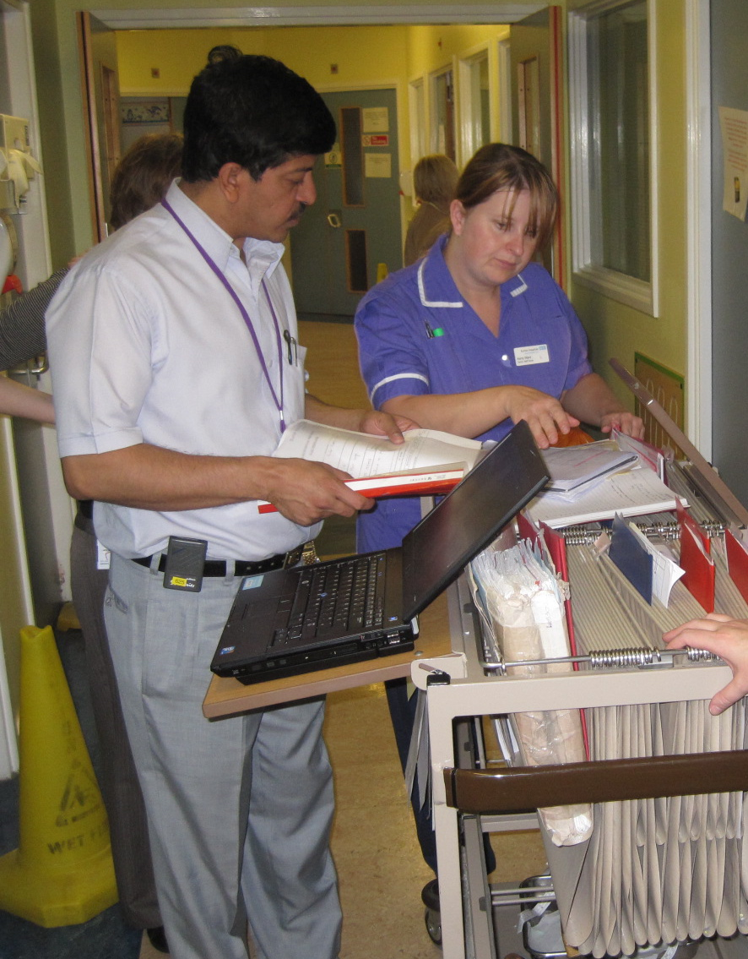
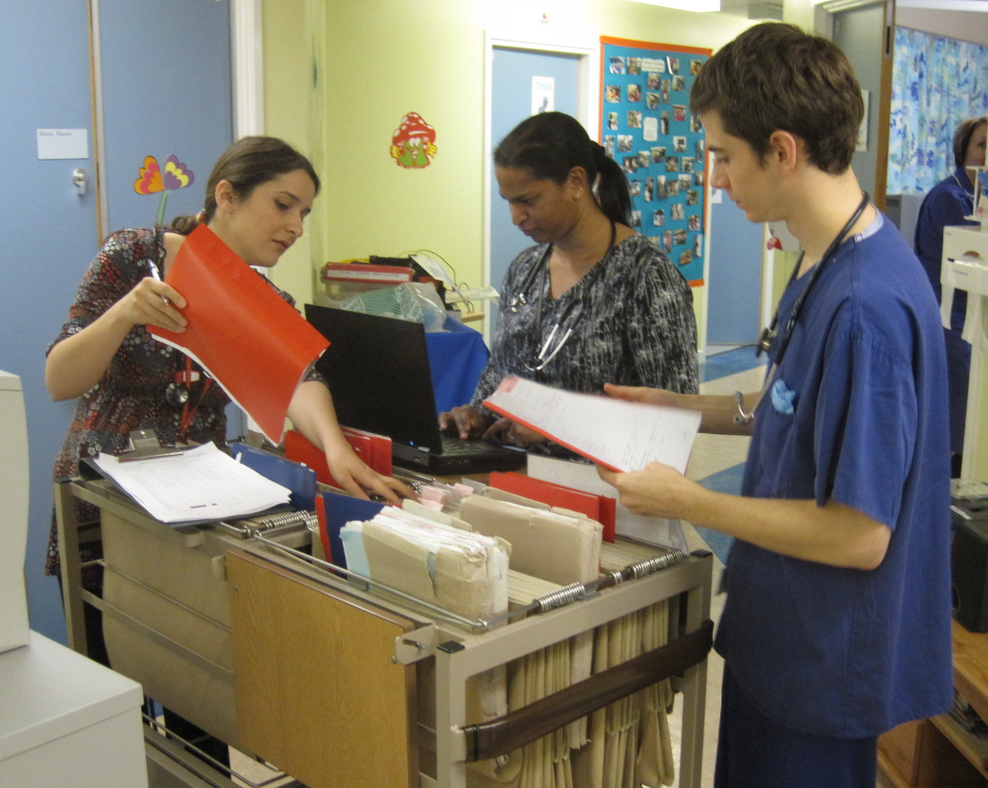
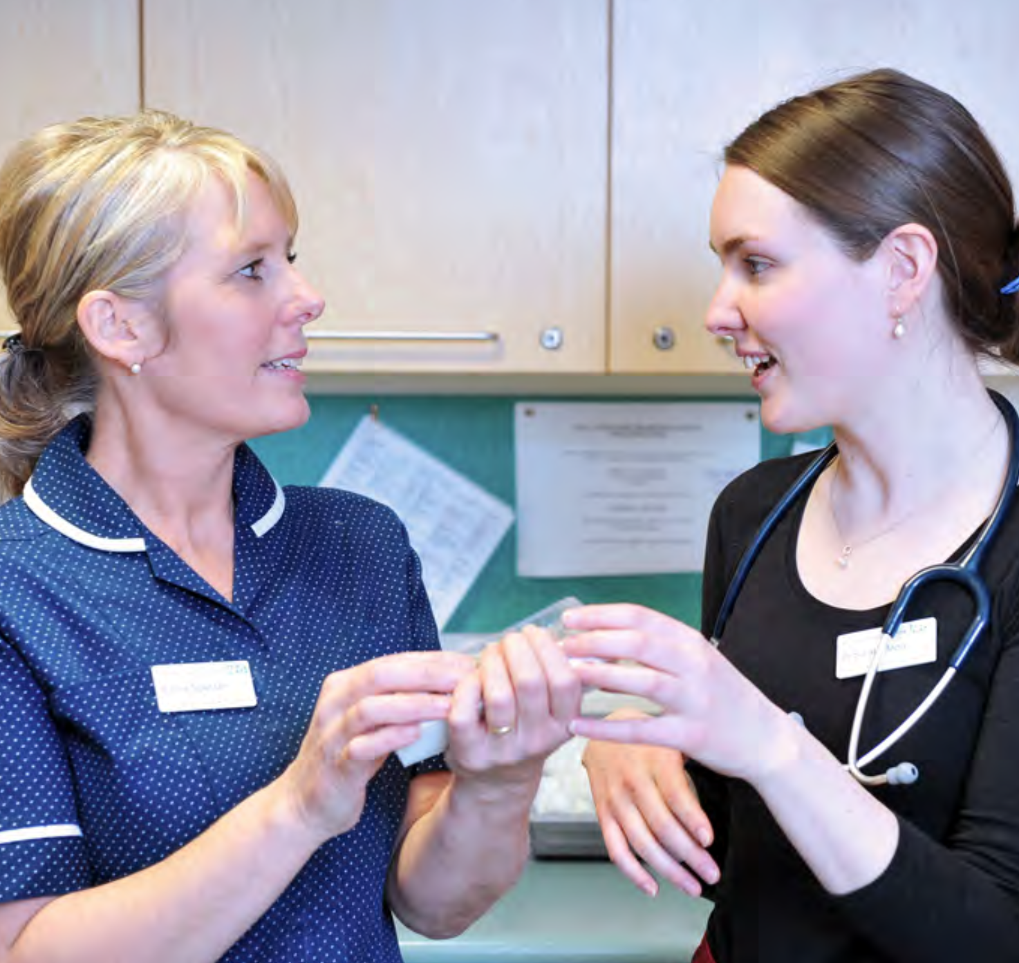
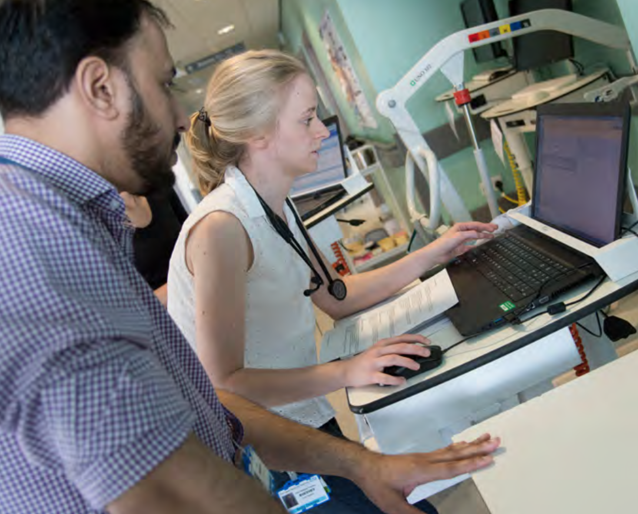
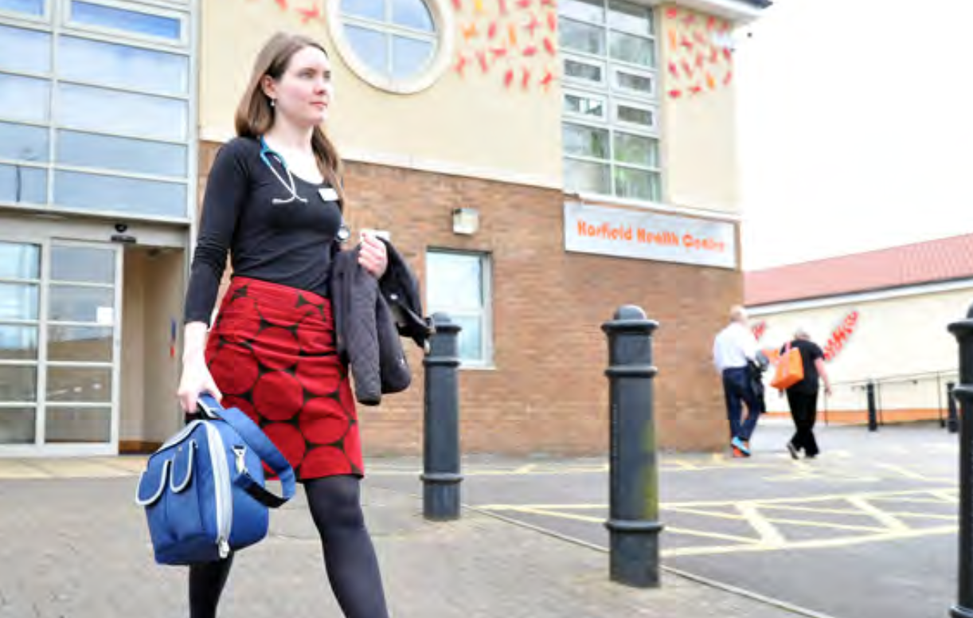

Slide 14
3.1 Educational Approach
In line with the Purpose statement above and the generic learning outcomes expected, the educational approach taken in the Foundation Programme uses and approach of practical, experiential learning augmented by direct training and supported by self-development, including reflection.
This fits into a simple two-dimensional model of professional development that can be represented by an adaptation of the JoHari window where the FD is encouraged to demonstrate (disclose) the required capabilities through their behavior in the workplace and develop these by a process of reflection and further learning augmented by the feedback of others. (CR3.2).
More information on the JoHari window is found here.

Slide 17
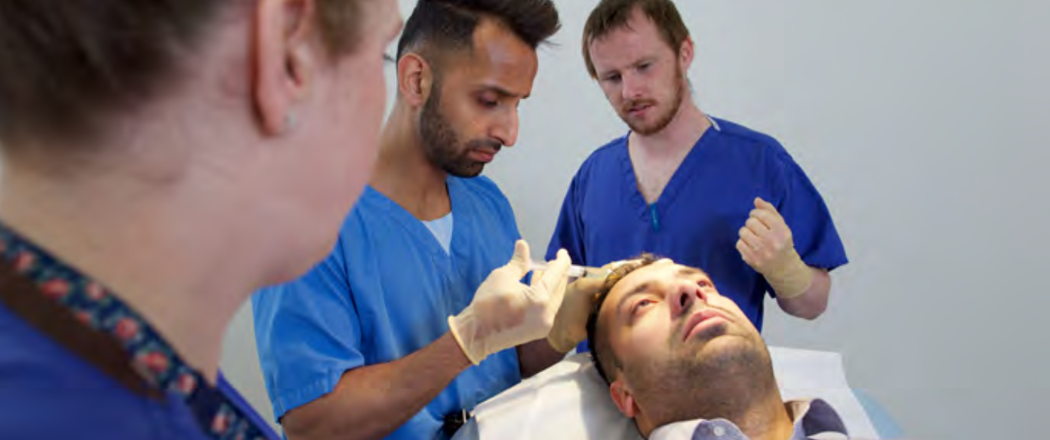
LEARN form

Slide 18
Summary narrative
Group reflection
Debrief
M&M meeting

Slide 19
HLO 1: An accountable, capable and compassionate doctor | HLO 2: A valuable member of healthcare workforce | HLO 3: A professional, responsible for their own practice and portfolio development
Clinical Assessment: Assess patient needs in a variety of clinical settings including acute, non-acute and community Clinical Prioritisation: Recognise and, where appropriate, initiate urgent treatment of deterioration in physical and mental health Holistic Planning: Diagnose and formulate treatment plans (with appropriate supervision) that include ethical consideration of the physical, psychological and social needs of the patient Communication and Care: Provide clear explanations to patients/carers, agree a plan and deliver health care advice and treatment where appropriate Continuity of Care: Contribute to safe ongoing care both in and out of hours | Sharing the Vision: Work confidently within and, where appropriate, guide the multiprofessional team to deliver a consistently high standard of patient care based on sound ethical principles Fitness to Practice: Develop the skills necessary to manage their own personal wellbeing Upholding Values: Act as a responsible employee including speaking up when others do not act in accordance with the values of the healthcare system Quality Improvement: Take an active part in processes to improve the quality of care Teaching the Teacher: Teach and present effectively | Ethics and Law: Demonstrate professional practice in line with the curriculum, GMC and other statutory requirements through development of a professional portfolio Continuing Professional Development: Develop practice including the acquisition of new knowledge and skills through experiential learning; acceptance of feedback and, if necessary, remediation; reading and, if appropriate, by research Understanding Medicine: Understand the breadth of medical practice and plan a career
CSR ESR TAB PSG eportfolio evidence PSA certificate - F1 only | CSR ESR TAB PSG eportfolio evidence | CSR ESR eportfolio evidence Learning log Engagement in feedback on training Form R / SOAR

Slide 20
ARCP Checklist
Satisfactory clinical supervisor’s end of placement reports | A clinical supervisor’s end of placement report is required for ALL placements. At least one CSR in each level of training must make use of PSG feedback. All clinical supervisor’s end of placement reports must be completed before the doctor’s Annual Review of Competence Progression (ARCP).
Satisfactory Team assessment of behaviour (TAB) | Minimum of one per level of training
Satisfactory Placement supervision group report (PSG) | Minimum of one per level of training
Satisfactory completion of all curriculum outcomes | The FD should provide evidence that they have met the 13 foundation professional capabilities, recorded in the e-portfolio. Evidence to satisfy FPC1-5 must include direct observation of at least 5 clinical encounters in the form of SLEs and the specific life support capabilities specified in FPC2.
Satisfactory engagement with the programme | Learning log of core/non-core teaching/and other learning Reflection including summary narrative Contemporaneously developed portfolio Engagement with feedback on training programme Completion of relevant probity / health declarations including Form R / SOAR or equivalent
Successful completion of the Prescribing Safety Assessment (PSA) (F1 only) | The F1 doctor must provide evidence that they have passed the PSA within two years prior to entry to the programme or on completion to the programme.
Evidence of completion of additional requirements set by HEE/NES/NIMDTA/HEIW and approved by UKFP Board
Provisional registration and a licence to practise with the GMC (F1 only) Full registration and a licence to practise with the GMC (F2 only) | To undertake the first year of the foundation programme doctors must be provisionally registered with the GMC and hold a licence to practise. In exceptional circumstances (e.g.refugees), a fully registered doctor with a licence to practise may be appointed to the first year of a foundation programme To undertake the second year of the foundation programme, doctors must be fully registered with the GMC and hold a licence to practise.
Completion of 12 months F1 training (taking account of allowable absence) | The maximum permitted absence from training, other than annual leave, is 20 days (when the doctor would normally be at work) within each 12 month period of the foundation programme. Where a doctor’s absence goes above 20 days, this will trigger a review of whether they need to have an extra period of training (see GMC position statement on absences from training in the foundation programme – June 2013).
A satisfactory educational supervisor’s end of year report | The report should draw upon all required evidence listed below. If the FD has not satisfactorily completed one placement but has been making good progress in other respects, it may still be appropriate to confirm that the FD has met the requirements for progression.
Satisfactory educational supervisor’s end of placement reports | An educational supervisor’s end of placement report is required for all FD placements EXCEPT for the last FD placement at each level of training; the educational supervisor’s end of year report replaces this.

Slide 21
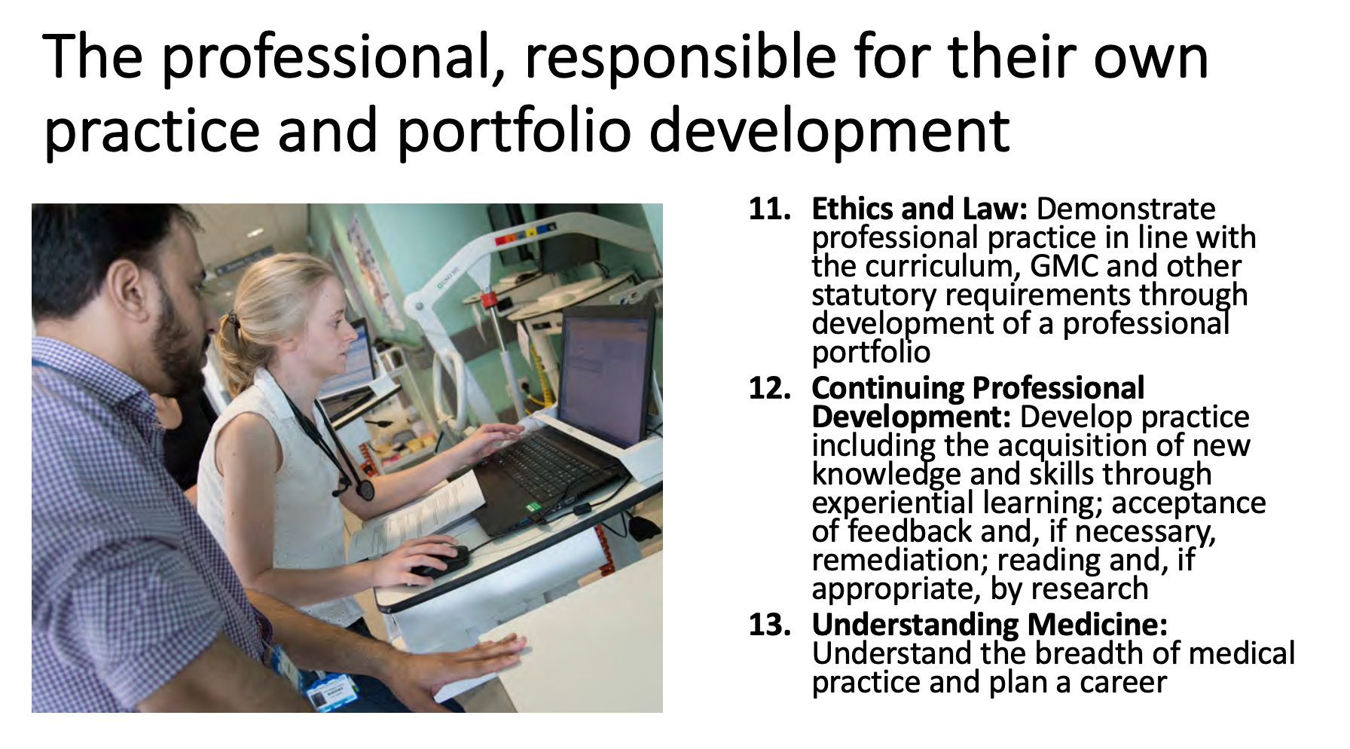

Slide 22
2016 curriculum
4 outcomes
20 capabilities
2021 curriculum
3 outcomes
13 capabilities
Up to 100 pieces of evidence
Requirement for 16 SLEs
No compulsory PSG
Up to 65 pieces of evidence
No minimum number of SLEs
Compulsory PSG
Summary narrative
Still require supervisor reports for each placement and multisource feedback (TAB)

Slide 23
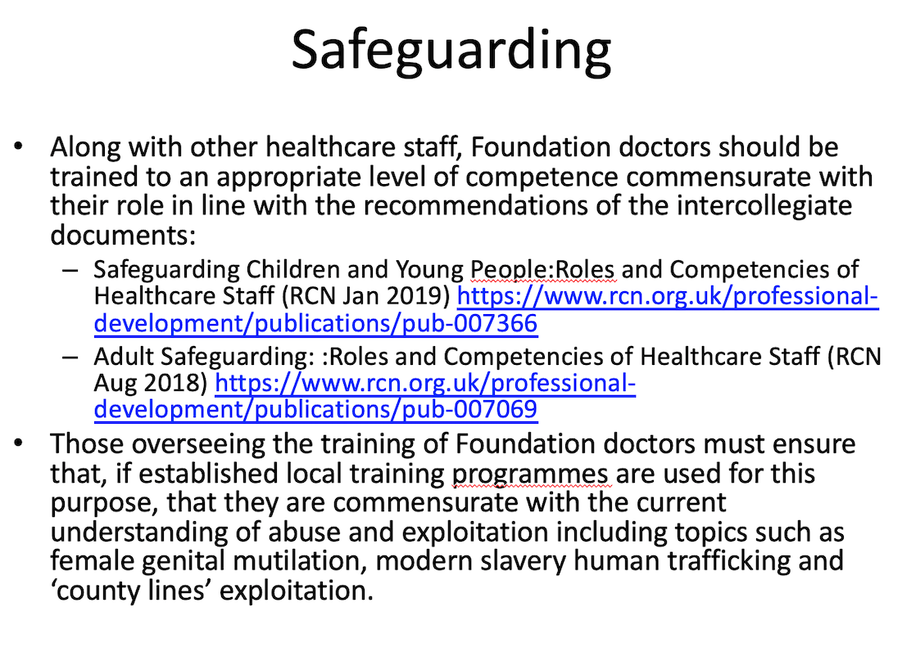

Slide 25
Program of learning
2016 curriculum
Teaching program
Based on curriculum outcomes
70 % attendance which is currently
30 hours (core)
30 hours (non core)
2021 curriculum
Program of learning
Curriculum delivered learning (30 hours) with some directed content
Additional learning (30 hours) including personal learning and non-core education more in-line with continuing professional development (CPD required of more senior doctors)

Slide 27
Summary of changes in the 2021 FP curriculum (from 2016 version)
Written to link explicitly with GMC’s GPCs
Number of Higher Level Outcomes (previously ‘Sections’) reduced from 4 to 3
Number of Foundation Professional Capabilities (FPCs) that must be demonstrated have been reduced from 20 to 13
There is no specific number of formative Supervised Learning Encounters (SLEs) that need to be undertaken (previously 16) but at least one is required to be submitted summatively for each of the five clinical FPCs evidence of capability
Importance of Placement Supervision Group (PSG) emphasised and made mandatory to ensure a broader range of healthcare professionals provide feedback to Foundation doctors
Specific ‘core’ teaching sessions make explicit the need for training programmes to provide teaching in certain areas including simulation
The new curriculum defines the role of the doctor
The new curriculum makes a specific statement regarding the importance of mental health and specifies a syllabus covering this important area of medical practice
A ‘summary narrative’ provides an alternative to current reflective practice
The review has provided an opportunity to develop a curriculum that considers and incorporates recent work in the area of differential attainment including a clear statement on reasonable adjustments being made for doctors with a disability
The curriculum explicitly allows for reasonable adjustments in the performance of clinical skills
Please register your feedback by clicking here and following the link to the survey nn the webpage
Thank you

